Slide 1
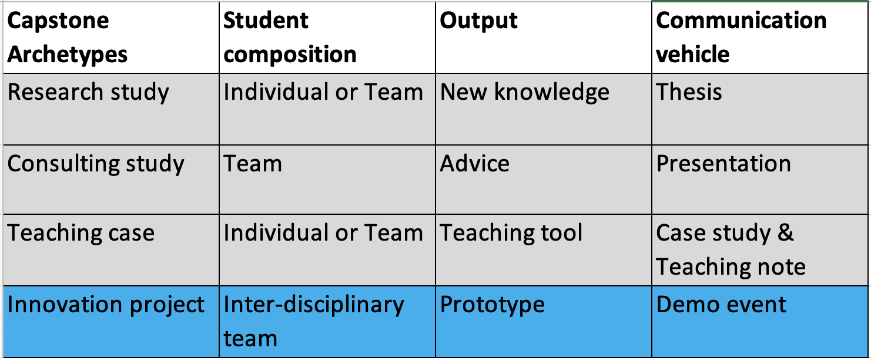
DDM new capstone: update (1/5/2023)
6 pilot teams: Kick-off Apr-23; Demo Day Nov-23; Grad Dec-23
Weekly DDM new capstone meeting
Done 2 faculty briefings; 3 student briefings scheduled
DDM chair walking the talk + in planning mode (Ray Jones)

Slide 2
New capstone <-> NIC (Naval Innovation Center)
Major opportunity for NPS to provide more value to stakeholders
Because innovation is a hits business, feeding the NIC with enough project volume is essential to have sig. wins
Y-Combinator incubated 650 start-ups in 2022
NPS 1,200 graduates/year, guess 1,000 are doing theses
Opportunity for 200-300 NPS student projects/year

Slide 3
New capstone: NPS student edge
Chris Boss &
Javaungh Baltrip
2nd category -> Null Problems
Considered minor & therefore not worth fixing
But many possess hidden significance to operators
In both cases, USER EXPERIENCE is essential for problem-solving
For more innovative organizations -> educate USERS to innovate

