Slide 1
Automation
Joshua A. Kroll
jkroll@nps.edu
CS 4000: Harnessing AI
7 October 2019

Slide 3
What is automation?
Operation of a process according to a set of established rules
Generally, the rules are referred to as a specification
Explicit specifications
Implicit specifications (more on this later)
Can be simple or highly complex
Can be implemented in a variety of ways, both human and machine
In software (software controllers, AI)
Mechanically (looms, autopilots)
Via groups of people (bureaucracies, “computers”)
Often, automation works in tandem with humans
Very few scenarios are truly “fully automated”
Today, we’re going to explore what it means to automate something

Slide 5
Examples of Automation: Automata

Slide 6
Examples of Automation: Jacquard Looms

Slide 7
Examples of automation: Autopilot

Slide 8
Examples of automation: Autopilot

Slide 9
Examples of Automation: Computers

Slide 10
Automation and Intelligence
The complexity or utility of automation doesn’t mean we necessarily ascribe intelligence to the system.
Tasks which “require human intelligence” are increasingly automated

Slide 11
Example of Automation and Intelligence

Slide 12
Examples of Automation: Warehouses

Slide 13
Examples of Automation: Warehouses

Slide 14
Examples of Automation: Warehouses

Slide 15
Problem Concepts and Automation

Slide 17
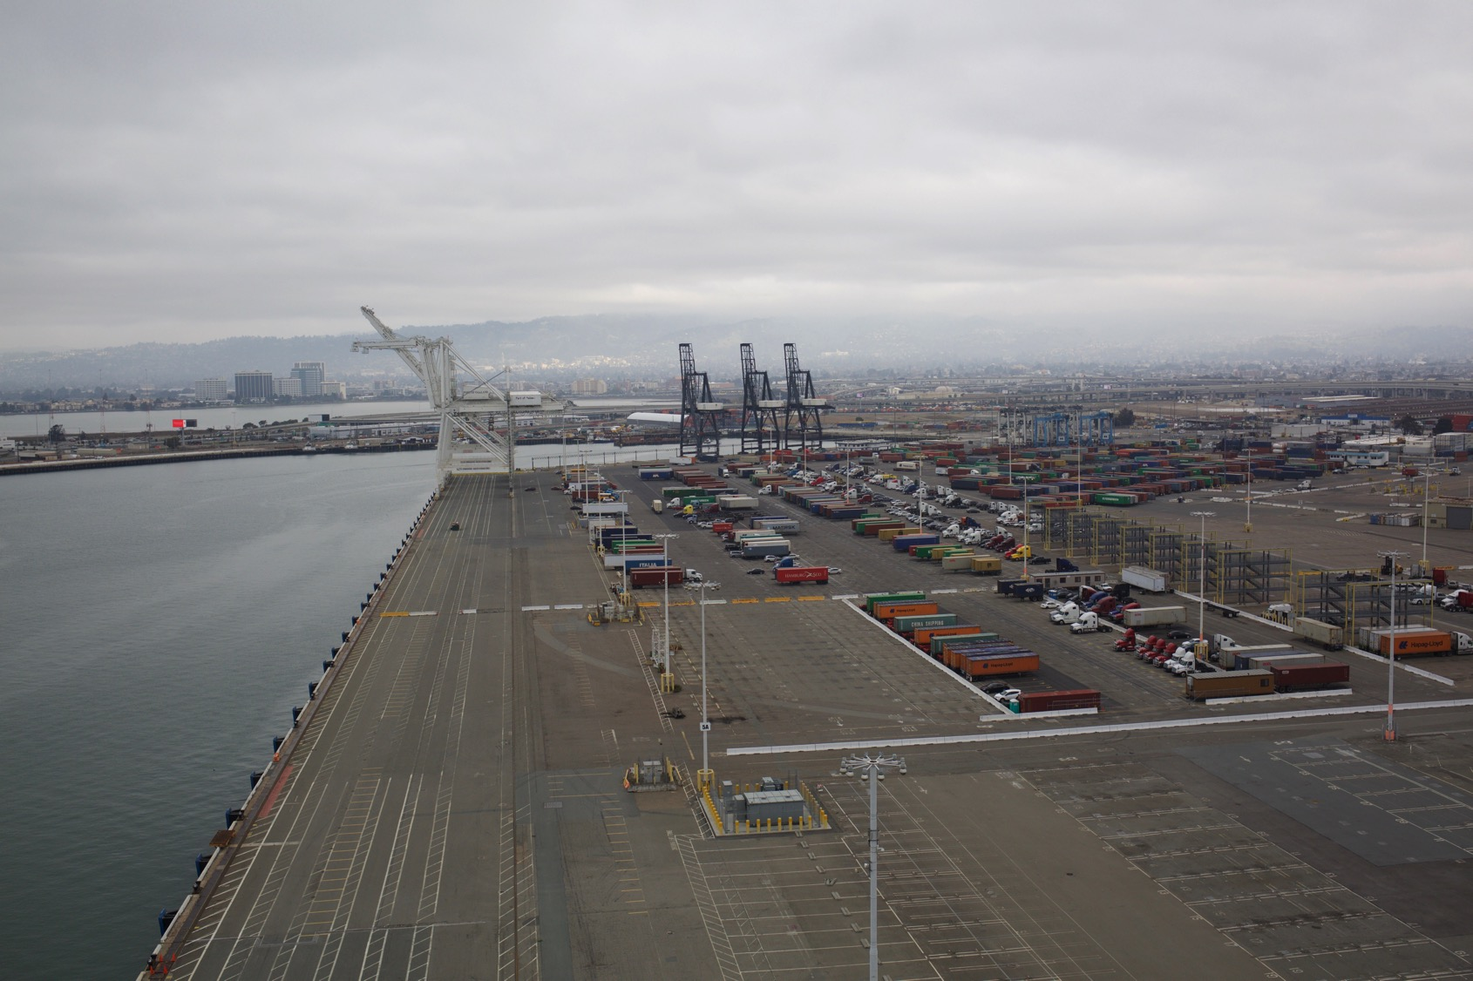

Slide 18
Problem Concepts and Automation
→

Slide 19
Rules vs. Standards
Rules require no interpretation, so can be objectively applied both quickly and in a large number of cases
Consistency/Reproducibility/Predictability of outcomes
Once rule is set and facts determined, outcome is also determined
E.g., “You must be at least 35 years old to become president.”
Standards are more flexible, allowing for some discretion in application
Flexibility to balance countervailing concerns or mitigating circumstances
Require a decision-maker to apply
E.g., “You must be sufficiently mature to become president.”
Principles are open-ended but mandatory considerations
E.g., “No one should profit from their own misdeeds.”
E.g., “No citizen is above the law.”

Slide 21
How does Automation Fail?
Specification Error: When the system’s rules are somehow substantively incorrect or incomplete.
E.g., a system doesn’t have a way for humans to flag bogus outputs or escalate wrong decisions
E.g., in 1988, the USS Vicennes shot down an Iranian commercial airliner believing it to be a fighter plane, likely due to re-use of id numbers by the radar system
Implementation Error: When the rules are correct, but the system doesn’t implement them properly.
E.g., a computer welfare benefits-determination system in Colorado incorrectly denied benefits to needy families due to faulty programming.

Slide 22
Automation Bias/Automation Dependency
Automation Dependency: By taking tasks away from humans, we deny them the ability to practice performing those tasks, deskilling the humans.
When was the last time you saddled a horse?
Automation Bias: Humans tend to believe that automated systems are doing the right thing, and will discount contradictory information even if it is correct.
E.g., In one study, breast cancers diagnosed in 46% of cases without automated aids were discovered in only 21% of cases when an automated diagnostic aid failed to identify the cancer.

Slide 24
How can we Trust Automated Systems?
Do careful engineering around specifications for completeness/correctness
Do careful tests/validation of the system for conformance to requirements & overall function
Examine full context: automation & people & policies
Provide escalation paths to resolve automation failures
Allow humans to challenge automated results when they’re wrong
Provide alternate non-automated approaches that can reason beyond the rules

Slide 25
Tradeoffs: When and what should we automate?
Benefits of Automation
Speed/scale
Consistent, reliable, predictable
Remove tedious human work
Structure a process
Risks of Automation
Failures can propagate
Models are not truth
Deskilling humans
Loss of human autonomy/dignity

Slide 26
What do we gain by automation?
Automation is very useful!
Faster
Avoids human foibles (inattention, fatigue, capricious departure from rules)
Automation isn’t intelligence
In fact, it often changes our perception of what requires intelligence!
But automating functions doesn’t automatically increase reliability
Automated systems fail differently to human-operated systems
Need to understand what to automate, how to automate it, and why
Trustworthy automation integrates machines and humans and the contexts of each

