Slide 1
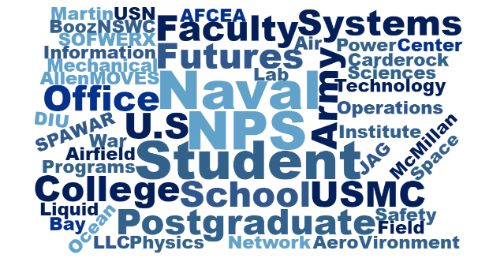
CRUSER TechCon 2019 Quick Look Report
NPS Field Experimentation 18-4
CRUSER TechCon 2019 Highlights:
CRUSER TechCon 2019 Participation:
Innovation benefits from having a space and place for building partnerships.
Competition and collaboration are both necessary to move forward.
Laws and regulations can be an impediment, but need good faith to work through the challenges.
There is “magic” in having a short space between NPS student work and putting innovation into practice.
It is important to understand ecosystem for innovation – identify your innovation hub
There is not one-size-fits-all agreement – each arrangement takes time and energy in order to be effective.
For small businesses, a rapid on-ramp with small (~$300k) investments would be a great way to engage more new concepts more rapidly.
40 resident + 20 remote participants
17 panelists + 3 moderators
Industry
~20
NPS Faculty
~30
NPS Students
~15
Event Description From Technical to Ethical...From Concept Generation to Experimentation...
NPS CRUSER held its eighth annual Technical Continuum (TechCon) on 17 April 2019 in the NPS Mechanical Engineering Auditorium. CRUSER's annual NPS TechCon provides the greater CRUSER Community of Interest an opportunity to gather and explore research topics of mutual interest. Responding to SECNAV direction, TechCon 2019 focused specifically on how NPS researchers might work more successfully with industry.
All opinions expressed are those of the authors and do not represent the official policy or positions of the Naval Postgraduate School, the United States Navy, the Office of the Secretary of Defense or any other government entity. Nothing contained herein should be viewed as an endorsement of any product or service. DISTRIBUTION STATEMENT A. Approved for public release; distribution is unlimited.

Slide 2
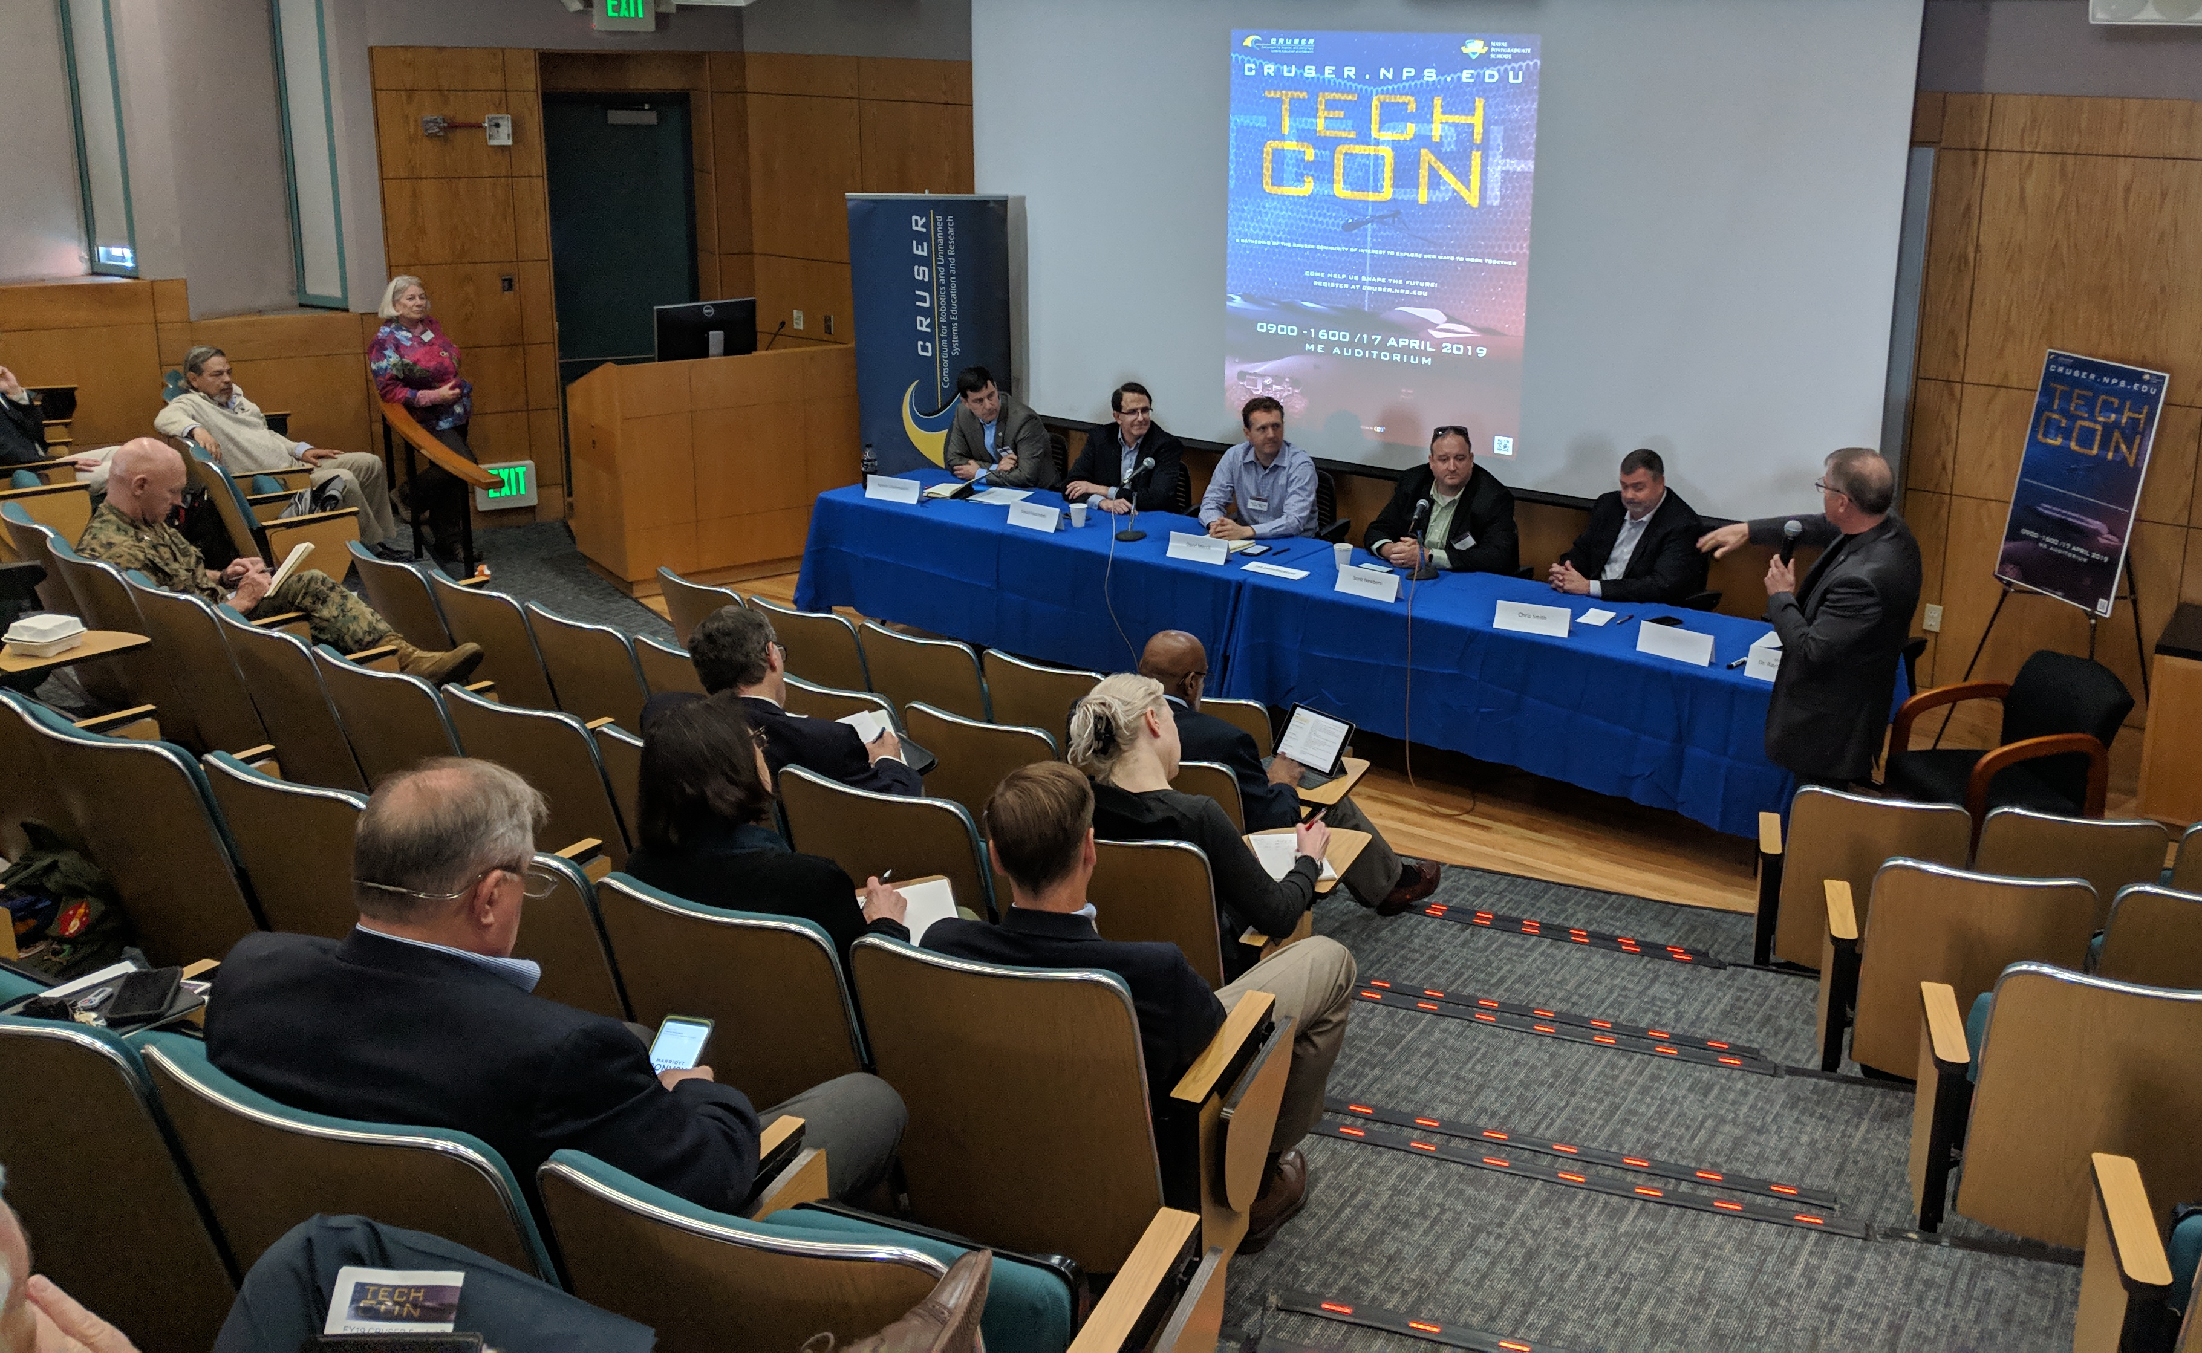
CRUSER TechCon 2019 Panel Highlights
PANEL 1 Government Innovators:
Understand the ecosystem for innovation - CRADAs helpful for adoption
Urgency – leverage recent legislative innovation to enable collaboration
Embrace and practice human-centered design and disruptive technology
Role of tacit knowledge is underappreciated in the federal government
Fail often, procrastination gives “rumination” time for innovation
Customer always comes with solution, not necessarily the right problem
Do not go back to the “usual suspects” and expect something new
Often no easy solution, but hard solutions that can work
Need to address concerns of the force, and to talk about it as a story
PANEL 2 The Entrepreneurs:
The government can often lack the speed and agility needed by small businesses to justify engagement.
Venture capitalists may view government contracts negatively due to delays and unreliability.
KOs and PMs must often take personal/career risk to make things happen – and there is no incentive for trying more things more rapidly.
Even big companies find the processes onerous, a good example being “artificial competition where the government actively seeks to create a competitor”.
The is a general perceived lack of urgency on the government side for both large and small contracts, together with false starts, and interrupted performance this means that only those with deep pockets can succeed in working with the government.
PANEL 3 NPS Research with Industry:
Working collaboratively with NPS Research and Sponsored Programs Office from the beginning leads to better results. RSPO has the institutional knowledge on how to match the formal agreements with the goals of the partnership.
Industry partnerships have direct benefits to the NPS enterprise: e.g., support for critical research facilities, new capabilities brought to campus, augment NPS expertise in areas that are not part of our existing expertise, NPS student exposure to cutting edge technology and resources, and building relationships between NPS students and leaders in industry and academia.
NPS researchers are continually building productive, formal and informal, partnerships with colleagues in industry and academia. Travel and conferences are a critical part of establishing and maintaining external partnerships. Barriers to these activities reduces the readiness of our researchers and has a direct negative effect on the educational environment at NPS. While restrictions have been reduced, we need to work together to continue to reduce barriers for travel and conferences.
Many of our current partnerships with industry include substantial technical research facilities. To sustainably maintain these facilities requires staff. To operate at the standards of industry these facilities should have dedicated GS staff, supported by the school, to man, operate and maintain such capabilities.
PANEL 1: Government Innovators
PANEL 2: The Entrepreneurs
PANEL 3: NPS Research with Industry

Slide 3
CRUSER TechCon 2019 Schedule
WEDNESDAY 17 APRIL
 | MECHANICAL ENGINEERING AUDITORIUM
0900 | Opening Reception
0930 | Welcome Address | VADM Ann Rondeau USN (ret), NPS President
1000 | PANEL 1: Government Innovators | "Government success working with industry" CDR Pablo Breuer USN, SOFWERX Dr. William Bundy, NWC COL John Dillard USA (ret), NPS SE Adam Hesch, DIU Rogue Squadron Garth Jensen, NSWC Carderock Col Todd Lyons USMC, NPS MODERATOR: Dr. Jeff Paduan, NPS Dean of Research
1115 | NPS Student Innovation | LCDR Santhosh Shivashankar USN, NPS Network Operations and Technology student
1130 | Get your Lunch | Fetch lunch to bring into the panel discussion at noon!
 | LUNCH OPTIONS: | Del Monte Café outside Dudley Knox Library El Prado Dining Room in the basement of Herrmann Hall
1200 | PANEL 2: “Just One Thing” The Entrepreneurs | "What one thing should decision makers be thinking about?" Romin Dashmalchi, Kaman David Marchetti, Ocean Power Technologies David Merrill, Elroy Air Scott Newbern, AeroVironment Chris Smith, AT&T MODERATOR: Dr. Raymond Buettner, NPS FX Director
1315 | NPS FX Opportunities | Mr. Gregory Arenas, NPS Field Lab Site Manager
1330 | PANEL 3: NPS Research with Industry | "Exploring new ways for NPS to work with DoD partners in industry" Dr. Chris Brophy, NPS MAE Dr. Don Brutzman, NPS IS Dr. Mollie McGuire, NPS IS Dr. Jonathan Phillips, NPS PH Dr. Todd Weatherford, NPS ECE Dr. Oleg Yakimenko, NPS SE MODERATOR: Dr. Brian Bingham, NPS CRUSER Director
1430 | Guided Lab Tours | ARSENL, CAVR, Hydrodynamics, Space Systems, and Undersea Sensing
1600 | Networking Reception | TRIDENT ROOM

Slide 4
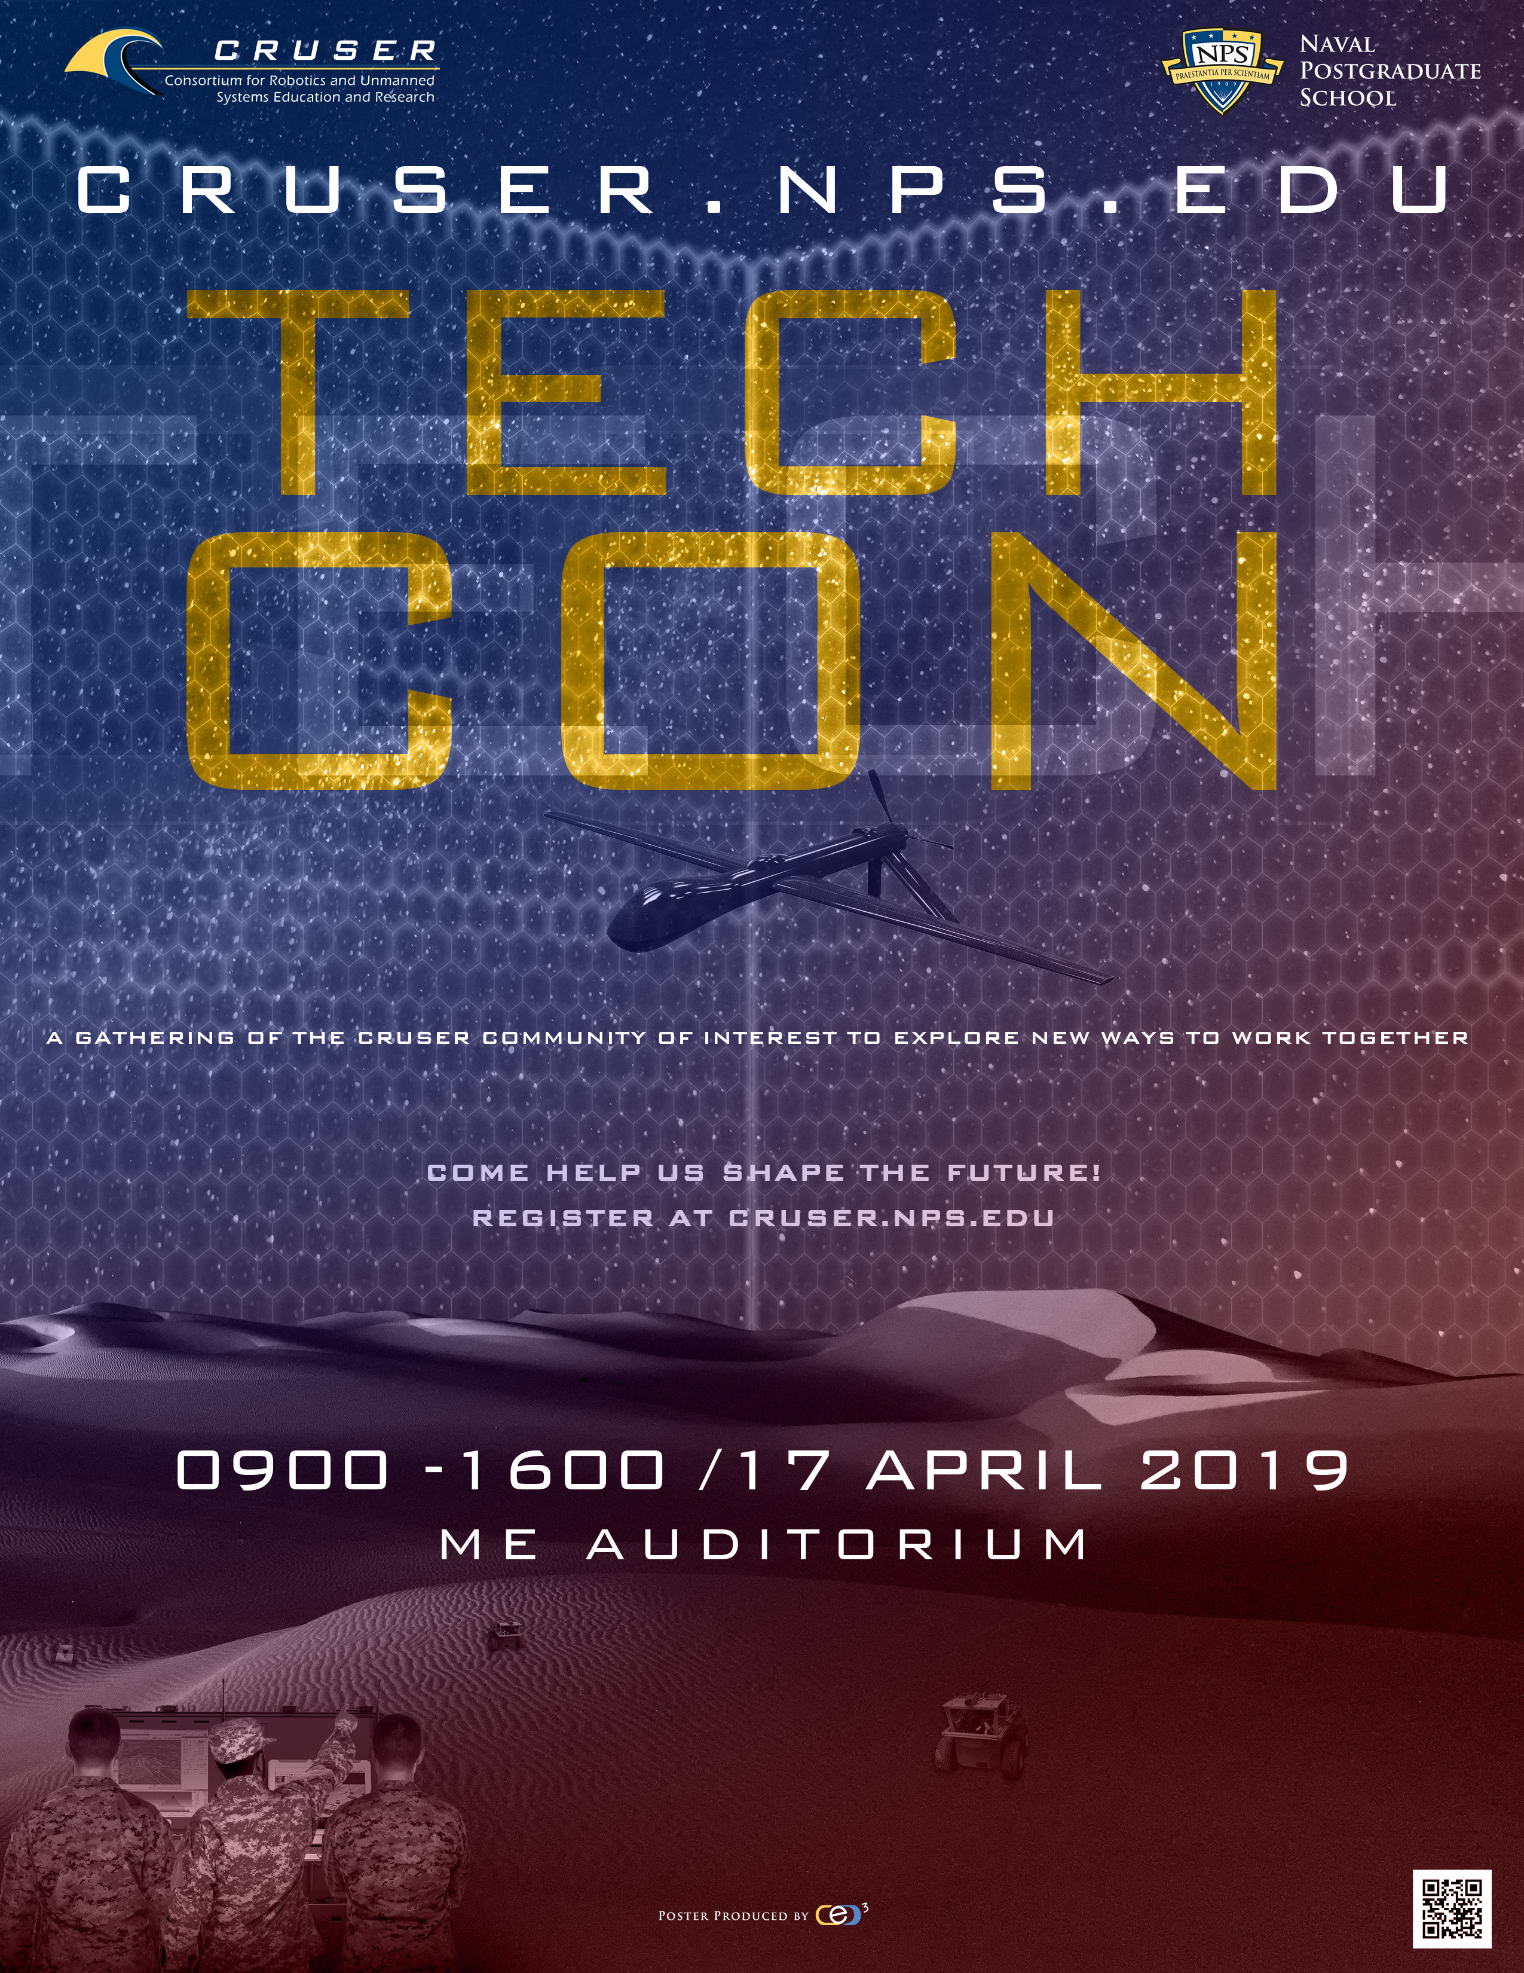
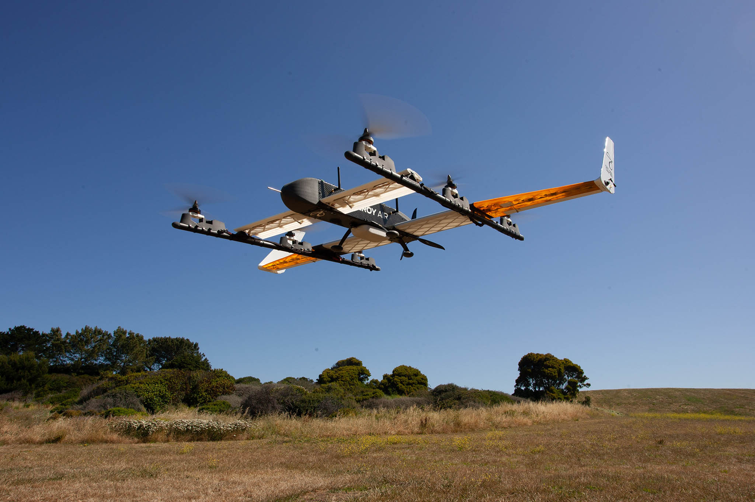
NPS Field Experimentation 18-4
CRUSER Overview From Technical to Ethical...From Concept Generation to Experimentation...
At the direction of the Secretary of the Navy, the Naval Postgraduate School (NPS) leverages its long-standing experience and expertise in the research and education of robotics and unmanned systems to support the Navy's mission. The Consortium for Robotics and Unmanned Systems Education and Research (CRUSER) serves as a vehicle to align research efforts and integrate academic courses across discipline boundaries. Established by the Under Secretary of the Navy in 2011, CRUSER is an initiative designed to build an inclusive community of interest around the application of unmanned systems in naval operations. With the operational needs of the Navy and the Marine Corps at its core, CRUSER is an inclusive, active partner for the effective education of future military leaders and decision makers.
CRUSER seeks to capitalize efforts, both internal and external to NPS, by facilitating active means of collaboration, providing a portal for information exchange among researchers and educators with collaborative interests, fostering innovation through directed programs of operational experimentation, and supporting the development of an array of educational ventures. Annually, CRUSER conducts concept generation workshops for naval missions and hosts technical symposia to address naval missions, and field experimentation to test selected technologies.
CRUSER TechCon 2019 Key Take Away Message
“NPS, with its emphasis on applied research, is a place where this magic can thrive due to the proximity of warfighters, operators, researchers and industry.”
Elroy Air VTOL Aerial ULS:
Sub-Scale Aircraft at JIFX 18-4, February 2019

