Slide 1
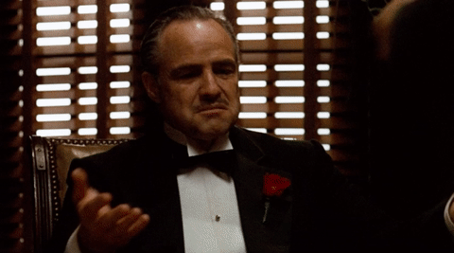
Welcome to the Graduate Writing Center!!

Slide 2
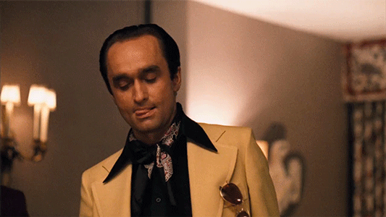
I … I … okay, I don’t know what passive voice is … so

Slide 3
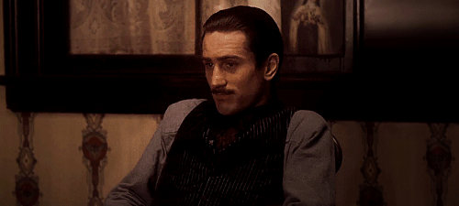
So … does my topic sentence read well?

Slide 4
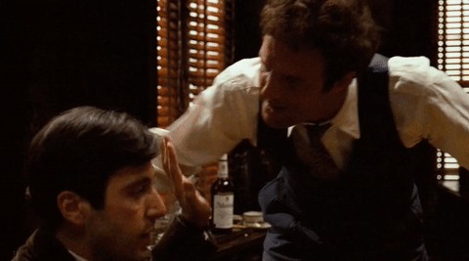
Com’ere … so don’t start a paragraph with a quote, eh?!

Slide 5
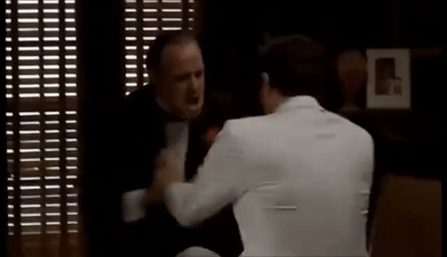
Wha-- … You can paraphrase like a MAN!!

Slide 6
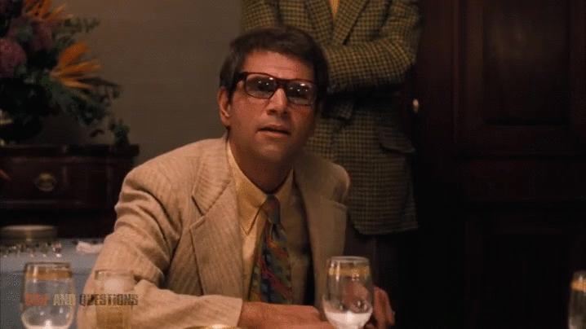
I’m Mo Green …. You don’t tell ME about SEMIcolons!

Slide 7
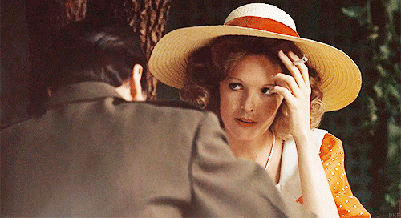
He really seems to know his citing systems …

Slide 8
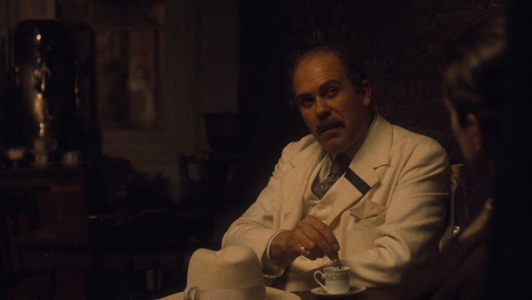
I haven’t been to college in ten years …. I can’t even change my line spacing ….. Oh, wha? … He just said “brainstorming” …. What is he givin’ me, a weather report?

Slide 9
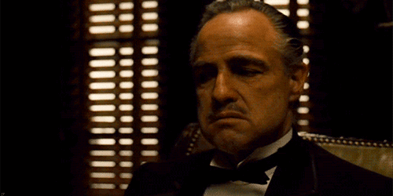
We’ll make you an offer to write better you can’t refuse …

