Slide 1



Lesson 7: Recognizing and
Rewarding Performance
DPMAP Rev.2
July 2016

Slide 2

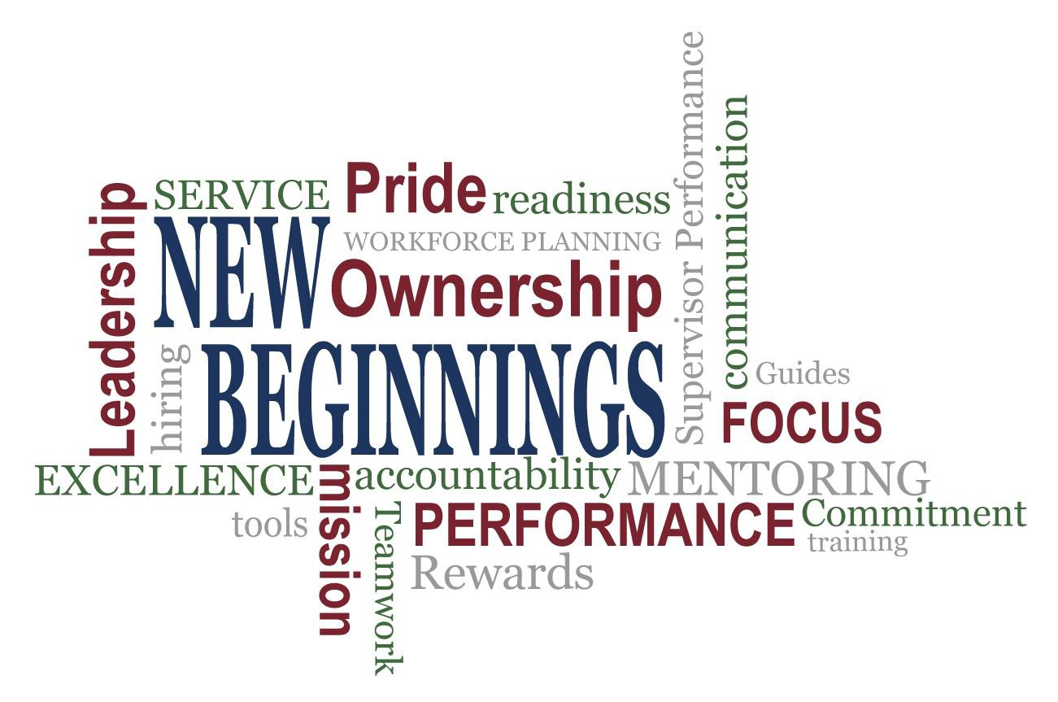
Fair – Credible - Transparent

Slide 3
Learning Objectives
Upon completion of this lesson, you will be able to:
  Describe the importance of recognizing and rewarding the employee’s success.
  Identify types of recognition and reward related to performance management.
  Determine creative ways to recognize and reward employees.
Fair – Credible - Transparent

Slide 4
Performance Management
Ongoing
Supervisors and employees share responsibility
Consist of:
PLANNING
Proactively planning work and setting expectations
Continually monitoring performance
Evaluating performance in a summary fashion
Recognizing and rewarding good performance
PERFORMANCE
MANAGEMENT
EVALUATING
MONITORING
RECOGNIZING AND REWARDING
No surprises for either party at the end of the appraisal cycle

Slide 5
Recognizing and Rewarding Performance
Monetary
One-Time cash award
Salary Increase
Promotion
Time-Off Award
Non-Monetary
Award plaque
Challenge Coin
Public acknowledgement at meeting
Simple “Thank you” or other way to show employee performance was observed and recognized
NOTE: Must adhere to ethical spending limit guidelines in 5 CFR 2635 and DoDI 1400.25 V451

Slide 6


Recognizing and Rewarding Performance
Employee successes and accomplishments should be recognized and rewarded
  Supervisors should:
    Actively solicit and act on input from
employees
    Communicate positive results based on employee input back to employees to show value of their ideas and suggestions.
    Verbally thank deserving employees for
good performance
    Give positive feedback on performance, when warranted, as often as possible
  Employees should:
    Proactively communicate successes and accomplishments to their supervisor

Slide 7

Recognizing and Rewarding Performance
DoD is committed to
“a fair, credible and transparent”
performance management and appraisal program
How can we make recognition and rewards
fair, credible, and transparent?
Credible

Slide 8

Exercise: Create a Recognition and Rewards Library
As a class create a list of non-monetary employee recognition and rewards methods that a supervisor could use throughout the performance appraisal cycle

Slide 9
Exercise Debrief: Create a Recognition and Rewards Library
What did you come up with in your groups?

Slide 10

Exercise: Employee Recognition and Rewards Toolkit
➢Identify favorite methods
10 ideas with one dot sticker
per idea
OR
More than one dot sticker for a particular favorite

Slide 11

Exercise Debrief: Create a Recognition and Rewards Toolkit
What are the Top 10 ideas for the entire class?
Which groups had the three highest numbers of dot stickers

Slide 12

What Motivates Us

Slide 13
Learning Objectives
You should now be able to:
  Describe the importance of recognizing and rewarding the employee’s success.
  Identify types of recognition and reward related to performance management.
  Determine creative ways to recognize and reward employees.

Slide 14
Additional Resources
DODI 1400.25, Volume 410, DoD Civilian Personnel Management System: Training, Education, and Professional Development.
DODI 1400.25, Volume 431, DoD Civilian Personnel Management System:
Performance Management and Appraisal Program.
DODI 1400.25, Volume 451, DoD Civilian Personnel Management System: Awards.
DCPAS Resources and References web site: https://www.cpms.osd.mil/Subpage/NewBeginnings/ResourcesReferences/
DCPAS HR Toolkit: https://dodhrinfo.cpms.osd.mil/Directorates/HROPS/Labor-and-Employee-
Relations/Performance-Management/Pages/PM-Guides-TipSheets-Checklists.aspx
DCPAS LERD web site
https://dodhrinfo.cpms.osd.mil/Directorates/HROPS/Labor-and-Employee- Relations/Pages/Home1.aspx
Corporate Leadership Council. Building the High-Performance Workforce: A Quantitative Analysis of the Effectiveness of Performance Management Strategies (Washington D.C.: Corporate Executive Board, 2002)

Slide 15
Questions?
Are there any questions?

