Slide 1



Lesson 4: Continuous Feedback
DPMAP Rev.2
July 2016

Slide 2

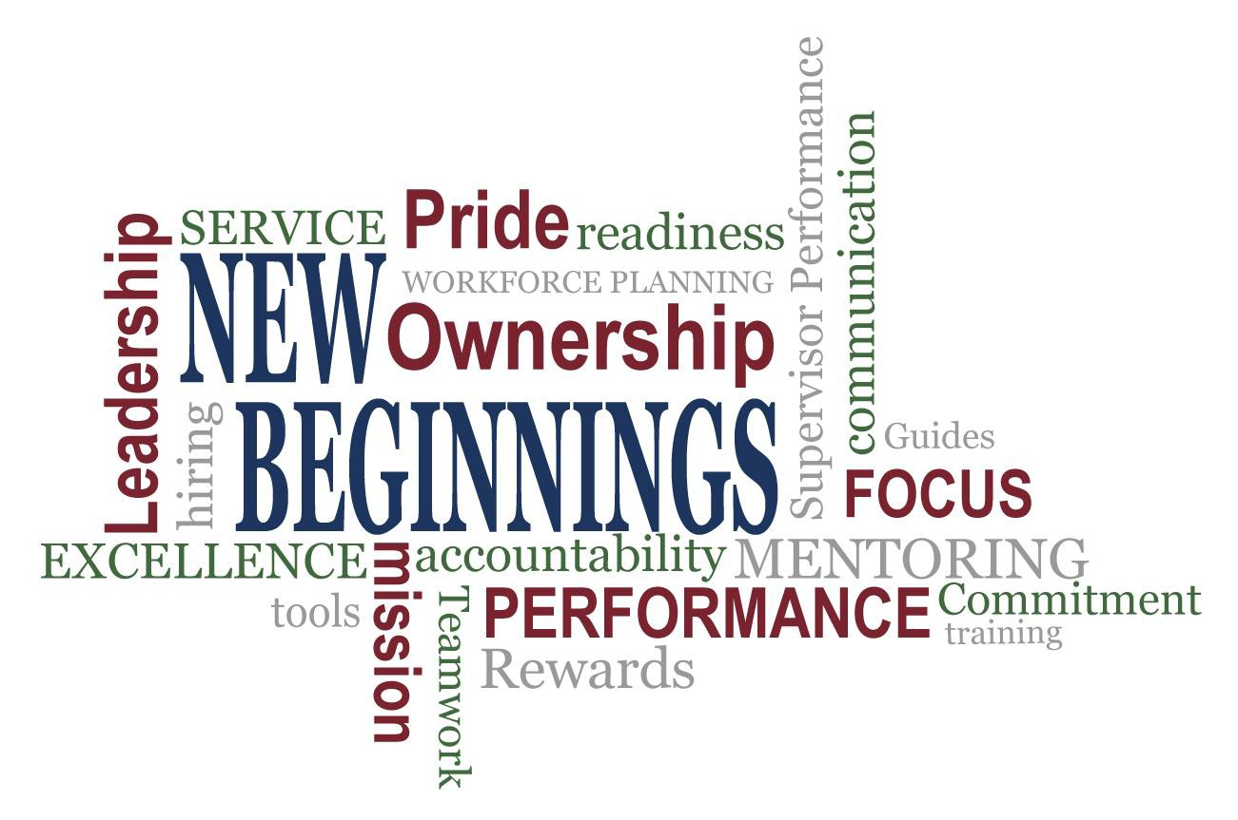

Slide 3
Lesson 4 Learning Objectives
Upon completion of this lesson, you will be able to:
Define the role continuous feedback plays in successful performance management.
Identify behaviors that promote a constructive performance
feedback session.
Explain how helpful performance feedback is beneficial for
supervisors and employees.
Give examples of how to provide effective performance feedback.

Slide 4

Changing The Way We Do Business
Effective Performance Management
DoD Culture of High Performance

Slide 5












Trust Behaviors
Trust between supervisor and employees is essential in high- performing organizations and a key part of effective performance management
Trust behaviors to consider:
Engaging and Motivating
Sharing of Information
Planning Work
Assigning and Managing Work
Finding Solutions and Removing Barriers
Providing Continuous Feedback
Appraising Performance
Managing Talent

Slide 6
Relationship Between Effective Performance Management
and Performance Feedback
Frequent
Timely
Meaningful
Continuous
PERFORMANCE
FEEDBACK
Two-Way

Slide 7

What is Performance Feedback ?
Performance feedback is the two-way, meaningful exchange of information between supervisors and employees regarding performance expected and performance exhibited

Slide 8
Why Is Feedback Important?
Beneficial for both supervisors and employees
Promotes an understanding of the issue/topic/concern
Makes the other person aware of one’s perspective
Performance Context | Developmental Context | Personal Context
Feedback provides employees and supervisors with the other's perspective of what’s working (or not) | Feedback provides opportunities to improve competence, to learn, and to progress in careers | Feedback can improve the quality of relationships

Slide 9
Examples of Effective Feedback Techniques
TYPE | EXPLANATION | EXAMPLE
"When you …” | State specific facts of behavior - (non-judgmental) | ???
"I'm concerned ...“ | Describe how behavior affected you or the office. | ???
"Because I ... “ | State why the observed behavior affected you in this way. | ???
Pause and listen for response | Ask if the other person has ideas about what to do. Give the other person an opportunity to respond. | ???
"I would like ... " | Describe what change you want the other person to consider. | ???
"Because ... " | State why the change is needed. | ???
"What do you think ... " | Listen to response. Discuss options and compromise on a solution, if necessary. | ???

Slide 10

Center for Creative Leadership’s (CCL)
Situation-Behavior-Impact Feedback Model
BEHAVIOR
What did the behavior cause?
Make the experience internal to individual
The When/Where
Be as specific as you can
What did you see?
Describe without
judgement
SITUATION
IMPACT
DPMAP Rev.2
July 2016
(10)

Slide 11
SBI Example #1
Situation: | “Joe, in last week’s performance discussion, while I was sharing my accomplishments,
Behavior: | you picked up your phone and started texting.
Impact: | I felt like our discussion was not important enough for you to give me your full attention.”

Slide 12

SBI Example #2
Situation:
“Carmen, at Monday’s budget meeting,
you ensured that the meeting started on-time and that everyone had the correct handouts in advance.
Behavior:
All of your research was correct, and all meeting
member questions were correctly answered.
You did an excellent job and made us all look
rea lly goo d. T hanks for all o f your hard work!”
Impact:

Slide 13

Exercise - Now You Try It
As a class use the SBI Model handout and discuss examples of effective feedback that you might give based on each scenario.
Situation
Behavior
Impact

Slide 14
Giving and Receiving Feedback
What are some difficulties in giving feedback to employees on their performance?
What are some difficulties in receiving feedback?
What is the most important part of giving
performance feedback?
Why is it important to receive feedback?
What are some ideas for overcoming challenges of giving and receiving feedback?
DPMAP Rev.2
July 2016
(14

Slide 15
Feedback Approaches
Am I presuming innocence rather than attributing negative motives?
Am I authentic – candid, yet compassionate, to build trust and respect?
Is my feedback based on facts, not assumptions or judgments?
Do I have
positive intent?
Is my feedback intended to help, not control or manipulate?
Will my feedback stimulate mutual learning and inspired action?
FEEDBACK

Slide 16
Feedback Guidelines for the Feedback“er”
Be specific and factual; don’t evaluate or judge
Separate observations about behavior from the impact of the
behavior
Check for clarity to ensure that the receiver fully understands
what’s being conveyed
Refer to behaviors about which the receiver can do something
Provide timely feedback after the behavior

Slide 17

Feedback Guidelines for the Feedback“ee”
Just Listen
Don’t interrupt
Don’t get defensive
If things get awkward or too emotional, don’t respond and ask for a break. But be sure to
re-connect with person giving feedback
“Thank you for the feedback.”

Slide 18

Feedback Practice
Partner with someone on the team to offer positive feedback
based on an experience you had with that person

Slide 19
Learning Objectives Review
You should now be able to:
Define the role continuous feedback plays in successful performance management.
Identify behaviors that promote a constructive performance feedback session.
Explain how helpful performance feedback is beneficial for supervisors and employees
Give examples of how to provide effective performance
feedback.

Slide 20
Questions?
Are there any questions?
DPMAP Rev.2
July 2016
(20)

Slide 21
Additional Resources
National Defense Authorization Act for Fiscal Year 2010 Section 1113(d) (Washington D.C.: November 2011)
DODI 1400.25, Volume 431, DoD Civilian Personnel Management System: Performance Management
and Appraisal Program.
DODI 1400.25, Volume 451, DoD Civilian Personnel Management System: Awards.
DCPAS Resources and References web site: https://www.cpms.osd.mil/Subpage/NewBeginnings/ResourcesReferences/
DCPAS HR Toolkit:
https://dodhrinfo.cpms.osd.mil/Directorates/HROPS/Labor-and-Employee- Relations/Performance-
Management/Pages/PM-Guides-TipSheets-Checklists.aspx
DCPAS LERD web site
https://dodhrinfo.cpms.osd.mil/Directorates/HROPS/Labor-and-Employee-Relations/Pages/Home1.aspx
Center for Creative Leadership (CCL) with Karen Kirkland and Sam Manoogian. Ongoing Feedback: How to Get It, How to Use It (1st Edition) (Greensboro: Pfeiffer, 2007)
Center for Creative Leadership (CCL) with Raoul J. Buron and Dana McDonald-Mann. Giving Feedback to Subordinates (1st Edition) (Greensboro: Pfeiffer, 2007)
Corporate Leadership Council. Building the High-Performance Workforce: A Quantitative Analysis of the Effectiveness of Performance Management Strategies (Washington D.C.: Corporate Executive Board, 2002)
Crane, Thomas G. The Heart of Coaching (4th Edition) (San Diego: FTA Press, 2007)
DPMAP Rev.2
July 2016
(21)
It’s NOT about the 365th day

