Slide 1
Robodata.nps.edu
Unmanned System Data Archives
Project Support for NPS Field Experimentation (FX)
Don Brutzman
Information Sciences (IS) Department
Undersea Warfare Academic Group (USWAG)
4 April 2017

Slide 2
Overview
robodata.nps.edu

Slide 3
Objectives
Background
  Bootstrap a short course to expose initial capabilities, if approved
  Evaluate course suitability, provide recommendations for further work
Current
  Scale across/outside campus to support JIFX experimentation, Camp Roberts
  Build a growing institutional data archive
Long term
  Ensure that every NPS experiment with unmanned systems is archived and reusable
  Enable steadily improving analysis, insights, applications and data-driven progress
  Influence, align with broader DoD and scientific practice

Slide 4
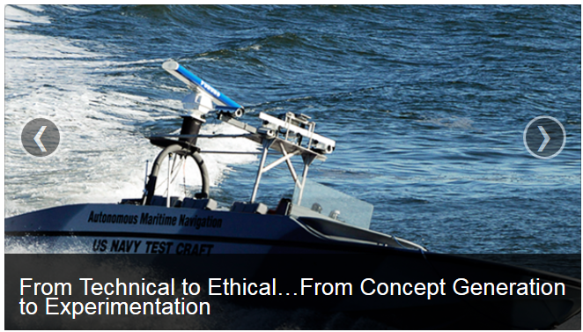
CRUSER
Consortium for Robotics and Unmanned Systems Education and Research (cruser.nps.edu)
NPS leverages long-standing experience and expertise in research and education of robotics and unmanned systems to support the Navy's mission.
CRUSER serves to align disparate research efforts and also integrate academic courses across disciplinary boundaries.

Slide 5
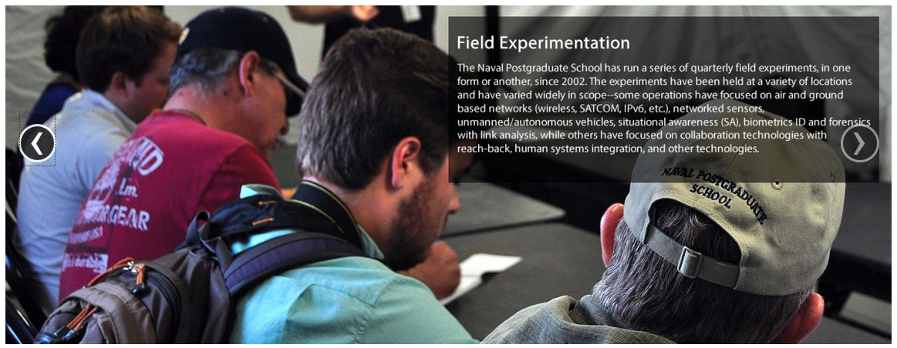
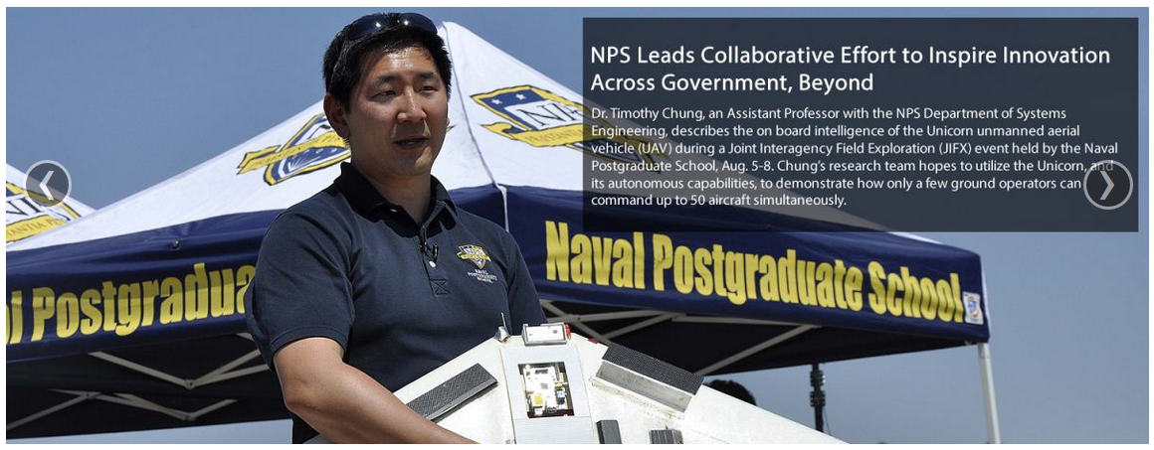
JIFX: Joint Interagency Field Experimentation
Held quarterly, usually at Camp Roberts
Run robots in controlled airspace/playpen
Open to industry and external academia, each self supporting
Experimentation, not exercise: includes freedom to fail and learn
Established ~5-year program with DoD sponsorship
Closely affiliated with CRUSER

Slide 6

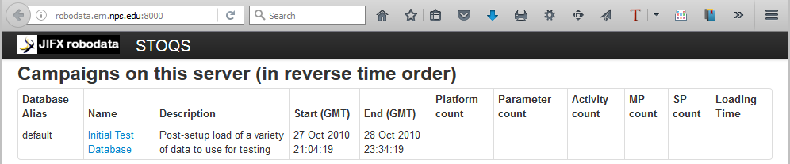
Applying an Operational System from MBARI to Establish New Capabilities at NPS

Slide 7
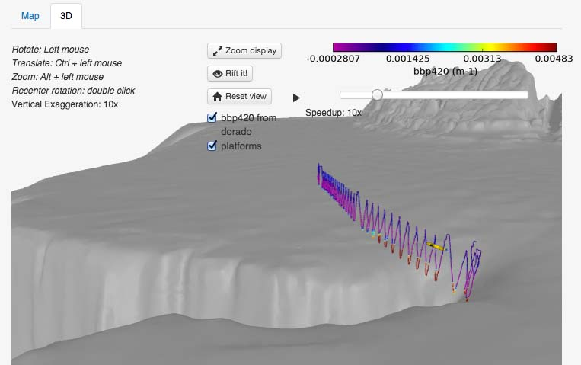
STOQS
Spatial Temporal Oceanographic Query System
Inputs
  Diverse robots, sensors and systems
  Collected air, surface, subsurface data
  Precise metadata tags, scientific terms
Outputs
  Queries, filters and mashups
  Data plots, 2D maps, 3D views
Learn more
  STOQS home page and paper
  STOQS overview video
  Online query and open source
Can view 3D flythrough in Web browser

Slide 8
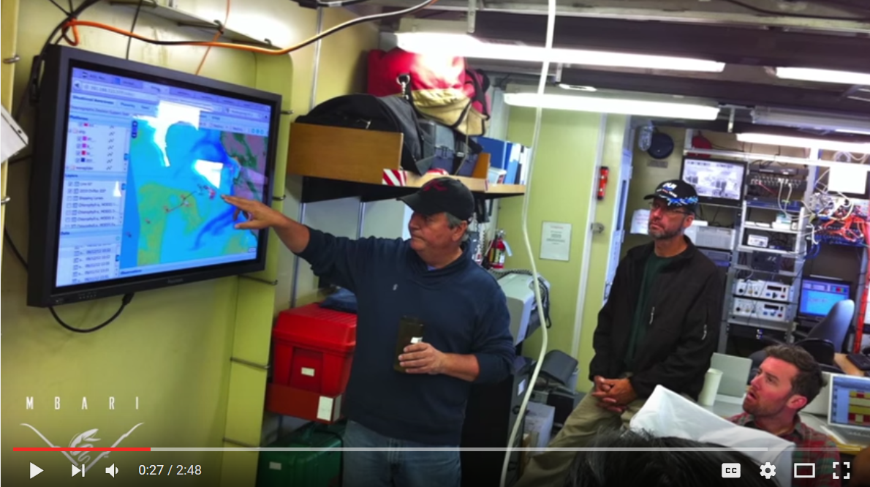
STOQS YouTube Video

Slide 9
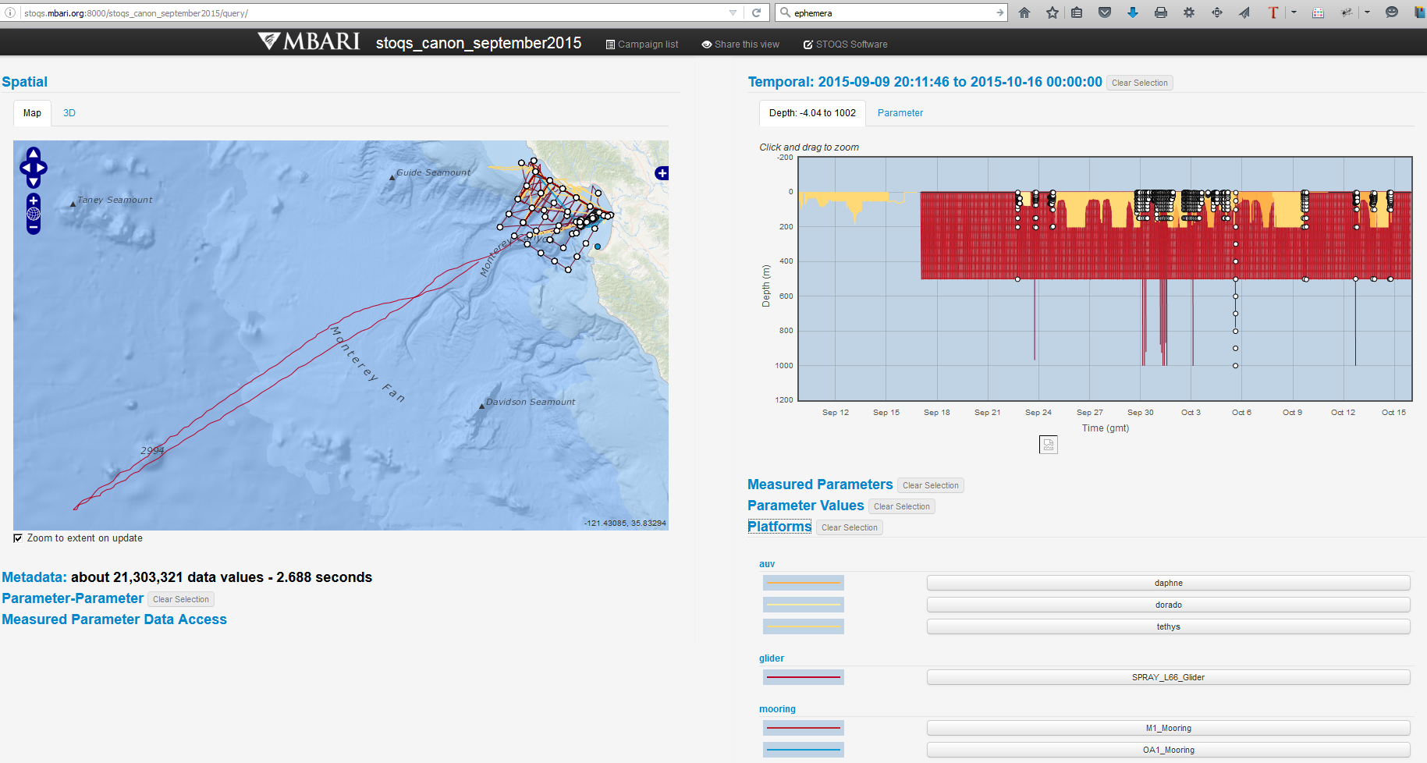
Example STOQS query display
Can view 2D maps and data graphs

Slide 10
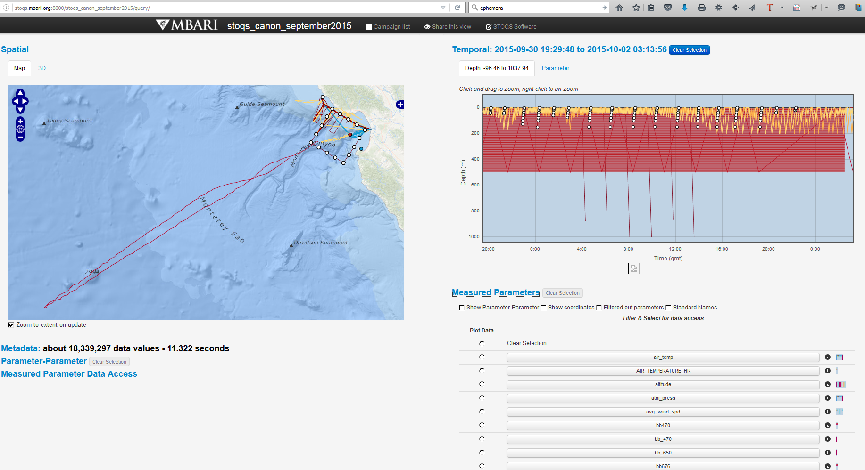
STOQS filtered query # 2
Web-based queries can filter and select

Slide 11
Making data useful
(subtitle: making data not suck!)
Dataset collection conventions
  Precise timestamps, locations, measurements. Scrubbing, cleanup. “It is what it is.”
  Validation of correctness, schemas if possible, pay attention to units and conversions.
  Unambiguously describe the meaning of each data value with type and metadata.
  Adding narrative data: exercise logs, operator comments, images, ephemera.
  Logging, archiving, network access, security considerations, backups.
Metadata vocabularies
  Strictly defined nomenclatures and data-dictionary definitions, specialized as appropriate for each community of interest. Examples: oceanography, meteorology.
  Community of practice that governs standardization, adoption and evolution.
Success metrics
  Exploration, analysis, re-use, comparisons, publication, insight, understanding
  Big Data Mashups!
Notes:
Ephemera
things that exist or are used or enjoyed for only a short time.
items of collectible memorabilia, typically written or printed ones, that were originally expected to have only short-term usefulness or popularity.

Slide 12
Related NPS work: recorded datasets, outputs
Shelley Gallup’s FIRE database for Trident Warrior exercise data capture
Core Lab suite of Defense Analysis tools
Operations Research SEED Center
  Large datasets produced by clusters, computational modeling & simulation
MOVES Savage tool suite for 3D models
  X3D model archives, Autonomous Unmanned Vehicle (AUV) Workbench
  X3D-Edit authoring, visualization using simkit Discrete Event Simulation (DES)
ARSENL lab data/video records of swarm simulations, experiments
  … and still more? Please tell us about it!
No doubt additional NPS activities will emerge, this is a common need

Slide 13
Complex Systems Field Experimentation: objectives, activities and lessons learned
“You get what you measure” - deciding on data to record not only produces information, but also establishes feedback loops and progressive refinement on areas that are get focused attention
Experimental design shows intention
  What are the questions that your project is pursuing?
From engineering and analysis perspective: Data is Design
  Mashups and “big data” initiatives become practical
  Paul Pappas, “How Big Data Is Revolutionizing Design,” WiReD, November 2014

Slide 14
Looking ahead

Slide 15
Designing for future evolution
Growing collection of datasets over years and different locations
Scientific basis so that all data values are well defined for long term
Repeatable “business model” fully aligned with institutional practices
Useful for emerging, evolving Big Data activities
Real-world approaches adaptable to simulation outputs
Questions/analysis/answers for naval robotics is not so different from assessment of actual ships and aircraft deployed in the real world
Partnership with MBARI might grow to include other participants
Supports Department of Navy Innovation Goals for Data-Centric Navy

Slide 16
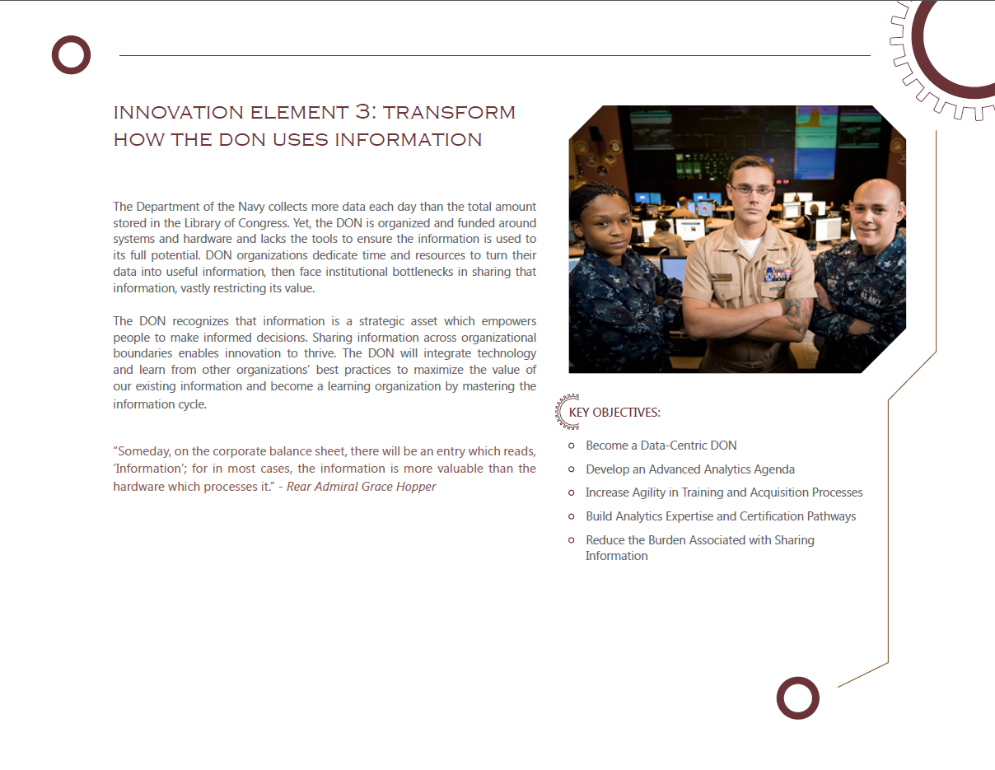
Navy Innovation: Data-Centric Navy
All key objectives supported

Slide 17
Working to establish NPS institutional support
Relevance to NPS educational objectives and research deliverables
  Catalog entries being prepared for Calhoun library archive search
Partnered support to establish system by multiple NPS stakeholders
  Information Sciences (IS) Department, JIFX/CRUSER, NPS Research Office, ITACS network infrastructure, Dudley Knox Library Calhoun Archive, others
  White paper available for review, discussions in progress
Feedback, participation from participants & users always welcome

Slide 18
Work in progress
Starting to connect first few unmanned systems
experiments from JIFX in early August 2016
Installing, testing local copies of STOQS open source
  robodata.ern.nps.edu (and eventually local copy at Camp Roberts when testing)
Adapt data-upload modules to NPS robots, prepare short-course module
  Developmental testing this time, production requirements/capabilities next time
Photographic and video recordings will be handled separately
  Media, storage, serving and playback requirements are quite different
  Shared need for common, cross-linked time/position/metadata annotations
Evaluate whether NPS publication-review rules sufficiently address data
  Acceptable open-source licenses; participation invitation
  Access restrictions: someday For Official Use Only (FOUO) on nps.navy.mil

Slide 19
Preparing robot mission data and metadata

Slide 20
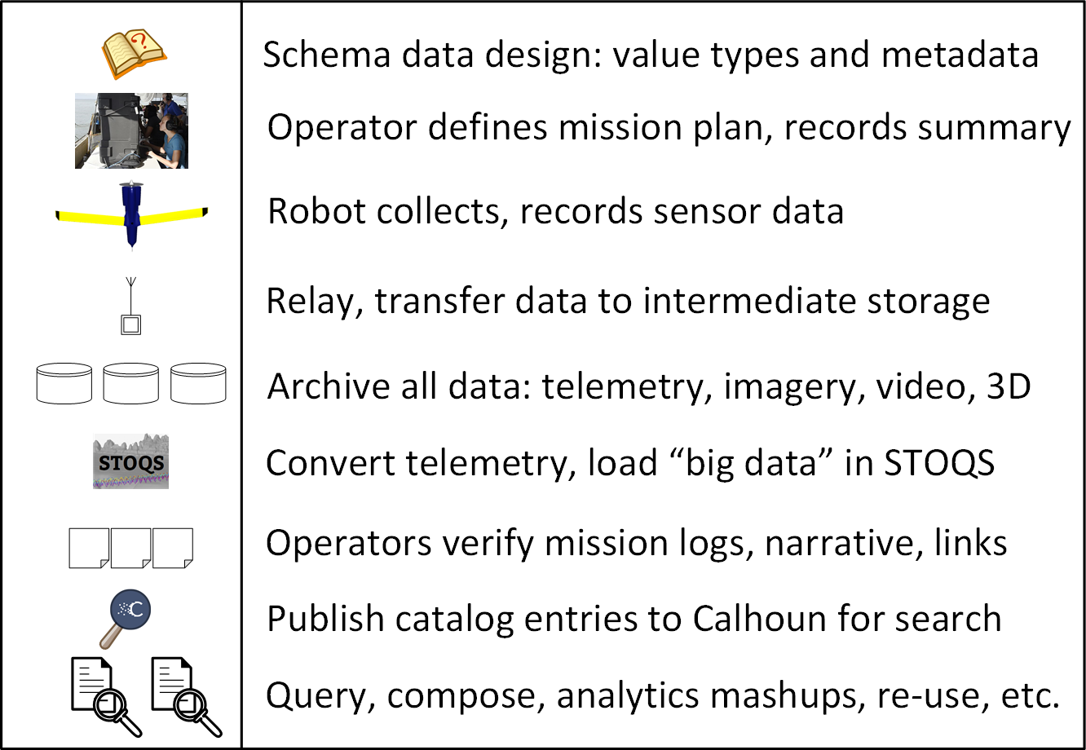
Robodata information flow provides a repeatable pattern

Slide 21
Contributing data
Interested? We're keen to work with your team.
Please email robodata@movesInstitute.org with as much of the following information as possible.
Robot name, type, configuration and identifying information
Experiment goals and outcomes
Location, date, times
Sensor types
Telemetry data files
Images with captions, date/time/location
3D models (we will convert into X3D for Web use)
Video availability

Slide 22
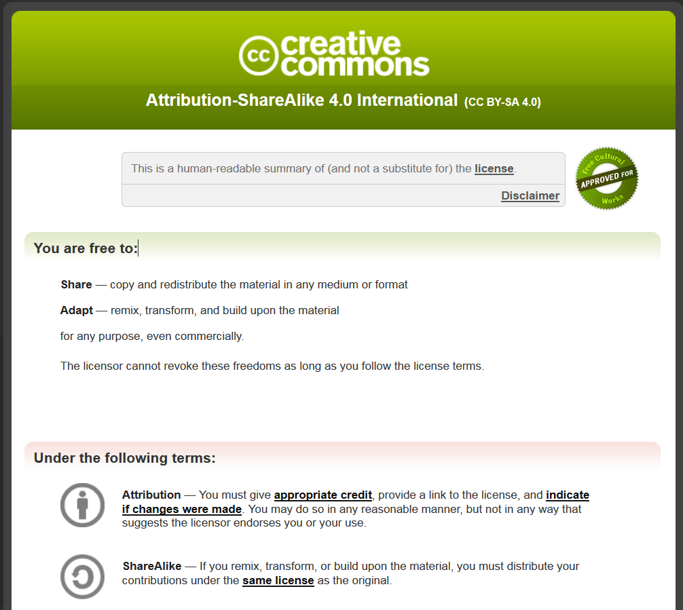
Open-Source Data Licenses
Suggested:
Creative Commons Attribution-ShareAlike 4.0 International
(CC BY-SA 4.0)
Other open-source licenses are acceptable

Slide 23
Questions for users – all feedback welcome!
What data does your unmanned system record?
  Data type, metadata classification, timing, location, purpose
Do you have past archives of data available?
Do you want to configure an active system to feed robodata archive?
What additional requirements and goals do you have?
Solution approach: multiple surveys with IRB compatibility

Slide 24
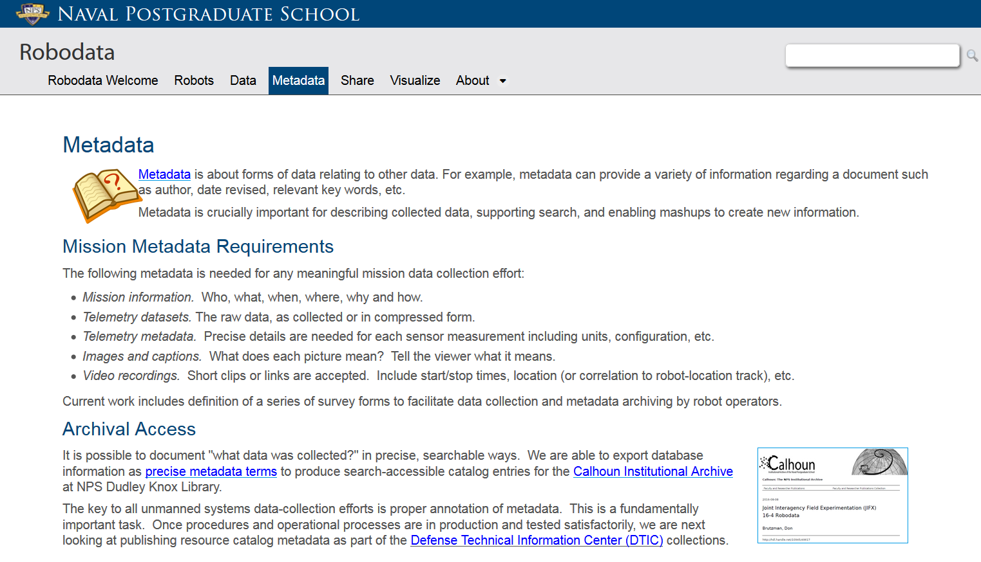
Metadata strategies

Slide 25
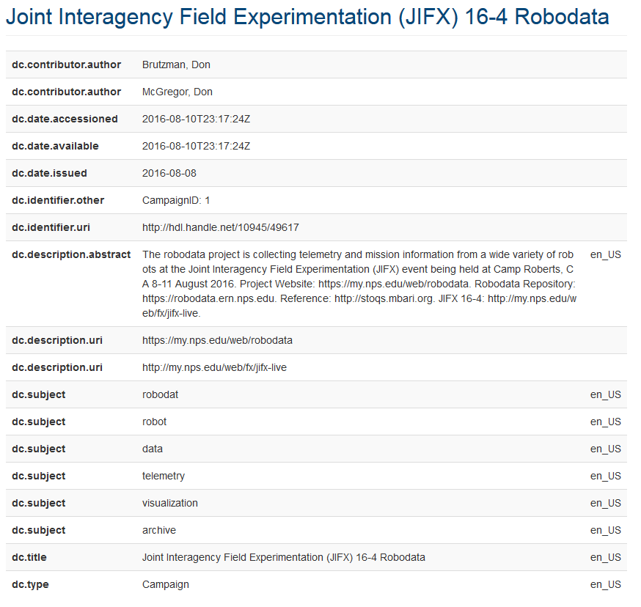
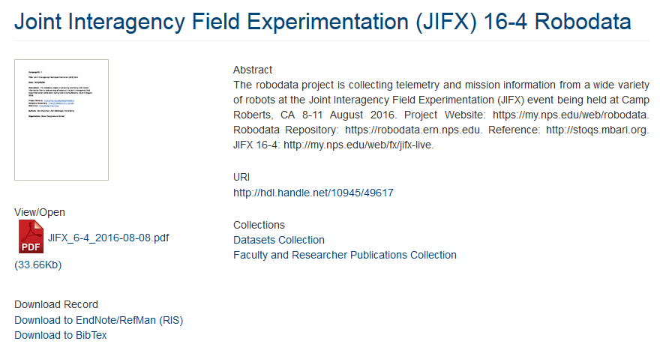
Metadata exemplar
https://my.nps.edu/web/robodata/metadata

Slide 26
Contact
Don Brutzman, Ph.D.
brutzman@nps.navy.mil
brutzman@nps.navy.smil.mil
http://faculty.nps.edu/brutzman
Code USW/Br, Naval Postgraduate School
Monterey California 93943-5000 USA
1.831.656.2149 work
1.831.402.4809 cell

Slide 27
Contact
Don McGregor
mcgredo@nps.edu
Modeling Virtual Environments Simulation (MOVES) Institute
Code MV/Mc, Naval Postgraduate School
Monterey California 93943-5000 USA
1.831.656.7605 work

Slide 28
Design Thinking and robot data

Slide 29
Designing a Short Course for
Creating Robotics Data Archives
NPS DA4500 Design Brief
Don Brutzman, Ann Gallenson, Shelley Gallup
June 2016

Slide 30
Objectives
Background
  Bootstrap a short course to expose initial capabilities, if approved
  Evaluate course suitability, provide recommendations for further work
Current
  Scale across/outside campus to support JIFX experimentation, Camp Roberts
  Build a growing institutional data archive
Long term
  Help NPS become a design-competent organization
  Influence, align with broader DoD and scientific practice

Slide 31
Project goal: given a short course, show students how to apply design thinking
Background: creating a new short course to utilize a system that supports ongoing needs and emerging capabilities in data capture.
Course shows how to plan, prepare, contribute and utilize datasets in the online archive.
Need to show how design thinking can be applied within any student project involving the collection and interpretation of data collected by robots or other unmanned systems.

Slide 32
Motivations
Expose many individuals at NPS to process of design thinking
Create data products that themselves are building blocks for ongoing design mashups and assessments
Better data produces better understanding
Not try to be all things for all people, but apply design principles well within a given context that has broad implications and connections

Slide 33
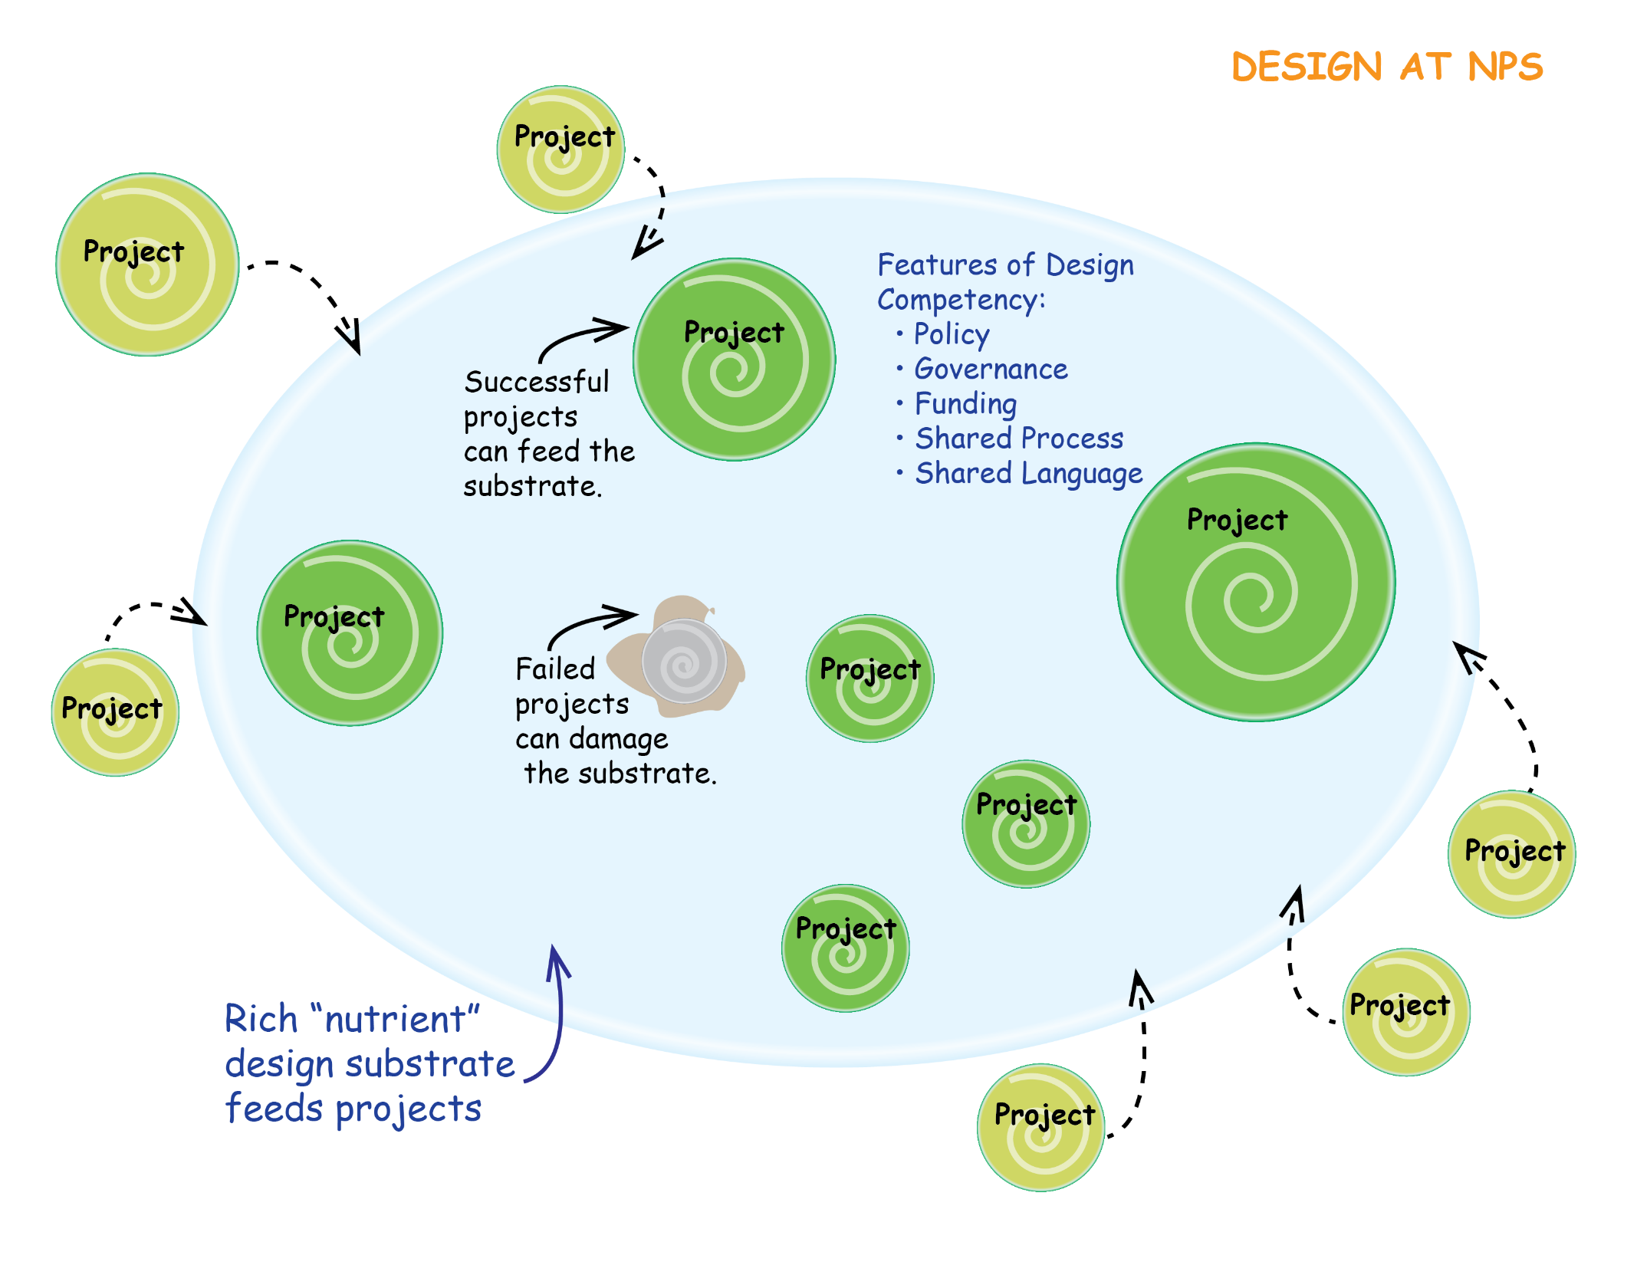
Design at NPS

Slide 34
Course syllabus: initial outline
Establish your project motivation, goals, and critical research questions
Experimental design
  What measures and scenarios answer the questions of interest?
  List robot and sensor assets available, desirable
  Data design: sensors availability, how to collect it, assigning correct metadata
Data archive mechanics
  How to use STOQS to display collected robot data for evaluation and analysis
  How to log, extract, massage, and upload your system data into NPS archive
Practical exercise
  Work with prepared data (from course or student project), create report

Slide 35
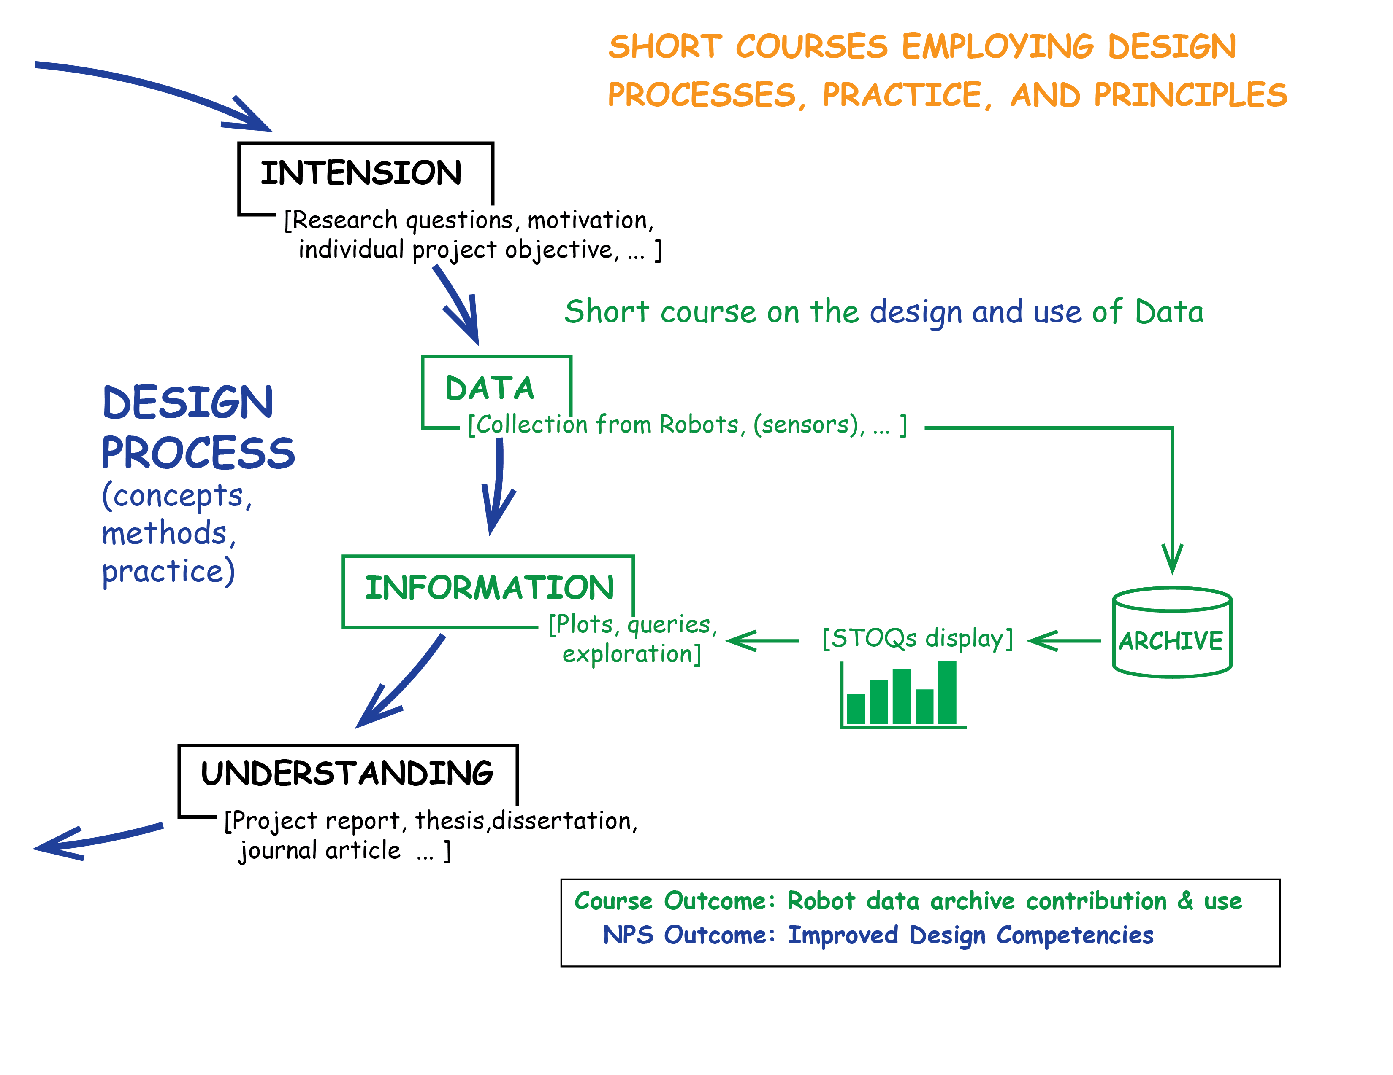
Illustrating Design Process

Slide 36
Relation to John Arquilla “Sponsor” Vision for Defense
DoD operations are increasingly unmanned
Data-driven evaluation of robotic systems is cross-cutting necessity
Opportunity: exploding availability of sensors, Internet of Things (IOT)
Humans have difficulty evaluating what they can’t see or measure
  “Captain, how did your team do out there?” versus “what happened to the robot?”
Deluge of data needs to be transformed into coherent information that effectively informs judgements and decisions (both human and artificial)
Bottom line:
Adapt NPS activities to understand changing nature of modern warfare
Foster design competencies in NPS course work and research projects

Slide 37
Sections of a Design Brief
1. agency (i.e. decision makers, stake holders, etc.)
2. intension / direction or strategy for approach
3. systems assessment (i.e. context, environment, elements etc.)
4. establishing limits or boundary / enabling judgments (i.e. priorities,
5. defining performance specifications (i.e. outcomes of good design)
intention - outcomes
6. defining prescriptive specifications
Designing (not part of brief)
7. concept development
8. design development
9. realization

Slide 38
Agency: decision makers and stake holders
Students: course work and capstone/thesis investigation
Faculty: course assignments, research experimentation projects
NPS: pedagogy, research support, institutional archive, mission
______________________________________________________
Sponsors: reusable record of project results
Partners
  Capture results from NPS JIFX field experimentation
  Share data compatibly with other universities and groups
Navy and DoD
  Mandates: Data-centric Navy, Data.gov imperatives
  Good practices worth repeating will continue to improve

Slide 39
intension / direction or strategy for approach: design a short course
Demonstrate mechanics of simple data collection
  Overview of STOQS system: capabilities, products, prerequisites
  Mechanics of collecting/converting simple sample series to build data sets
  Assigning proper metadata to data items, including timestamp and location
  Uploading annotated data stores into the archive
  Performing data analysis using online tools: graph plots, 2D maps, 3D flythrough
Communicate design principles for common tasks
  Define objectives and goals for a given robotics project
  How to develop key questions that support objective exploration
  Figuring out how their robot data can support answering those key questions

Slide 40
systems assessment
(i.e. context, environment, elements etc.)
Context
  Frequent reinvention of common task with poor results, then assets are lost
  Strategy thumbrule: “We all know how this plays out. How do we get there?”
Provenance
  MBARI has produced open-source system answering most of our technical needs
  NPS has mission goals and many stakeholders needing better support
Environment
  Modest budget: open source, high-tech infrastructure already available, sustainable
  Competence: skilled champion MBARI for support, repeatable demonstrated system
Elements
  Students and faculty running robotic data-collection systems need support
  Assume initial STOQS capability gets installed, becomes operational at NPS

Slide 41
establishing limits or boundaries, enabling judgments (i.e. priorities)
Keep expectations well scoped to what system can accomplish today
“Good data” is definable, supportable based on existing exemplars
Limited time available to course participants
  Only half-day/full-day tutorial is currently practical
  Keep It Simple Smartypants (KISS principle) with ongoing spiral improvement
Understanding data results is a process that comes from well-defined questions, open examination and iterative improvement
  Scientific method combined with scholarly inquiry, not a checklist
Technology is an enabler, not end goal or “silver bullet” per se
  Example: VR headset may help understanding but is not the end objective

Slide 42
defining performance specifications
(i.e. outcomes of good design)
Course goals, design rationale and syllabus
Ready to prepare initial course supporting JIFX, NPS quarterly break
Participants can apply material immediately after course completion
Student projects and theses presented in live forum, also archived
Iterative process: share lessons learned, encourage exploration
Second/third pass: record class video to support study at any time
Expectation: advanced and complementary course work will follow

Slide 43
Design is relevant at multiple levels of context
Supporting role: creation of new course to support students
Teach design principles for participants to apply in their projects
Designing for success: possibility of scaling up or adapting over time
Careful to identify specific context
when discussing relevant design points

Slide 44
Feedback welcome ☺
Questions and improvements please

Slide 45
Contact
Don Brutzman | Ann Gallenson | Shelley Gallup
Code USW/Br Information Sciences (IS) Dept. Naval Postgraduate School (NPS) Monterey CA 93933-5000 brutzman@nps.edu 831.656.2149 | Center for Executive Education (CEE) Naval Postgraduate School (NPS) Monterey CA 93933-5000 acgallen@nps.edu | Code IS/Ga Information Sciences (IS) Dept. Naval Postgraduate School (NPS) Monterey CA 93933-5000 spgallup@nps.edu

