Slide 1
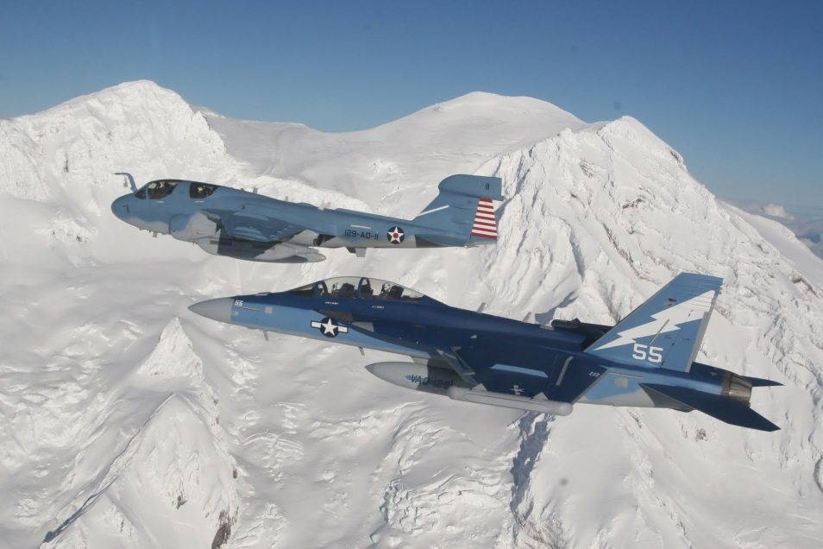
How to Minimize Time Spent on NKO
NPS Training Officer

Slide 2
This presentation will show you where to find all of your mandatory NKO courses for the Fiscal Year in one spot and enroll in all of them eliminating the need to individually search for a new course each time.
https://www.nko.navy.mil/

Slide 3
FY16 Requirements
Standard Core Training (Annual Requirements)
Face to Face
SAPR/EO
Suicide Prevention
NKO
Combatting Trafficking in Persons (DOD-CTIP-1.0)
Antiterrorism Level 1 (CENSECFOR-AT-010--1.0)
Cyber Security Awareness (DOD-IAA-12.0 or DOD-IC-IAA-12.0)
TS/SCI holders MUST complete the IC Version to satisfy annual security training.
Secret and below may complete either version on NKO or attend the ITACS hosted training.
Operations Security (NIOC-USOPSEC-2.0)
Privacy and Personally Identifiable Information (DOD-PII-2.0)
Records Management (DOR-RM-010-1.1)
Online
Counterintelligence Awareness (http://cdsetrain.dtic.mil/cidod/)
Command-Assigned Readiness-Enhancement (CARE) Training
(Biennial Requirements) – these topics are mandatory every 2 years and can be completed via face to face briefs, NKO or, in the case of Domestic Violence, on the new Mobile App.
Alcohol, Drugs & Tobacco Awareness
Stress Management
Domestic Violence
Sexual Health and Responsibility
Optional (Available on NKO )
Physical Readiness
Hazing Policy and Prevention
Personal Financial management
Operational Risk management
Energy Policy

Slide 4
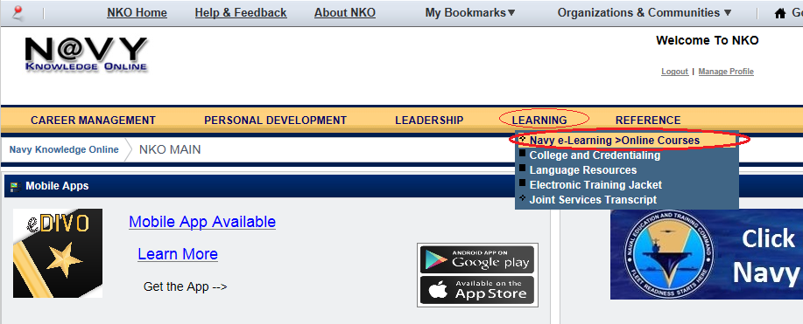
LOG onto NKO and go to e-Learning
*CAC Required

Slide 5
Click on the Course Catalog Tab

Slide 6
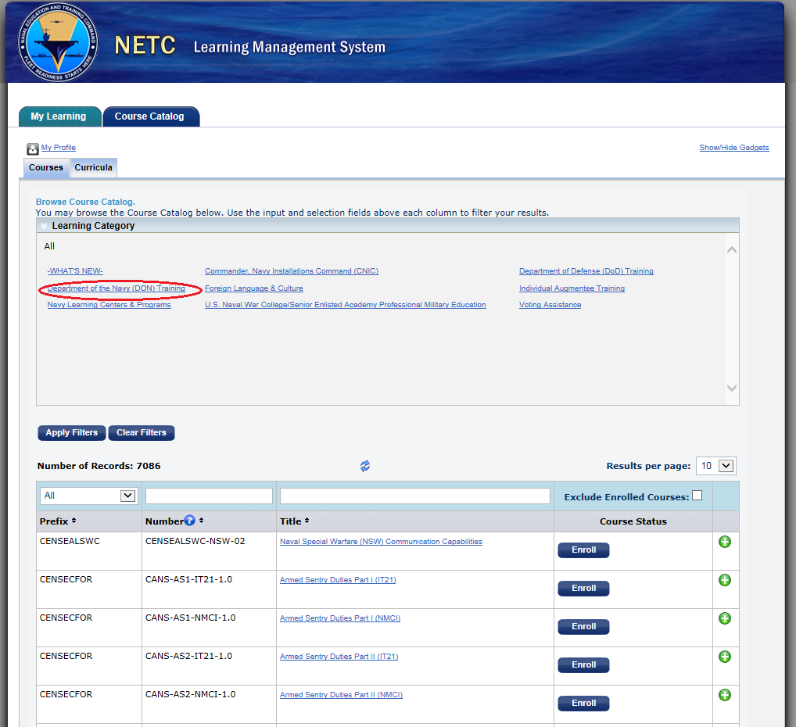
Select “Department of the Navy (DON) Training”

Slide 7
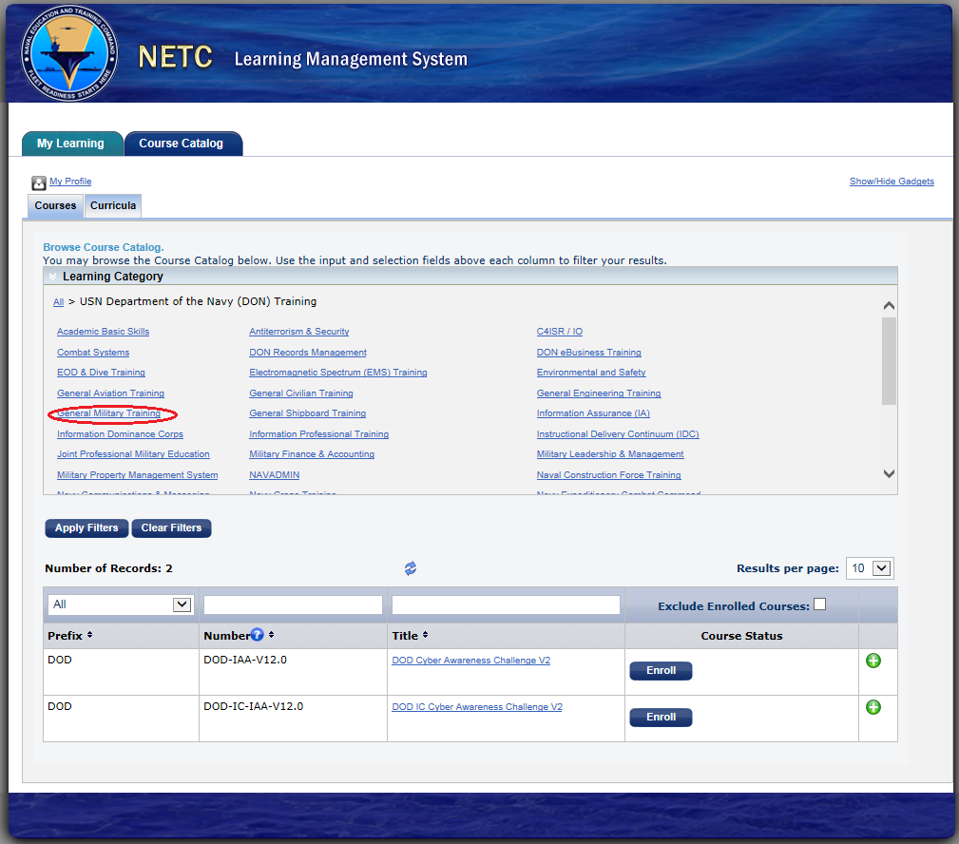
Select “General Military Training”

Slide 8
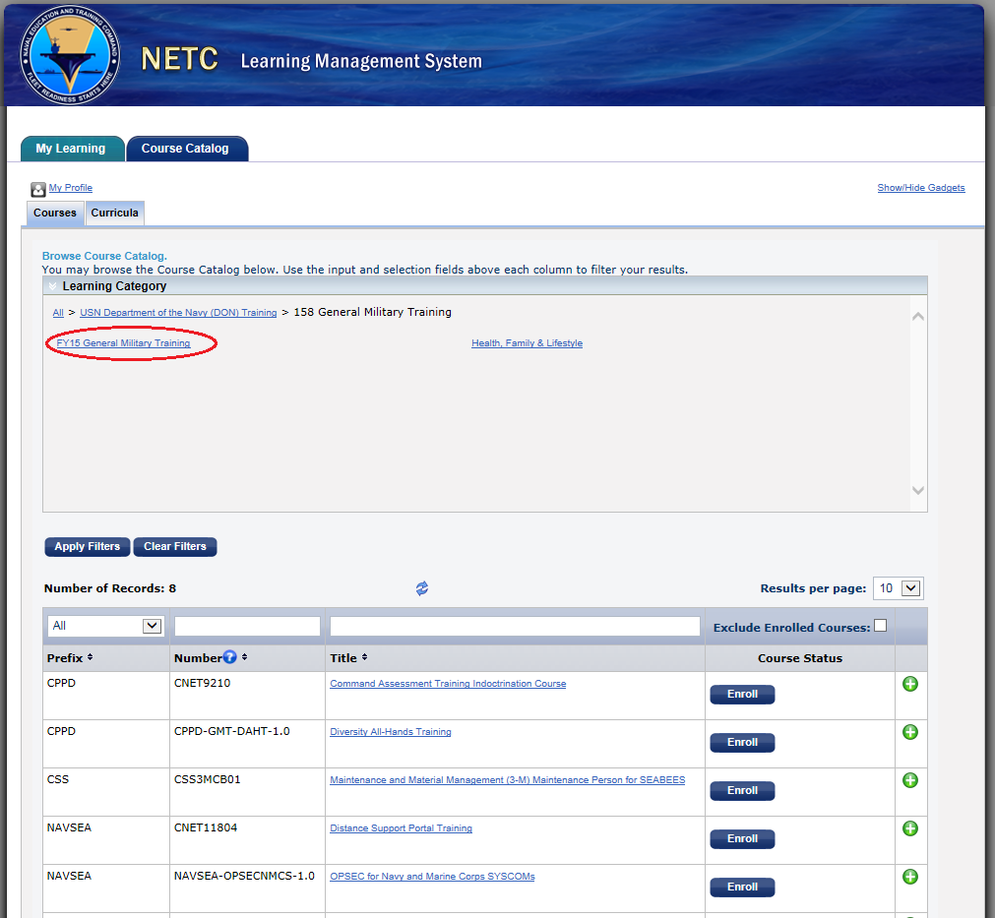
Select “FY16 General Military Training”

Slide 9
Click Enroll for each Mandatory Course
10 courses show up...
6 are Mandatory Annual Requirements
Combatting Trafficking in Persons
Records Management in the DON
DOD Cyber Awareness Challenge V2 (TS/SCI complete IC Version instead (DOD-IC-IAA-12.0))
Operational Security (Uncle Sam's OPSEC)
Antiterrorism Level 1 Awareness Training
Privacy and Personally Identifiable Information
2 courses are Mandatory Biennial Requirements
Domestic Violence
Sexual Health and Responsibility
2 Courses are optional
Energy Policy
Operational Risk management
Search for the Other 2 Mandatory Biennial Requirements in the Course Number Search Bar
Stress Management - CPPD-GMT-SM-1.0
Alcohol, Drugs & Tobacco Awareness - CPPD-GMT-ADTA-1.0

Slide 10
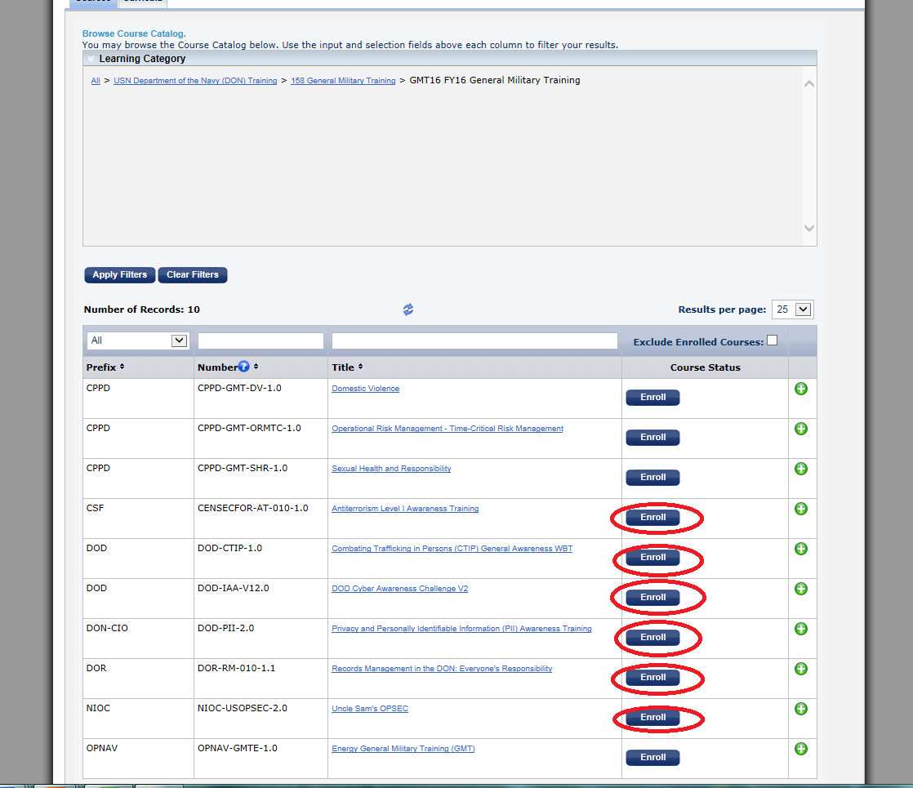

Slide 11
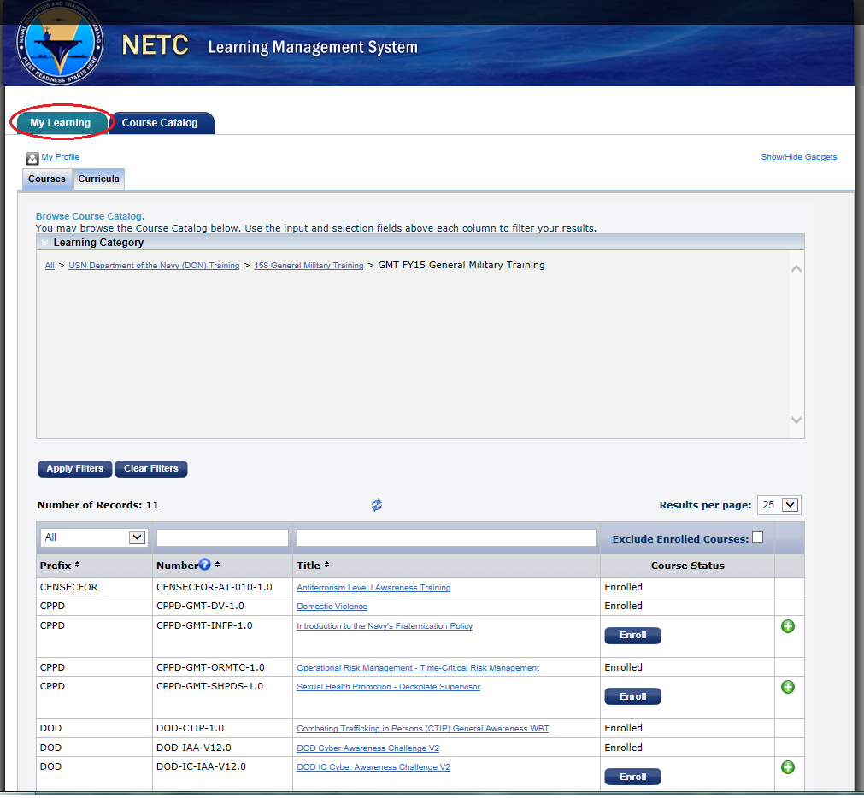
Go to My Learning Tab

Slide 12
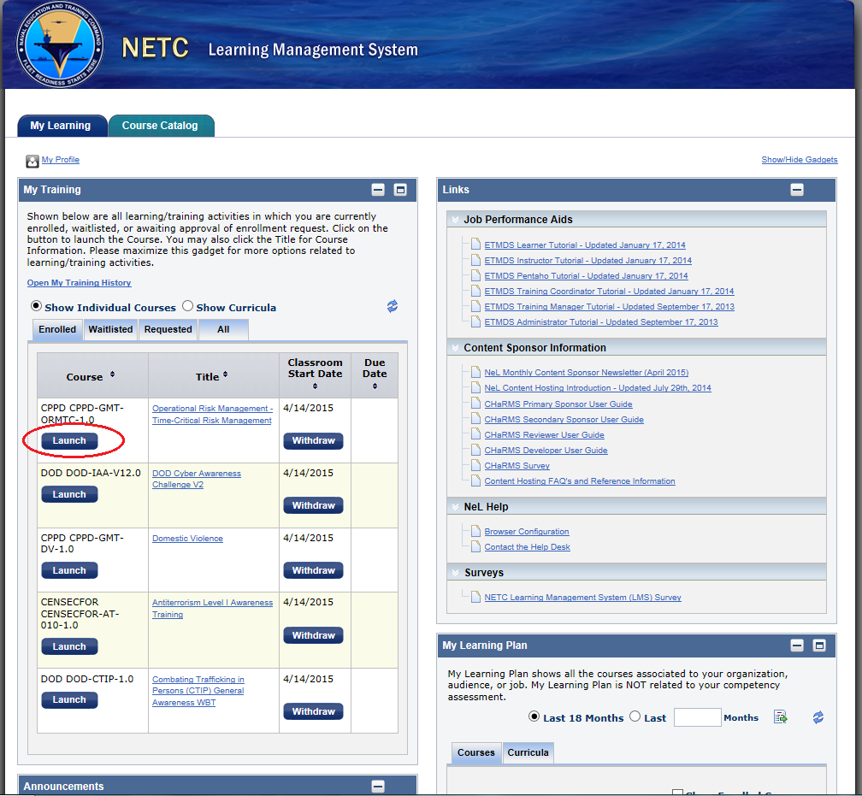
Launch Course when ready

Slide 13
Easy Return Access
Now every time you log into NKO the training you still need to do is waiting on your e-Learning homepage.

Slide 14
One exception…
There is one course not uploaded on NKO for FY16 that is mandatory.
Counterintelligence Awareness and Reporting
Use this link http://cdsetrain.dtic.mil/cidod/
Retain a copy for your records AND for security training.
Upload certificate on Security training site below. Link also accessible from the Training website on the NPS intranet homepage
https://cle.nps.edu/xsl-portal/site/4e3882c9-5fd4-4831-880e-4453fd7584b1

Slide 15
Courses offered elsewhere that will fulfill requirement
Information Awareness-
TS/SCI are required to do the IC Version on NKO for NPS Security Training
Either the normal version or IC version counts for GMT. You do not need to do both!
Those with a Secret or below can do either version on NKO or attend the ITACS run training. Be sure to muster at the event so your attendance is recorded and your FLTMPS record is updated

Slide 16
Questions?
Contact the Training Officer
LT Kristen Connor
krconnor@nps.edu
X-3031
BLDG 275 (Flag Admin)

