Slide 1
Introduction to CNC Milling
Martin Brantner, Mechanical Engineering
Brandon Naylor, Energy Academic Group

Slide 2
Outline
Introduction
Workflow Process
  CAD
  CAM
  Machining
  Finishing
Carbide Create (Alternate path)
Lessons Learned
For further information
Questions
Let’s Mill!
What this course is:
  An introduction to the CNC process
  An introduction to the Carbide Nomad 883
  Jump-off for reference material
What the course is not:
  All inclusive/ detailed discussion

Slide 3
Introduction
What is CNC?
  Computer Numerical Control
  Subtractive manufacturing technique
What is CAD?
  Computer Aided Design
  Way of creating models
What is CAM
  Computer Aided Manufacturing
  Way of translating a model into machine codes
CNC Files
  G-Code
  Programming language read by the CNC Mill
CAD Files
  Solidworks, Autodesk Fusion, Sketchup
CAM Files
  .stl: STereoLithography
  Surface rendering of object

Slide 4
Workflow Process
Your Idea,
Thingiverse
Knowledge of stock, tools, setup
Raw materials
Patience
CAD
CAM
CNC
Finishing
Solidworks,
Autodesk Fusion,
Sketchup
Meshcam
Carbide Motion
Carbide Create

Slide 5
CAD
Create the model you want to machine
  Utilize a model from Thingiverse
The model shouldn’t have negative volumes, exceptionally fine detail
The model can have reflective machining
Keep in mind the CNC is a 3-axis machine
Goal is to export a .stl file

Slide 6
CAM (1/3)
Determine single side, or double side machining
  Keep in mind you will need to physically re-setup your material
Define the stock size of your material
  8” X 8” limitation
  Size your part to fit your material
Where is your origin?
Set “keepout” regions
  Do you need supports?
  What will be your final Z height?

Slide 7
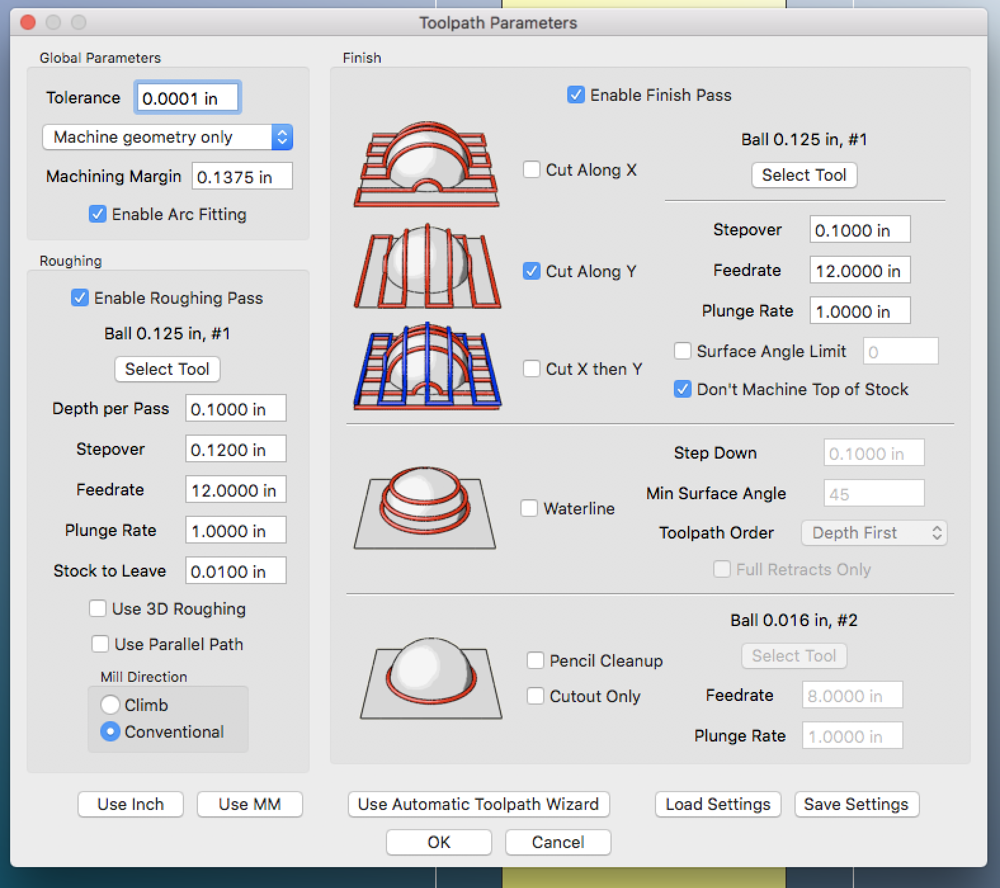
CAM (2/3)
Create your toolpaths
  Determine the tools you will be using
    Square head versus round
    Tool diameter considerations
  Settings for your materials
    Spindle speeds for your material: Nomad spindle chart
    Depth per pass
    Stepover
    Feedrate
    Plunge Rate
  Roughing pass vs Finish Pass

Slide 8
CAM (3/3)
Make sure to run the trial simulation
  May need to adjust settings
Goal is to export a G-Code file

Slide 9
CNC
Make sure your stock is secure in the machine
  Make sure you are not engaging the safety limits
“Zero” the machine
  Make sure your zero corresponds to the origin in the CAM process
Make sure the correct tool is in the machine
Machine the first pass
As necessary, install second tool
As necessary, rotate the part
Goal is to have a semi-finished part

Slide 10
Finishing
Flat tip mills are good for flat surfaces
Round tip mills are good for rounded surfaces
Congratulations!

Slide 11
Carbide Create
Alternate software option for relief milling
Probably the best choice for signs/ plaques

Slide 12
Lessons Learned
Homing issue
Time may be a limiting factor
Difficulty in two-sided machining
CNC vs 3D printing
Material sources

Slide 13
For Further Information
http://docs.carbide3d.com/
  Feed Chart
http://www.grzsoftware.com/
  Registration Code: C31C17-124F00-077A-1AF4
  License Type: Carbide Standard
RoboDojo Sakai
People
  mbrantne@nps.edu
  blnaylor@nps.edu

Slide 14
Questions?

Slide 15
LET’S MILL!

