Slide 1
U.S. Surface Navy Electrical Leap Forward…
….a Vision for the Future
Defense Energy Summit
Naval Post Graduate School
02 November 2018
Mr. Stephen P. Markle, PE
Electric Ships Office (PMS320)
Director & Program Manager
202.781.4427
stephen.markle@navy.mil

Slide 2

Power System Considerations
“I’m going to buy as much as I can afford. As much power as I can afford. Because I know by the time I retire the ship I’ll use it all.”
Admiral John Richardson
31st U.S. Chief of Naval Operations
Directed Energy Summit I March 29, 2017
Buy as much power as you can afford
  Power (esp. with electric propulsion) is fundamental to ship design and affects major components, arrangements, superstructure, compartmentalization, & ship control
  The power system must include a better approach to distribution flexibility throughout the ship’s service life; current design practices optimize for current requirements
  DDG 1000 has plenty of installed power but a distribution system limited to current requirements
  DDG 51 Flight III includes a costly power system upgrade for AMDR that was not in the original design
Follow the N96 Surface Capability Evolution Plan (SCEP)
The Electric Power System is the Foundation of the Ship’s Kill Chain

Slide 3
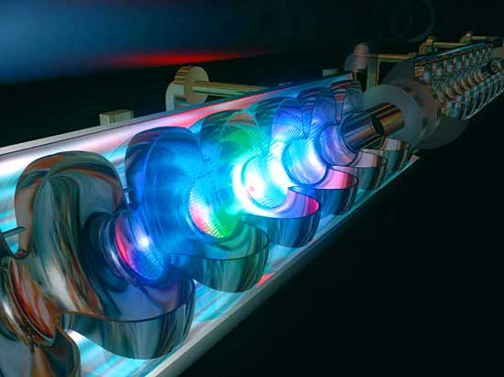


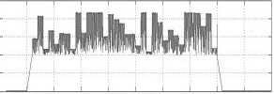
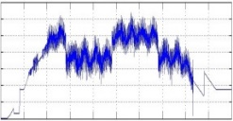
Evolution of the next large surface combatant…
FUTURE FORCE STRUCTURE
“The prioritized shipbuilding plan assigns the highest priority to frontline combat platforms, affording the opportunity to quickly adopt new capabilities in response to emerging disruptive capabilities…”
Annual Long-Range Plan for Construction of Naval Vessels (2019)
DISRUPTIVE TECHNOLOGY
High energy weapons and sensors required to pace technology, outpace adversaries, and maintain maritime dominance
Maintain flexibility to rapidly introduce new mission systems
Naval Directed Energy Weapons and Sensors
Weapon Demand
Sensor Demand
EW
Demand
Mission Capability
Key to Disruptive Technology is an Agile Power System…

Slide 4
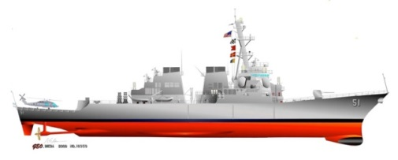
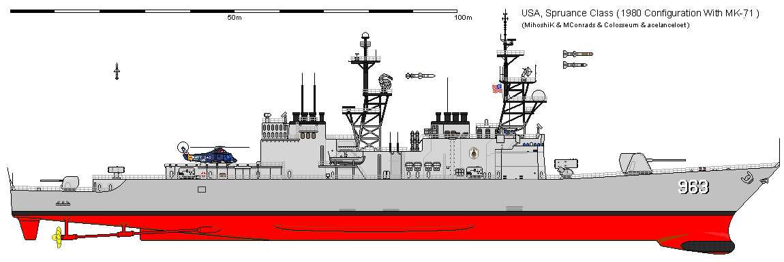
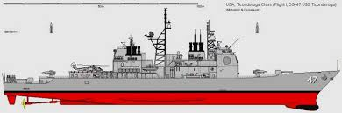
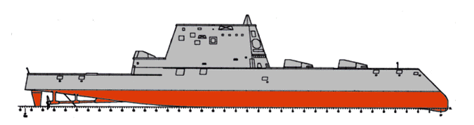
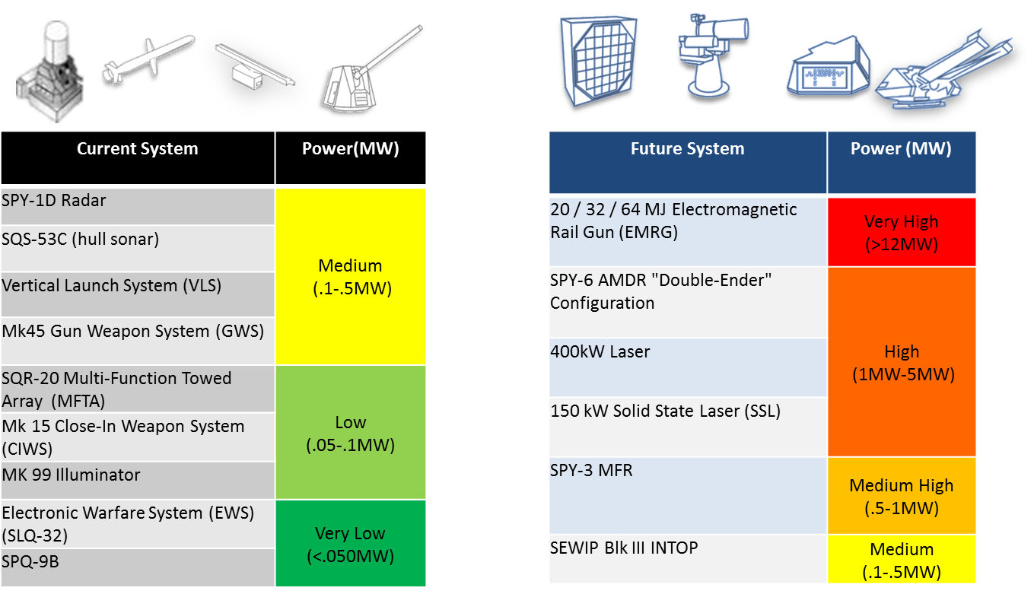
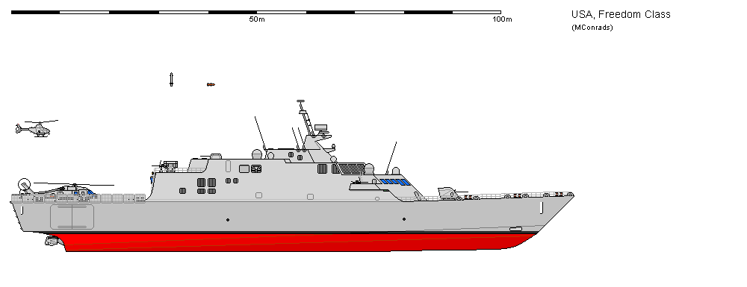
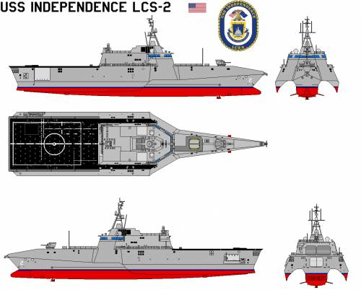
Evolution of Surface Combatant
DDG 51 Flt I 1991
DDG 79 Flt IIA - 2000
DD 963 - 1975
DDG-72 Flt II - 1998
DDG 125 Flt III – FY23
ASW/ASUW
FSCF
LSC / SSC / USV
Strike/AAW/ASW/ASUW
AAW/ASW/ASUW
Land Attack/AAW/ASW/ASUW
CG 47 - 1983
DDG 1000 - 2016
LCS 1 - 2008
FFG(X)
LCS 2 - 2010

Slide 5


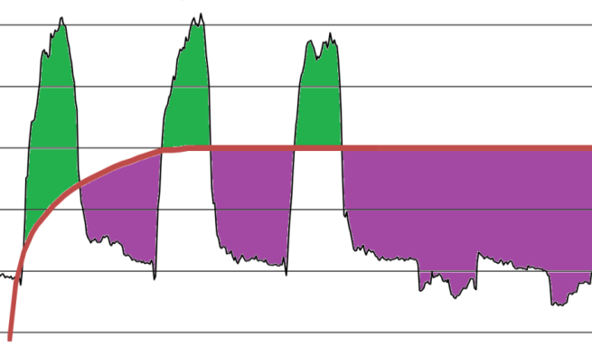


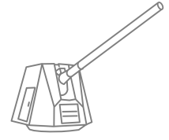




Directed Energy Mission System Power Demands
Current
Power = Energy/Time or Energy = Power x Time
Future
Generators operate at continuous loading for efficiency & reliability
Current generators cannot respond quickly and dynamically to new demands
Generator Response to Load
Energy Storage Response to Load
Pulses of a different nature require different ranges of pulse power technologies
Future directed energy demands need common large scale energy storage
Sensor Demand
ENERGY STORAGE PROVIDES
PULSE POWER
POWER
Mission Capability
POWER
TIME
Sensor Demand
GENERATOR CHARGES ENERGY STORAGE
TIME
Weapon Demand
Kinetic Weapons
EW Demand
Directed Energy Weapons and Sensors
?
Current Demand
Future Demands
Key to Success = Energy Storage and Advanced Controls

Slide 6

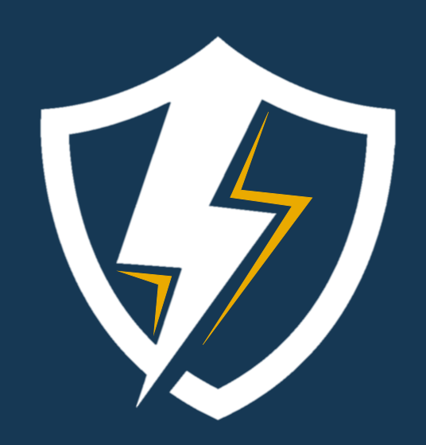
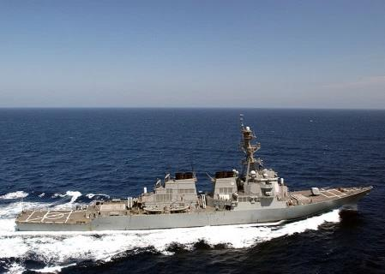
Path to the Future
Power is the Foundation of the Kill Chain
Share energy storage for new dynamic loads
Minimize space, weight and cooling impacts
Utilize maximum power a ship can provide
Path to the future
Shift the
power interface
Develop a common intermediate power and energy system
Advance Fully Integrated Power and Energy Systems
MIL-STD-LVDC/MVDC
ENERGY
MAGAZINE
IPES
Validation
Back fit / Forward fit
New Ship Design

Slide 7
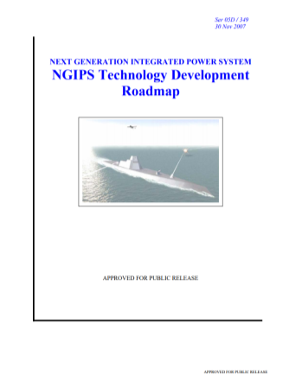

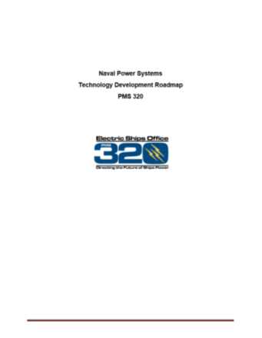


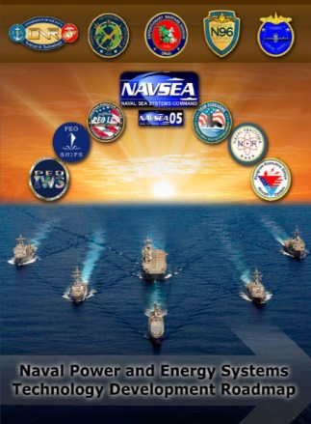

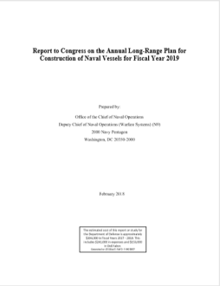
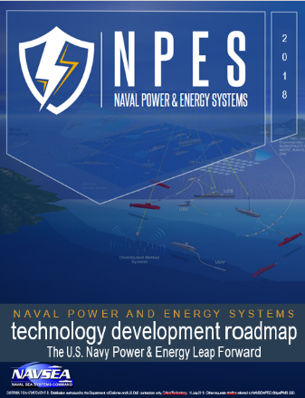
The Guidebook: NPES TDR
Naval Power and Energy Systems Technology Development Roadmap
Aligned to the Navy’s 30 year shipbuilding plan and Surface Capability Evolution Plan (SCEP)
Serves as a guide for future investment by Navy, DoD, Industry, and Academia
Includes all major product areas for Naval Power Systems
  Prime Movers
  Generators
  Energy Storage
  Electric Motors
  Distribution Systems
  Power Converters
  Controls
Originally issued in 2007 as part of the stand-up of the
Electric Ships Office
Updated and re-issued in 2013 & 2015
2018 Version utilized CPES OIPT input
2018 Version Currently in chop for SEA00 Signature

Slide 8
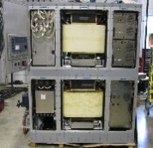
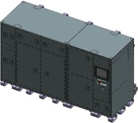
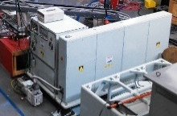

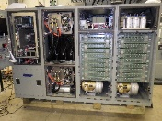
Power Hardware in the Loop Testing
Florida State University Center for Advanced Power Systems
Emulated
Power System
Compact Power
AMDR PCM
Emulated Mission Systems
FESS
Device(s) Under Test
EM-L
Real Time Simulation: Technical and Programmatic Risk Reduction

Slide 9
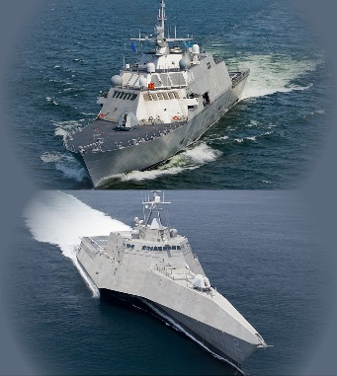
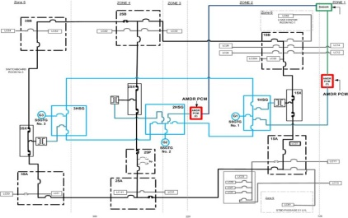
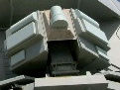


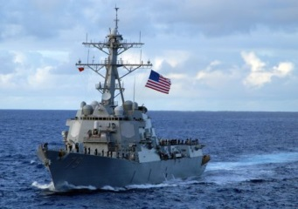


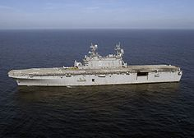
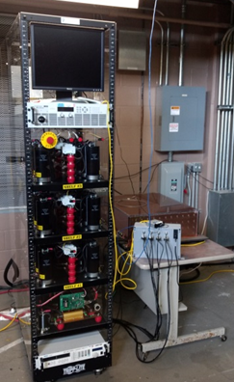
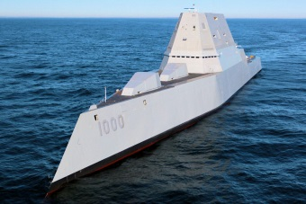
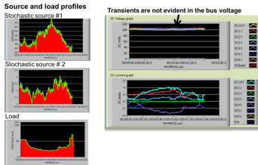
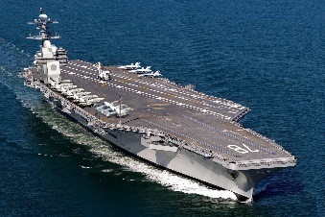

Energy Magazine Demonstration
Modeling & Simulation
DDG 51 Flt IIA & III VV&A’d Electrical System
Detailed Mission Systems, including:
SEWIP
Laser
AMDR
+ Energy Storage Models & Hardware
Real Time Dynamic Simulation
FSU CAPS
Knowledge
EM-L (DRS)
FESS (GKN/UK)
Control Hardware in the loop (CHIL)
Power Hardware in the loop (PHIL)
JHU APL
Adaptive Power System
(APS)
+ Power & Energy Management
Sandia NL Distributed Energy Management
Demonstrations Validate Interfaces for Pulsed High Energy Systems

Slide 10
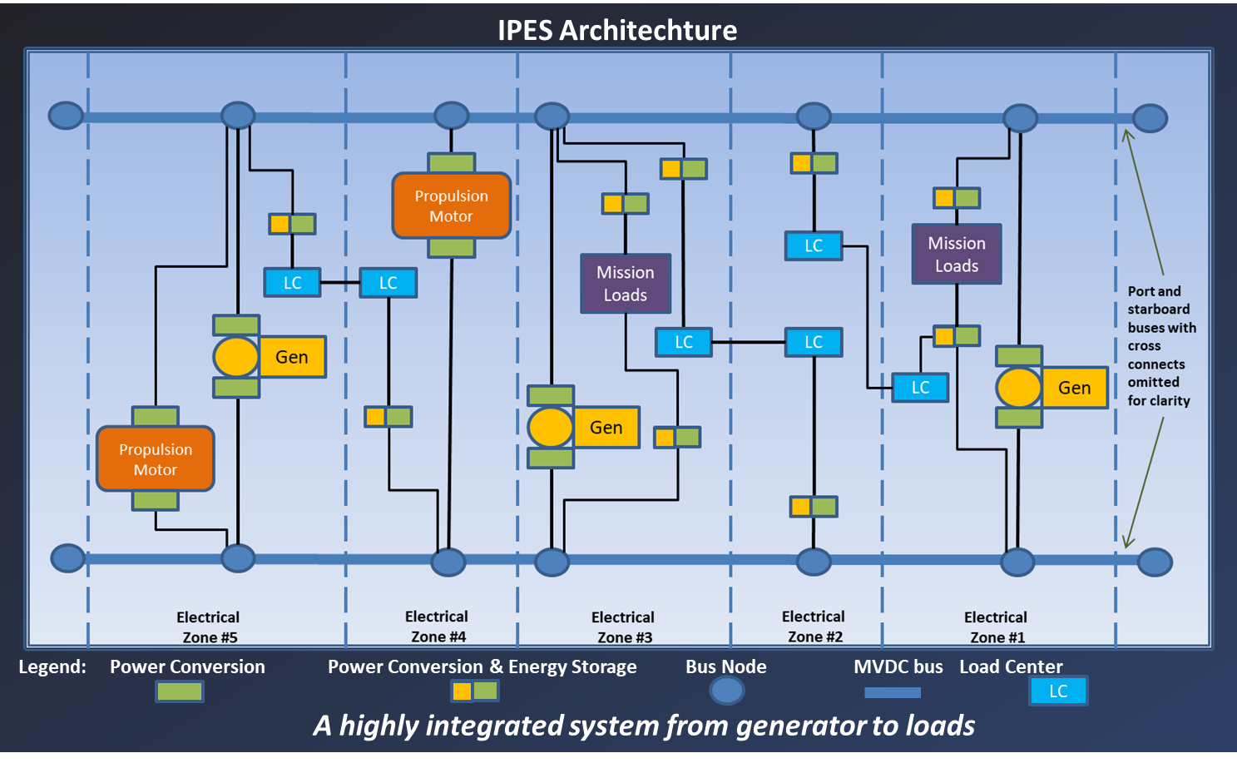
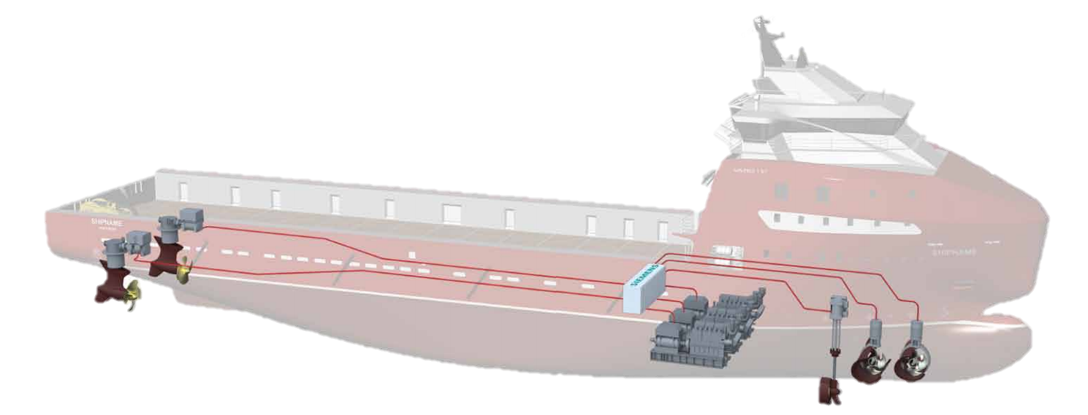
IPES Required to Access Total Ship Power
Integrated Power System (IPS) Architecture:
Shares Propulsion Plant with Ship Service
Integrated Power & Energy System (IPES) =
IPS + Shared Energy + Advanced Controls
DDG 1000
Evolutionary
Approach
Advanced
Controls
Electric Motor
Distribution
Electric Motor
Power
Conversion
Fuel
Gas Turbine
Generator
Distribution
Fuel
Gas Turbine
Generator
Energy Storage
Filtration
Switching
Ship Service & Weapons
Ship Service & Weapons
IPES Tactical Advantages:
Flexibility
  Enable Undefined Future Warfare Capability
Adaptability
  Support Evolving Mission Requirements/
  Systems
Survivability
  Limit Casualty Impact and Speed Recovery
  Whole Ship Power Backup
  Maneuver on “Battery”
  Engage Until Last Drop of Fuel Expended
Endurance/Efficiency
  Greater Range & Time on Station
Industry is currently implementing this concept, e.g. Siemens BlueDrive,
providing similar benefits with a significantly smaller footprint,
reduced weight, and lower operating costs.
Notional Offshore Service Vessel (OSV) with BlueDrive

Slide 11
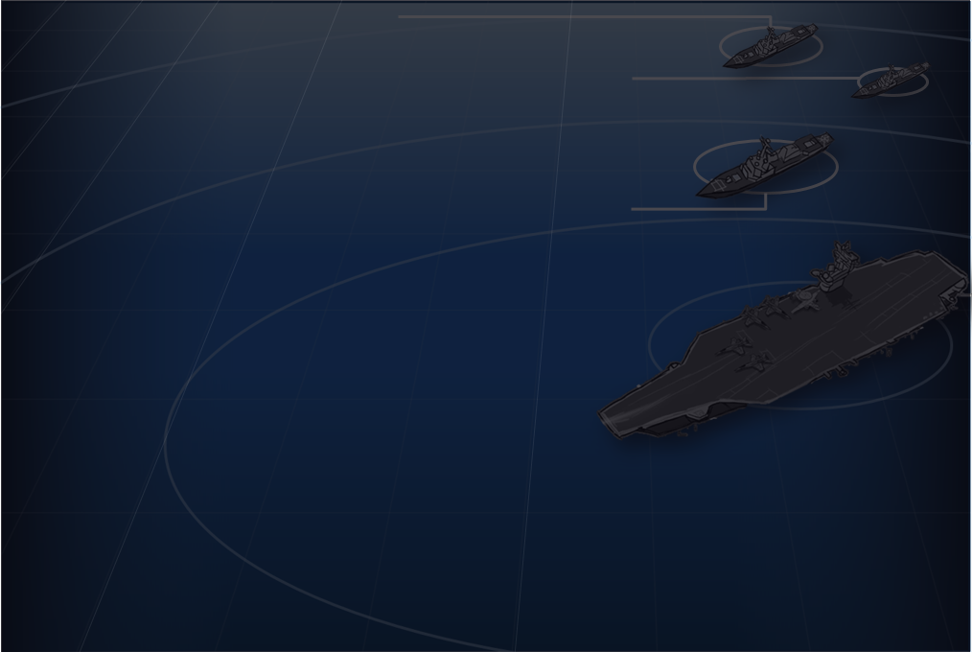
Program Manager Thoughts
Fruits of multiple investments in warfighting technology are maturing in near future
LSC Power system attributes driven by evolving Requirements
Markle Crystal Ball
  Stable Bus servicing highly dynamic DC loads
  Marriage between Combat Systems and Machinery Control Systems
    “Active State Anticipation”
  Uninterruptable Stable Back Up Power
  New way to look at Service Life Margin
    Total Ship Power Perspective
    Flexibility for the Future
      Interfaces
      Design “For” but “Not Fit With” at build
  Innovative data analysis → automated decision making
Technological enablers for the future:
  Expanded use of M&S to include heavy reliance on CHIL and PHIL
    12 kVDC IPES Emulation at FSU CAPS FY19
  12 kVDC power generation and distribution
    Dual-wound variable speed prime movers
    Efficient low loss power conversion
  High frequency power conversion
    Wide Band Gap Materials (SiC, GaN, Ga₂O₃ based devices)
  Agile Advanced Controls
  Integrated shared and distributed energy storage
    Media selected by dynamic responses required
  Thermal Electric Power Generation part of the Holy Grail
  Thermal Management Technologies
  Validated Specifications and Standards
Continued Active Partnership with Academia & Industry is Vital

Slide 12
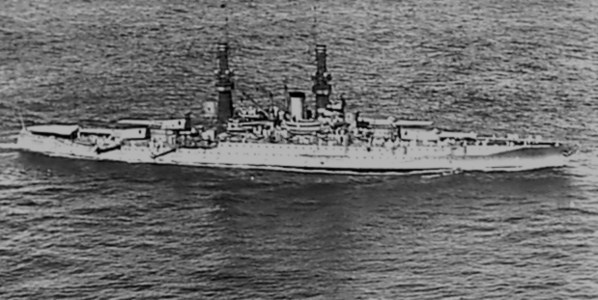
USS NEW MEXICO (BB40) – US Navy’s First All Electric Ship
Circa 1918
All the crew in lifeboats
All the gun magazines expended
All the decoys gone
All the coffee consumed
Every array face and electric weapon hot to the touch
Energy Magazine completely discharged
FUEL TANKS EMPTY!
A “Nobel End” for an Electric Warship having met an Overmatching Threat…

Slide 13
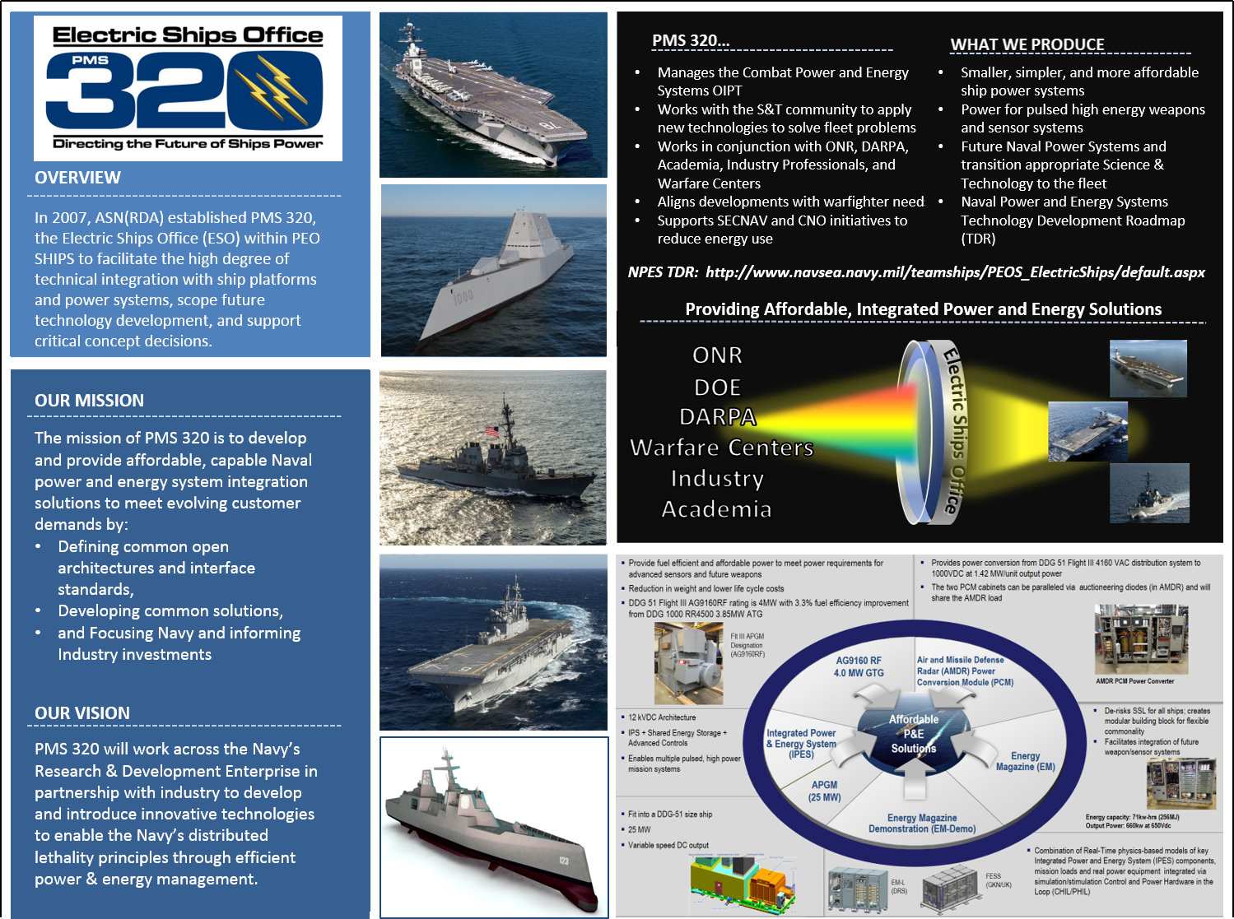



Slide 14
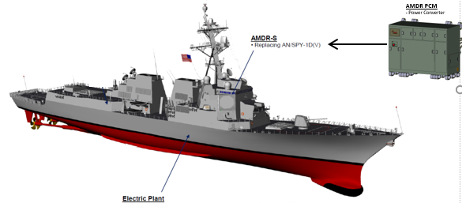
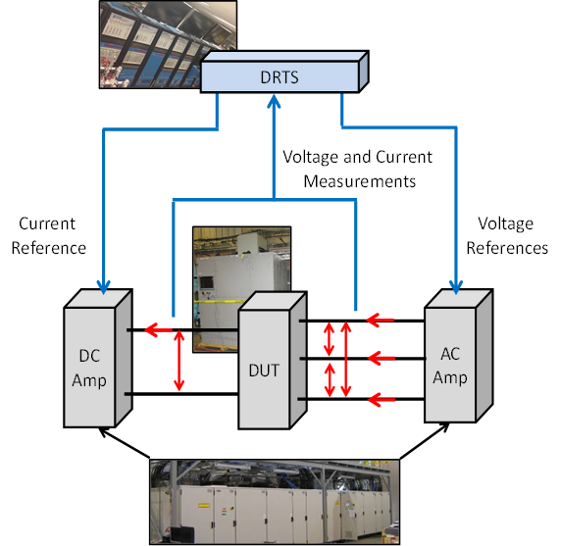
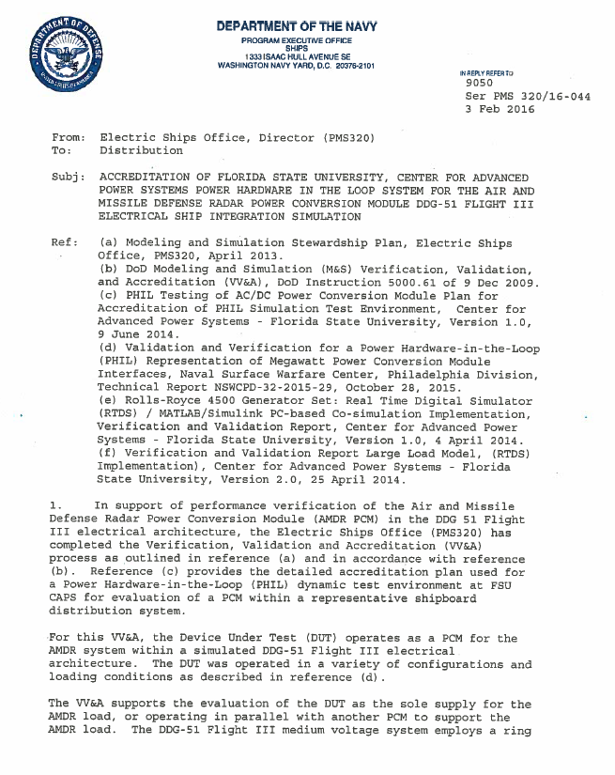
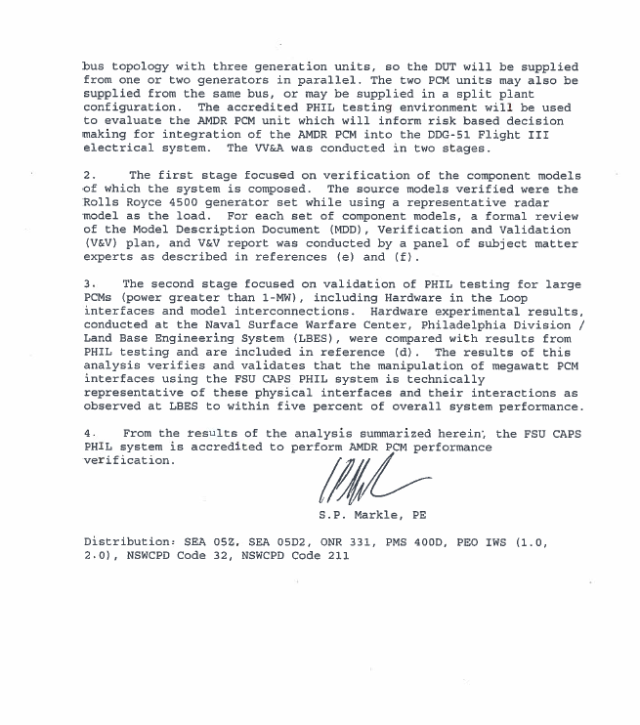
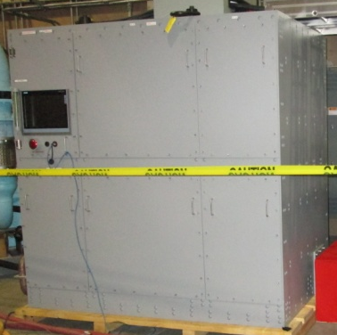
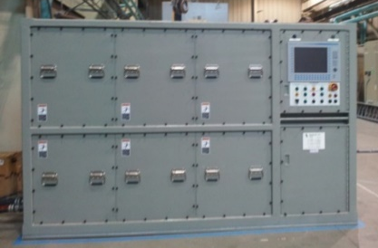
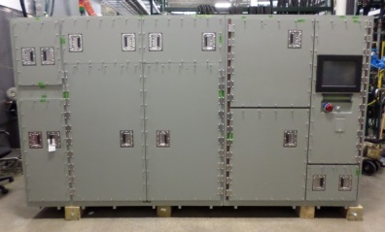
Preparing the Test Bed for DDG51 Flight III AMDR PCM
Verification, Validation & Accreditation Letter Feb 2016
Triton PCM 4 880KW used as surrogate
ONR 331/ PMS 320 (50/50) (Approx. $150K each) to refurbish and set to work @ FSU CAPS
Compact power: tested at FSU CAPS 4th QTR 2014 (3 months)
tested at NSWCPD LBTS 1st QTR – 3rd QTR 2015 (9 months)
Models validated/tested, accreditation letter signed February 2016
AMDR PCM Tested at FSU CAPS, October 2017 (available for test at NSWCPD today)

Slide 15
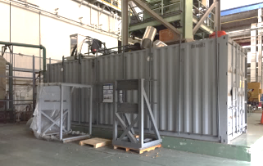

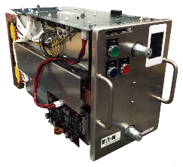
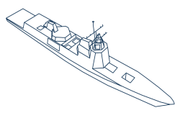

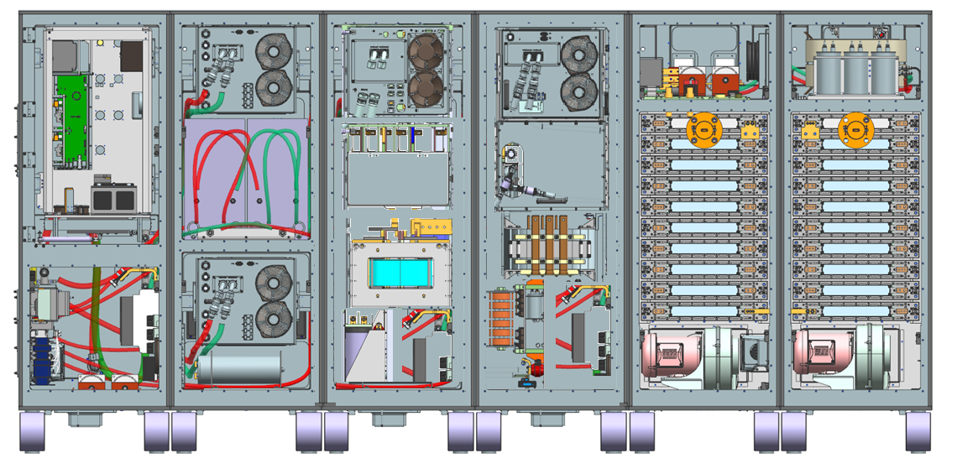
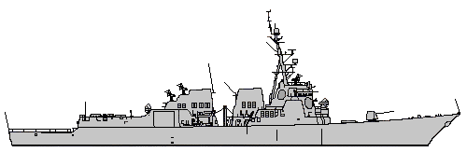
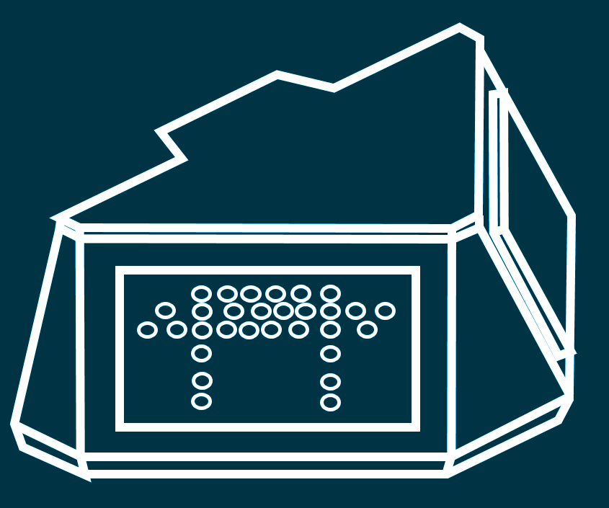

Energy Magazine: PEO Ships Leveraging ONR Investment
Upgrade
Technology
  2013: Energy Storage Module-Land (ESM-L):
  Proof of Concept for SSL-TM Land Demo Testing
  Lead acid battery based technology in 28’ conex box
2019: Multi-function Energy Storage Module (MFESM)
Power Electronics with Hybridized Energy Storage: Batteries + Capacitors
  2018: Energy Magazine Laser (EM-L)
ESM Capability in 1/10 the size with lithium batteries
Supports Laser Engagement Profiles
Upgrade for
Shipboard Use
2021: PEBB Expansion
4160VAC Converter with MFESM Power Electronics Building Blocks
  2019: Energy Storage Module-Ship (ESM-S):
  Second ESM Unit Modified for SSL-TM on LPD 27
  Enables 4 min of SSL operation
  2020: Combined Energy Magazine (EM)
Early Transition of MFESM
Batteries with Energy Magazine Prototype
  2019: Advanced Circuit Protection
  For DC Architectures
Incorporate Ship Readiness
Leverage Investment
Expand
Portfolio
2023 Energy Magazine (2020 BES)
Stores and Provides Energy from Ships Power to Directed Energy Weapons & Sensors
“Reloadable” Magazine for multiple engagements
Energy Magazine
Power Electronics
Energy Storage
19

