Slide 1
Data Science at NPS:
A Proposed Way Ahead for Strategic Planning
9 Nov 17
M. Stefanou
S. Huddleston

Slide 2
Purpose
To solicit your feedback and ideas
for growing NPS’s data science capability
in order to address the data-driven
decision-making needs of Navy and DoD

Slide 3
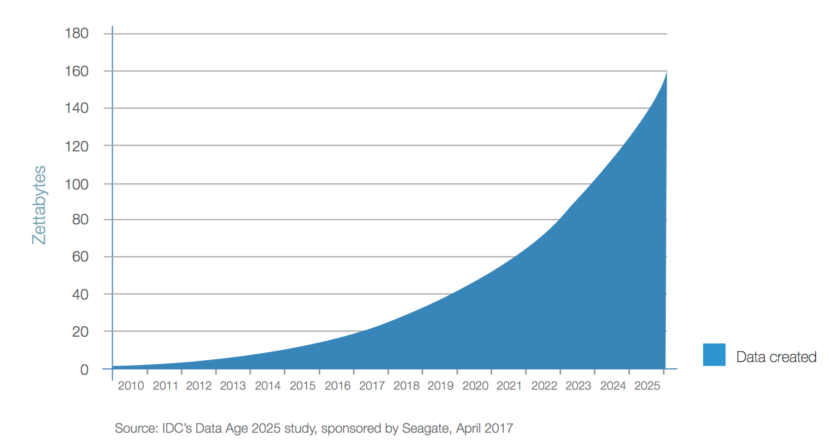
Why is Data Science Strategic?
We are here.
Explosion of sensors = explosion of data
Democratization of access to information/data (loss of advantage)
Data processing is now the bottleneck in situational awareness.

Slide 4
Across DoD, Bosses are Asking for Help in Making Better Decisions
Intelligence
Automated workflows
Predictive analytics
Operations
Readiness effectiveness
Adaptive tactical decision aids
Environmental understanding
Network Defense/Cybersecurity
Anomaly detection
Network traffic pattern recognition
Personnel Readiness
Insights to recruit, train, and retain the best people
Training effectiveness
Healthcare
Forecast patient health indicators for appropriate treatments
Planning, programing, and budgeting
Budget creation and force optimization
Link concepts and illuminate trade spaces
Leverage simulations to analyze program effectiveness
Discover future requirements
Logistics
Supply chain effectiveness
Predictive and diagnostic maintenance
Sparing
Systems Acquisition
Analysis of alternatives and requirements analysis
Design trade studies
Program life cycle cost estimation
Test and evaluation for operational effectiveness
"In an era in which cubesats are being launched into space, and zettabytes of information available, the advantage boils down to not who gets the information, but who can make the better sense of it. Who can orient themselves better, and make the better decision”
- ADM John Richardson, Chief of Naval Operations
68th Current Strategy Forum, 13 Jun 17

Slide 5
Leveraging the Power of ‘Data Science’ has Become a Priority for the Navy as Directed by CNO
Navy Digital Warfare Office (DWO) established February 2017
Main role is “to champion and facilitate smarter uses of data throughout the fleet”
VADM Tighe oversees the DWO
The DWO aims to do this by "bringing data scientists in and then bringing our data together in more coherent way than we have previously structured it to be able to take advantage of the new technologies, artificial intelligence, [and] human-machine teaming"
http://www.smartbrief.com/s/2017/02/navy-digital-warfare-office-aims-tap-data-advances
https://federalnewsradio.com/navy/2017/02/navy-opens-new-digital-warfare-office-aiming-exploit-advances-data-science/
Notes:
The DWO is starting with four pilot projects that will run from Fall 2017 through Spring 2018
https://news.usni.org/2017/10/04/navy-digital-warfare-office-proving-data-analytics-can-help-address-nagging-operational-problems)
An explicit goal of the DWO is to experiment. NPS should be a key facilitator and driver of this experimentation.

Slide 6
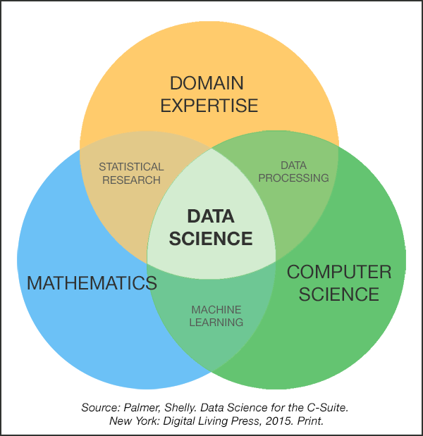
What is Data Science?

Slide 7
Data Science Requires A Mix of Competencies and a Team Approach
Domain Expertise Competencies
Specific functional areas
Influence with leaders
Problem solvers
Create narratives with data
Visual design and communication
Creative, innovative, and collaborative
Data Engineering Competencies
Scripting language (Python)
Statistical computing package (R)
Databases (SQL and NoSQL)
Distributed storage (Hadoop Distributed File System)
Distributed processing (MapReduce)
Cloud computing (Amazon Web Services)
Tool Development
Data pipelines (Pig/Hive)
Math and Statistics Analytical Competencies
Statistical modeling
Machine learning
Bayesian inference
Optimization
Simulation
Network science
Model development
NPS has an opportunity to “set the example” for DoD in how to conduct interdisciplinary data science

Slide 8
Problem Statement
Navy lacks knowledgeable personnel to “do” data science
Data science education requirements for Navy active duty and civilian workforce are unclear
Navy sponsor for data science education remains undefined
Navy lacks expertise to make informed decisions on large scale data science investments
Navy leaders at all levels lack the “know how” to establish data science capabilities within their organizations
NPS is not coordinating efforts to address the inherently cross-domain area of data science education and research
Lost sponsor opportunities
Not fully leveraging expertise across campus

Slide 9
NPS Network of Researchers in Data Science
DA
Everton, et. al (CORE) - large social graphs, Dynamic Twitter Network Analysis, social media exploitation
Warren/Barreto – predicting violent conflict
Porter – maritime dark networks
IS
McKinnon/Zhao/Gallup – Lexical Link Analysis
Miller/Godin/Boger - Navy Tactical Cloud , robots and Marines interaction, Enterprise Engine, Adv Manufacturing initiative
Buettner/Kline/Brutzman - UAV Swarm data, spatial-temporal database, JFEX data store, three dimensional data store
OR
Yoshida – unsupervised methods in tree space
Huddleston – geospatial statistics, crime finance
Whitaker/Buttrey – Twitter data sentiment analysis
Koyak – Using AIS data for maritime domain awareness
Shattuck – F/A-18 & T-45 physiological episode analysis
CS
Beverly/Singh/Gibson/Xie - Traffic analysis in large networks
Irvine - malware signature trending
Berzins – data structures
Rowe/McCarrin – cyberdeception, large-scale digital forensics analysis, natural language processing
Das/Otani – big data platform, data structures
Luqi – orbit determination, cognitive modeling, SATVUL
DRMI
Reigner – MARFORRES Hurricane decision simulator
MOVES
Balogh/Darkin - visualization of large data sets
Kolsch - computer vision, image understanding
ECE
Scrofani - sense-making, maritime domain awareness
Farques/Tummula/Kragh/Pace – machine learning, data mining
PH
Olsen – LIDAR scene understanding, multi-modal remote sensing
OC
Chu – Synoptic Monthly Gridded Global and Regional Data
Guest – Pacific coastal and marine spatial planning
Orescanin – near shore sediment transport
MA
Gara – terrorist network understanding, network topology
ITACS
Hafferman - Data Analytics of Real-Time Streams
GSBPP
Dillard/Pickar – Defense acquisition program data (DAMIR, DAVE)
Thomas – text analysis, OODA loop
SIGS
Jasper - behavior analytics in endpoint security solutions

Slide 10
NPS is Building its Capacity to Deliver Education in Data Science
Operations Research Master’s Degree Data Analytics Track
Established 2015, expanded to be available to all Operations Research students in 2017
>20 graduates/year; focus is on consulting skills
Meet operational needs for formally educated (Master’s degree) ops analysts
Data Science Certificate (NPS Center for Multi-INT Studies sponsorship)
Provide education in the use of data science methods to gain insights from large, complex data sets
4-course, 1-year distance learning sequence drawn from operations research and computer science curricula
First cohort of 19 National Reconnaissance Office employees graduate Sep 2017
Second cohort starts Sep 2017
USMC Analyst Community-of-Interest Short Course (MOVES sponsorship)
11-14 Jul 17, Quantico, VA
25 students in the Marine Professional Analyst Community of Interest
NAVAIR Short Course Series (MOVES sponsorship)
1-day overview of data science for NAVAIR employees at 2 locations/year
2016, 2017 NAVAIR Data Challenges
NPS as venue for team outbriefs
Brownbags and speakers
Notes:
We want certificate holders to be holistic thinkers – so the outcomes need to cover all approaches of dealing with data to processing and evaluating what tools work and when they should be employed
The outcomes show the need to understand the infrastructure for how to do computations on larger data sets, what the analytic tools like machine learning and data mining can and cannot do, how to use them, and how to translate and communicate the results
Our graduates must be able to do things to see patterns in the data as “smart practitioners”, but must also become “smart buyers” of the technologies that industry will sell govt for “doing” data science

Slide 11
(Some) Related Course Offerings
CC4250 Enterprise Architecture
CS/OA 3802 Computational Methods for Data Analysis
CS 3060 Database Systems
CS 4315 Intro to Machine Learning and Data Mining
CY 3650 Cyber Data Management and Analytics
DA 3450 Open Source Data Analysis
DA 3610 Visual Analytics
EC 3460 Intro to Machine Learning for Signal Analytics
EC 4747 Data Mining in Cyber Applications
GB 3040 Business Statistics and Data Analytics
IS 4205 Big Data Management, Architecture, and Applications
IS 4301 Data Warehousing, Data Mining, and Visualization
MN 4110 Multivariate Manpower Data Analysis I
MN 4111 Multivariate Manpower Data Analysis II
MN 3040 Data Management and Statistics of Manpower Analysis
MR/OC 3140 Probability and Statistics of the Air Ocean Sciences
MR/ OC 3150 Analysis of Air/Ocean Time Series
MR3220 Meteorology Analysis
OC 2902 Fundamentals of Geospatial Information and Services
OC4325 METOC for Warfighter Decision Making
OC 3030 Oceanography Computing and Data Display
OA3802: Computational Methods for Data Analytics#
OA 3103 Data Analysis
OA 3604 Statistics and Data Analysis
OA 4106 Advanced Data Analytics
OA 4108 Data Mining
OA 4118 Statistical and Machine Learning
OA4105: Nonparametric Statistics
OA4910: Case Studies in Analytics
SE/IS 3201 Enterprise Data Management Systems
SS 3101 Ground system and Mission Operations

Slide 12
Proposed Vision for Data Science at NPS
To coordinate and focus the unique talent, infrastructure, relationships, and geography of NPS
in order to provide an educational platform, research programs, and advisory services to organizations within the Departments of the Navy and Defense that seek to gain insights from data.

Slide 13
Four Lines of Effort to Realize the Vision
Education – Expand certificate programs (distance learning and resident) and tracks within existing resident curricula
Impact: Graduates serve as members and leaders of data science teams in the Fleet
Research – Coordinate research efforts across campus to focus on relevant data science problems and provide value-add for individual NPS PI’s to use data science in their research
Impact: Student theses and capstone projects address relevant sponsor problems and allow graduates to take insights back to the Fleet
Impact: NPS dataset curation and transparency lead to more efficient research efforts for PI’s and less “reinventing the data engineering and analytics wheel”
Service – Sponsored research leads to close collaboration with DoD partners, making NPS an “honest broker” in data science capability
Impact: Guide DoD organizations in making decisions about data science investments and help leaders create data science capabilities
Coordination – NPS adopts a strategic approach that aligns efforts across campus
Impact: Provide the right education solutions for the Navy workforce
Impact: Connect PI’s with the right data engineering and analytic expertise to increase productivity in responding to sponsor needs with high quality research outcomes

Slide 14
Tangible Next Steps
Coordinate NPS data science efforts
Strengthen the existing network to coordinate data science education, research, and outreach efforts across campus by 3Q FY18
1 FTE for Director
1 FTE for Data Engineer
Physical central location for the NPS data science network
Compute/storage/network infrastructure solution(s) for data set curation
Establish sponsor foothold
Obtain OPNAV vector for NPS role in education of active duty and civilian DON workforce
Expand NPS-NAVAIR agreement to offer Data Science Distance Learning Certificate for NAVAIR workforce in FY19
Build faculty talent
Initiate hire of specialized data engineering and data analytics faculty in GSOIS, GSEAS, and GSBPP

Slide 15
We Believe that Coordination in Data Science Requires Strategic Investment
Vision (do we want to be the Navy’s thought leader?)
Resources (the needs go beyond any single current funding source)
Identity (we need a point of contact on campus for internal/external; we need to speak with one voice)
Functional Form (there are many possible forms this coordination could take)
Relevance (Retain flexibility to experiment and innovate, while still being able to “answer the mail” from DON and DoD)
Value Add (must provide a tangible benefit to faculty across campus)

Slide 16
Questions
Website https://my.nps.edu/web/data-sciences
Contact Information
Marcus S. Stefanou, Ph.D., Col, USAF (Ret)
Assistant Professor
Computer Science Department
Naval Postgraduate School
Glasgow Hall East, Rm 332
NIPR: msstefan@nps.edu
JWICS: Marcus.S.Stefanou@coe.ic.gov
Office: 831-656-3316
Cell: 703-346-5069
Webpage: http://faculty.nps.edu/msstefan/

Slide 17
Backup

Slide 18
Proposed NPS Data Science Lines of Effort (LOE)
Current Efforts
a
Decide NPS strategic direction
LOE #1: Education
b
Define DON data science education requirement and NPS role
Distance learning certificate
OR analytics track
Individual courses
Short courses
Expand Distance learning certificate
Expand short courses and executive education
Offer resident certificates
Offer degrees
c
c
c
c
c
c
c
c
c
c
c
c
c
c
c
c
c
c
c
c
c
c
c
c
c
c
c
c
c
c
c
c
c
c
c
c
c
c
Conduct monthly data science forum
d
Initiate 3 data science faculty hires
LOE #2: Research
Individual sponsored projects
“Stovepipes of excellence”
Individual compute clusters
Early AWS contract
Coordinated research thrusts
Annual funded research opportunities
Multi-year research portfolios
e
Recruit Director and data engineer
LOE #3: Service
f
Decide on organizational structure
g
Conduct site visits to data science centers
h
Hire 3 – 5 postdocs to support data science research
Review data science aspects of DoD programs
i
Optimize contract vehicle for on-demand cloud compute
k
Determine research thrusts
Trusted agent for DoD
l
Hire PM and admin support
LOE #4: Coordination
FY17
FY18
FY19
FY20
FY21
FY22
FY23

Slide 19
(Some) NRP Topics FY14-17

