Slide 1
3D Printing in the RoboDojo
Captain Matt Audette
Aug 2017
mraudett@nps.edu

Slide 2
Topics Covered
History
Basic Overview
Types of printers
Ultimaker 2
Printing on the Ultimaker 2
Best practices

Slide 3
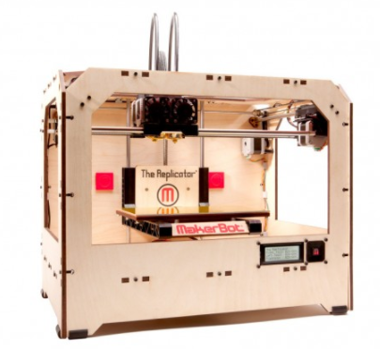
History
“Additive manufacturing”
“Rapid prototyping”
First developed in the mid 80s
2007- first commercial system under $10,000, “RepRap” movement and open source
2009- first commercially available kits
BfB RapMan and MakerBot “Replicator”

Slide 4
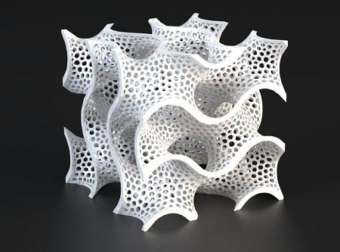
Uses
Rapid prototyping
Complex, non-machinable shapes
Less material used
Tools and internals printed all at once (eg. ratchets)
Deals in bits and bytes
Small batch manufacturing
“Hyper Local Manufacturing”
Societal impacts

Slide 5
Uses

Slide 6
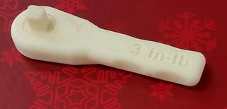
Uses

Slide 7
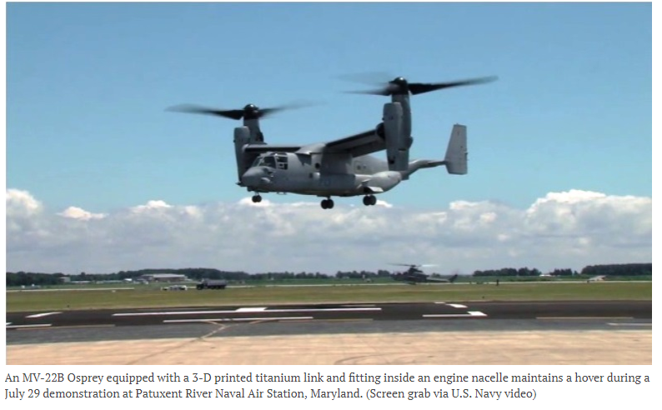
Military Use -Update
Air Force/plastic clips
USMC field testing
Nibbler
Osprey ($900,000)
EOD/innovation challenge
http://www.military.com/daily-news/2016/09/29/marines-conducting-tests-with-3d-printed-munitions.html

Slide 8
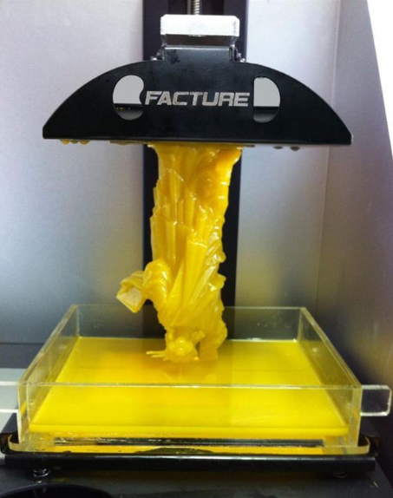
Types of Printers
SLS- Selective Laser Sintering
SLA- Stereolithography
FFF- fused filament fabrication
FDM- Fused Deposition Modeling

Slide 9
Selective Laser Sintering
Oldest type
Photoreactive powder and lasers
Large, expensive machines
Messy and difficult to engineer
Only just becoming commercially available
Why? // metal printing Video:
https://www.youtube.com/watch?v=cNGdGC5SCKg

Slide 10
Stereolithography
Photoreactive resin liquid
High quality prints
Used my professional prop and model makers
Longer prints vs FFF
More expensive printers, consumables

Slide 11
Fused Filament Fabrication
Us!
Thermoplastics layered
“Hot glue gun”
Cheapest printers
Cheapest materials w/ widest variety
PLA, ABS, rubber, nylon, wood
Lowest quality prints
RepRap movement
Kits
Prusa i3 Kit Printer

Slide 12
Parts
Extruder
Single vs dual Update
Diameters of filament
Motors, fans
Feed mechanism
Push vs pull
Shroud/enclosure
With, without
Print bed
Heated vs non heated
Input port
Tethered vs nontethered

Slide 14
Printable Materials
PLA
Lower temperature resistance
Less heat warping
Weaker plastic, more rigid
Greater variety of colors
Higher printing speeds, smaller layers, sharper corners
Cheaper
Hobbyist preferred
ABS
Higher temperature resistance
“Curls” easier, heat warping
Strong plastic, more flexible
Soluble in acetone – “welding”
Somewhat machinable
Slight smell
Requires heated bed
Engineer preferred

Slide 15
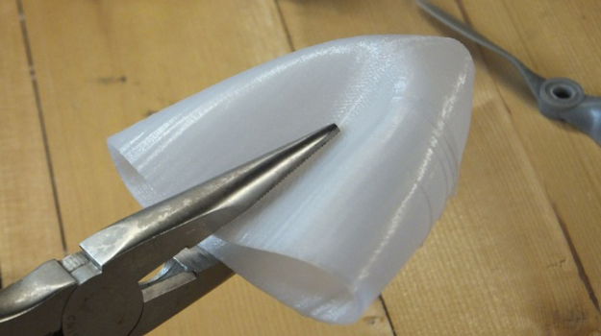
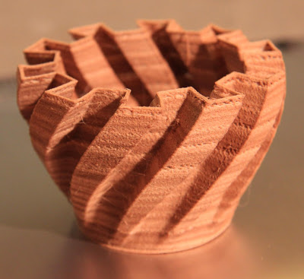
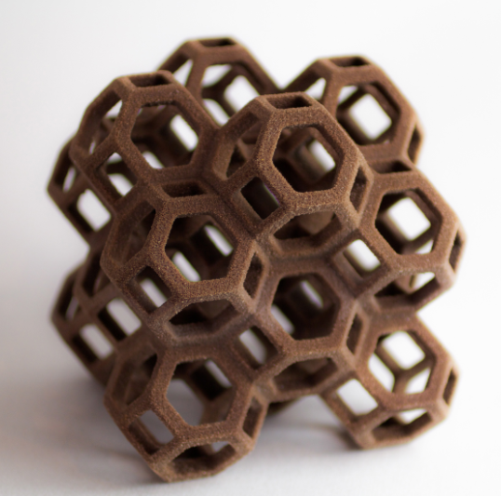
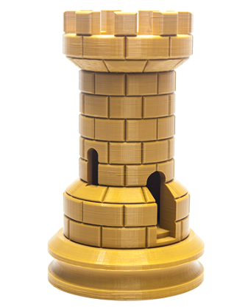
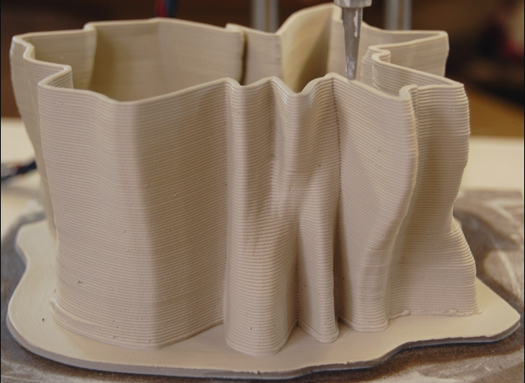
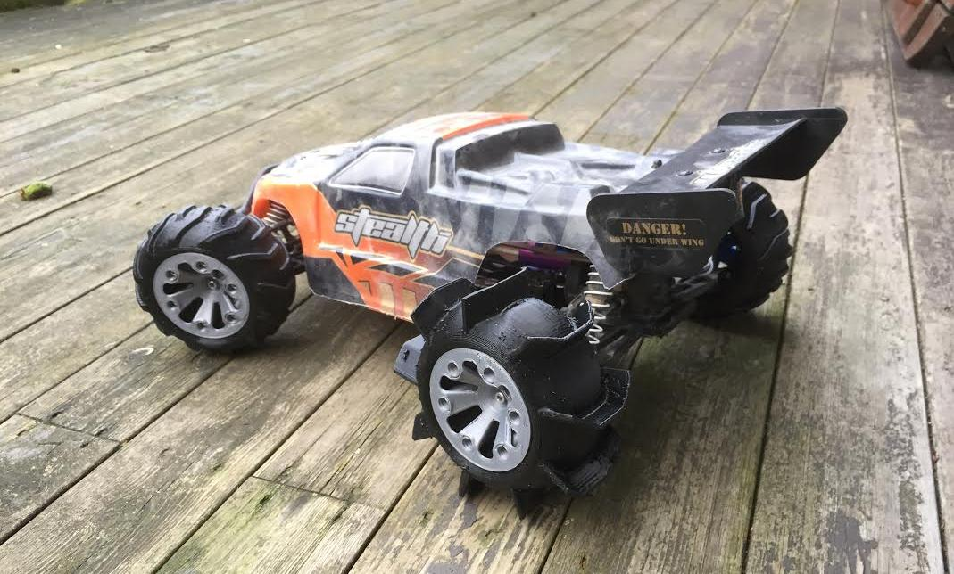
Exotic Materials
Wood
Nylon
Rubber
PET-G
PVA
Sandstone
Clay
Chocolate
Plastic Explosives (LLNL)
Brass/Copper

Slide 16
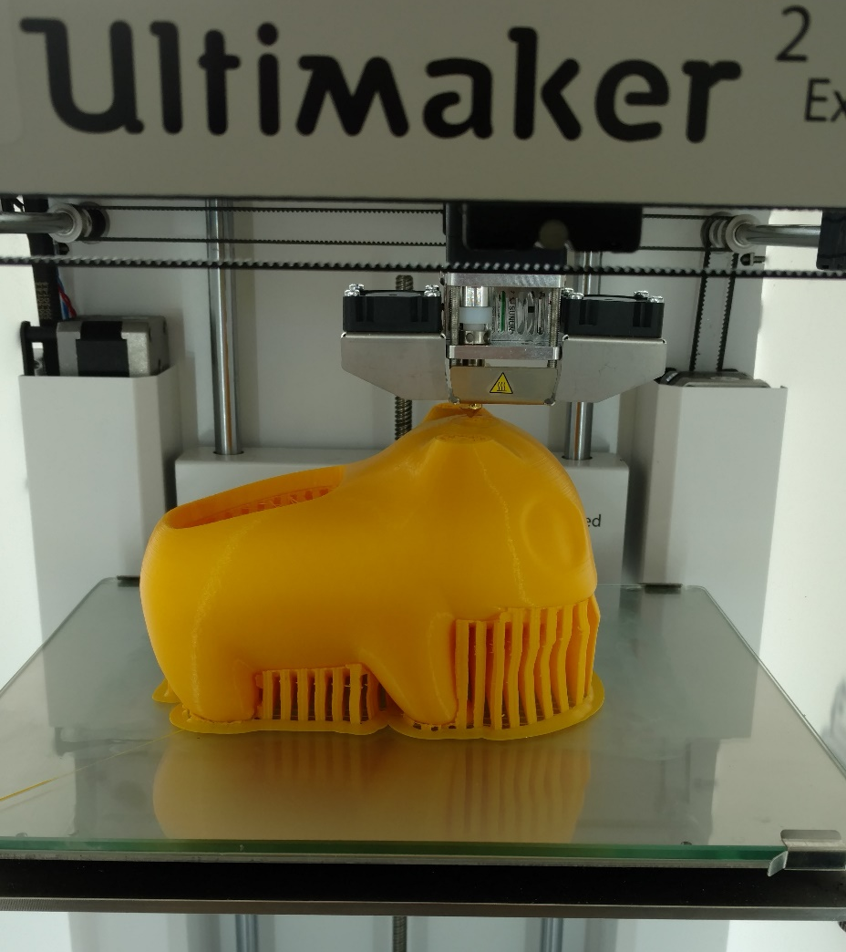
Characteristics of 3D Prints
Hollow- infill
“honeycomb”
Overhangs
Automatic in Cura

Slide 17
Printing
Ultimaker 2+
3d Models
G-Code and Cura
Loading files
Printing
Changing Settings
Calibrating the Ultimaker
Changing Materials
Best practices

Slide 18
Ultimaker 2+
Universally good reviews
Performance vs cost ($2,000)
Ships assembled
Prints right out of the box
Stand alone
Reliability/Ease of use
Support
Non-proprietary materials

Slide 19
Steps to Printing
3D Model
SolidWorks, SketchUp, Maya, Fusion 360
Thingiverse
Generate G-Code
Line by line instructions for printer
“Slicer” program
Sometimes proprietary
Cura for Ultimakers (.stl files)
Set print settings: layer height, infill, brim/skirt/raft
Send files to the printer
Tethered, SD card, USB
Watch, adjust, wait

Slide 20
Print Settings in Cura
Running theme:
time and material vs quality of print!
tailor to your specific need!
Layer height:
smaller = better resolution, more time to print
.1mm = “normal” resolution, .06mm = “high” resolution
% Infill:
Higher = stronger print, more material used, more time to print
Model Orientation
Position on bed
Model scale

Slide 21
Cura
“Slicing software”
Translates 3d models to G-code
Takes .stl files

Slide 22
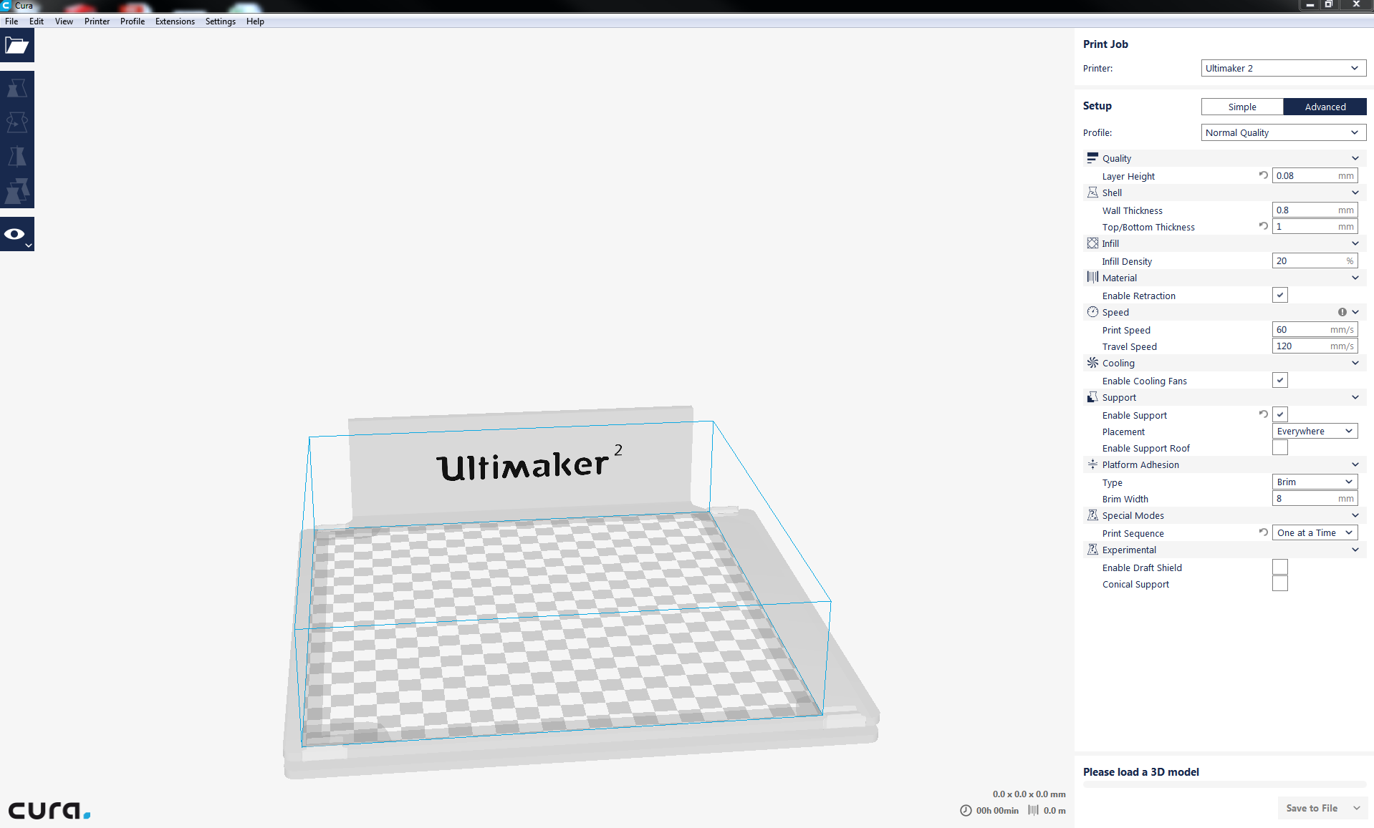
Select Printer
Open .stl files
General Tip:
Mouse over for details
Simple/Advanced
settings
Scale,
Time to print, Materials
“Save to SD Card”

Slide 23
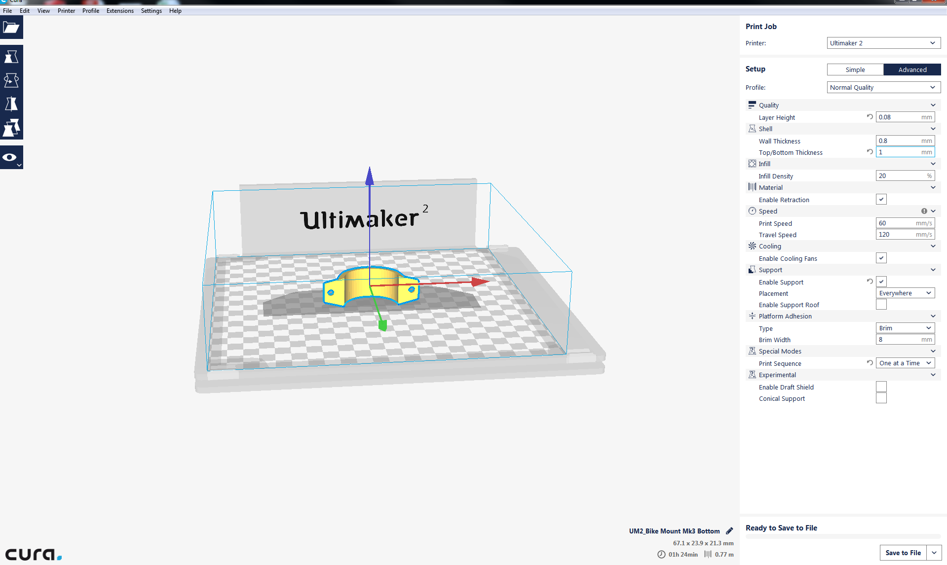
Scale
Movement Arrows
Notice Changes
“Print head shadow”

Slide 24
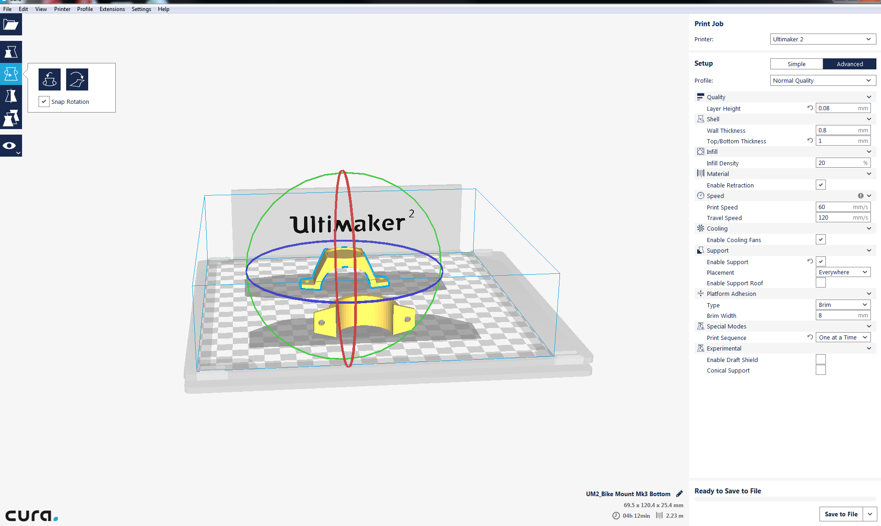
Rotate
Snap rings for X, Y, Z axes
Rotated models snap to print surface
Printerhead shadow affect placement

Slide 25
Mirror
Individual model settings
Views: Solid, Xray, Layers

Slide 26
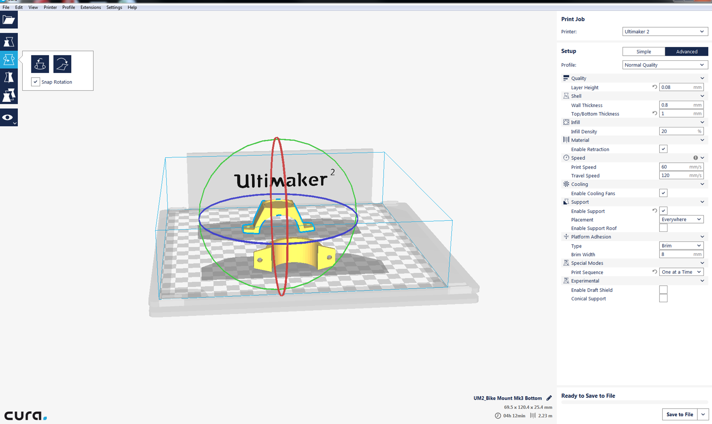
Things to change
Layer Height
.1mm low res
.06mm high res
Infill density
(20% is par)
Support
(Everywhere vs Touching build plate)
Platform Adhesion
-Brim (set width)
-Skirt
-Raft (setings)
Print Sequence
-One at a time vs all at once

Slide 27
Things to not touch
Always enable retraction
Speed (Default is fine)
Enable cooling fans (can change during print)
Experimental

Slide 28
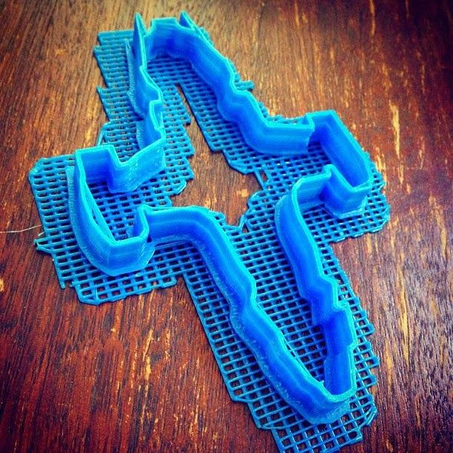
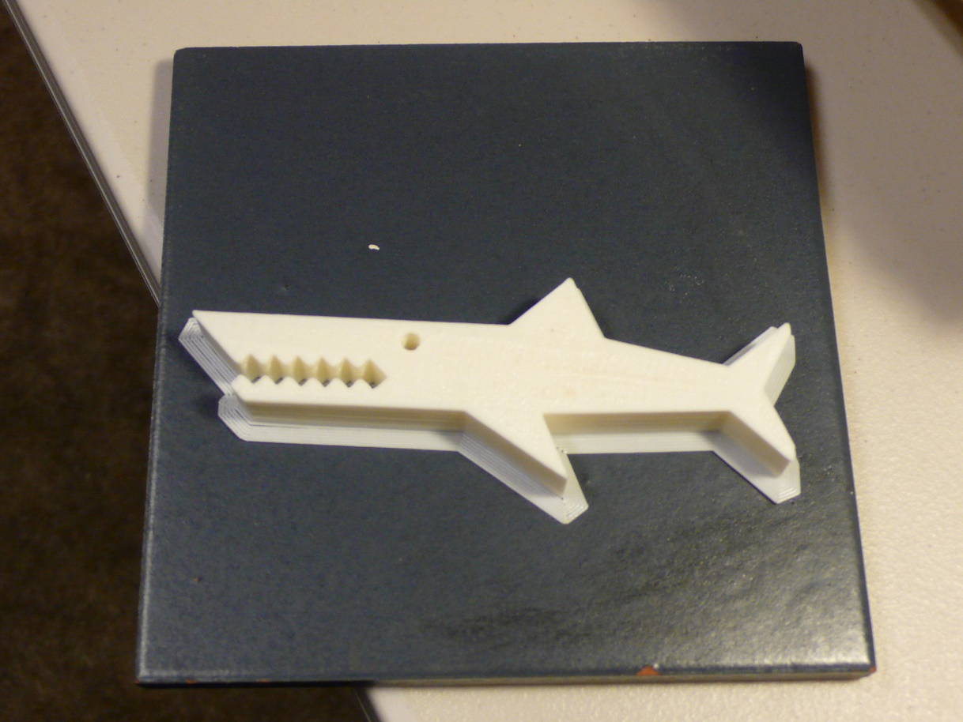
Skirt vs Raft vs Brim
Skirt
Outline, does not touch part
“Primes” extruder before print
Minimal adhesion, shorter print time, less material
Brim
Concentric outlines of part
Touches part
Middle ground
Good adhesion (ABS)
Raft
Platform/latticework
Stabilize models with narrow footprints
Maximum time, material, adhesion

Slide 29
Changing Print Settings
During print: “Print Settings”
Extruder temperature
( 210 deg PLA, 250 ABS)
Bed temperature
( 60 deg PLA, 100 deg ABS)
Fan speed
Tips:
Personal print log
Observe previous prints
If the print before yours sucked, yours will too!
Adjust based off of theirs
Default: don’t touch it unless it needs fixing!

Slide 30
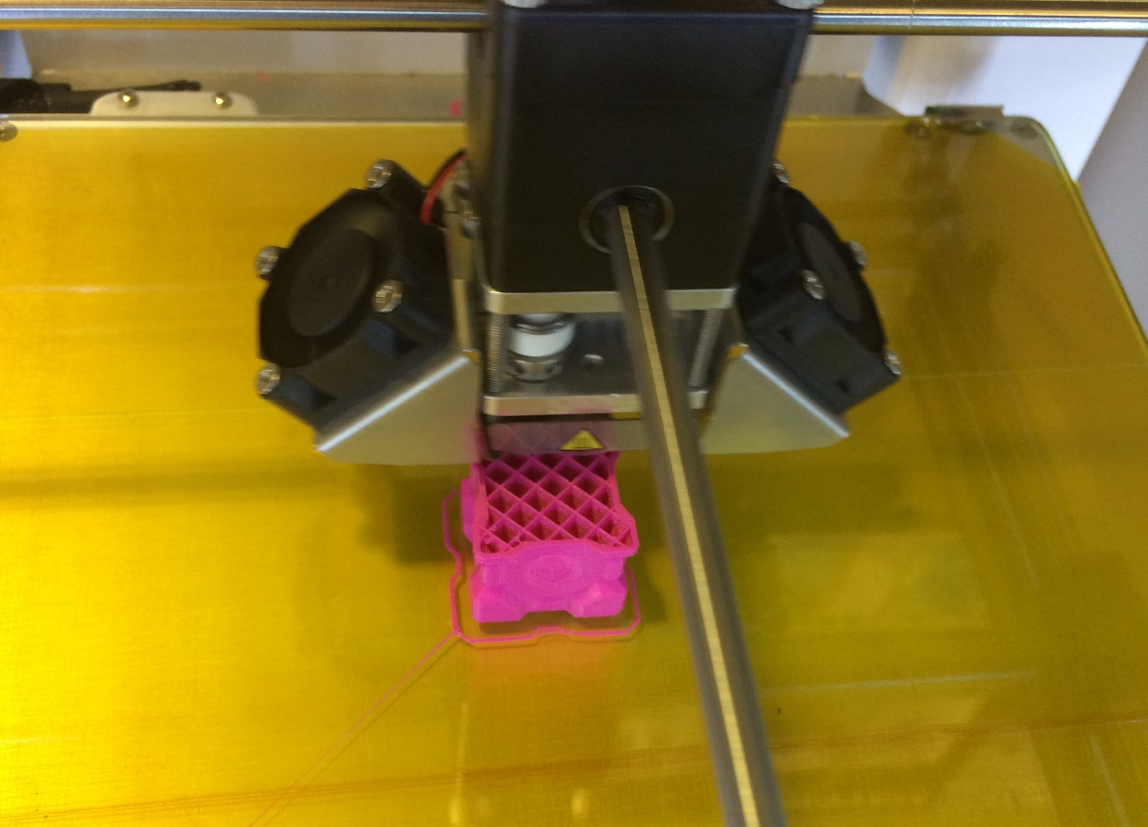
Adhesion
Hedging bets to make our prints stick
Lots of tools in the toolbox:
Glue stick
Painter’s tape
Awesomely wide masking tape
White glue (tacky)
PEI sheets
Jell-o

Slide 31
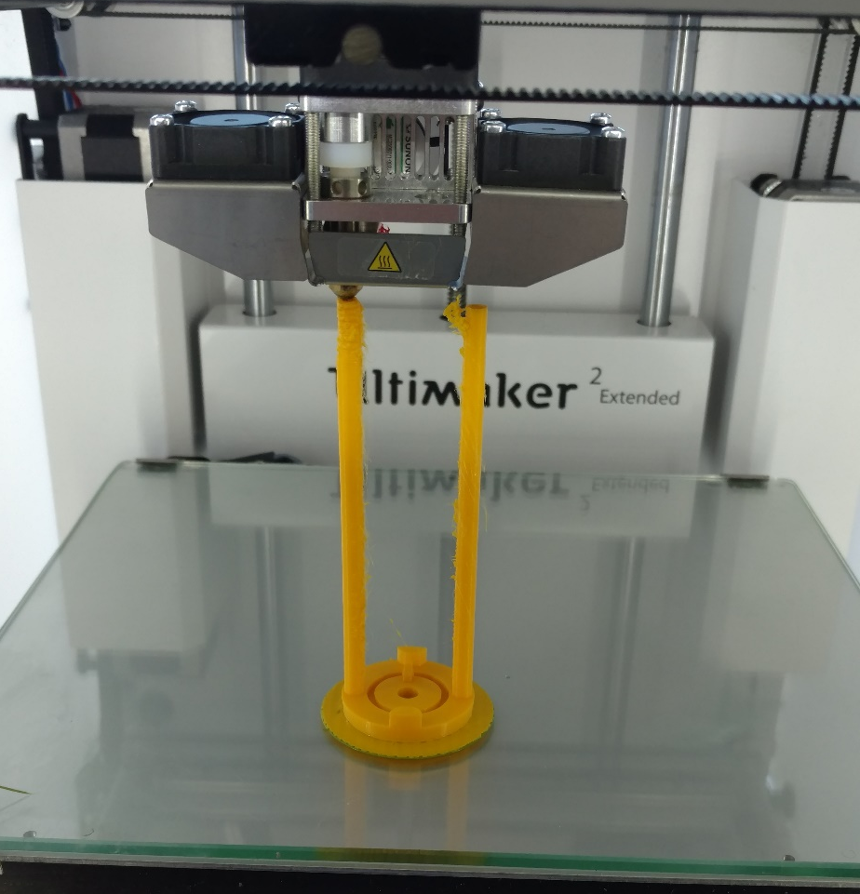
Best Practices
“Test shot” before long prints
Catan house, earring
“Can I?” vs “Should I?”
Reinventing wheels that are commercially available
Right tool for the right job
Laser cutter
CNC
Hardware stuf
Boxes

Slide 32
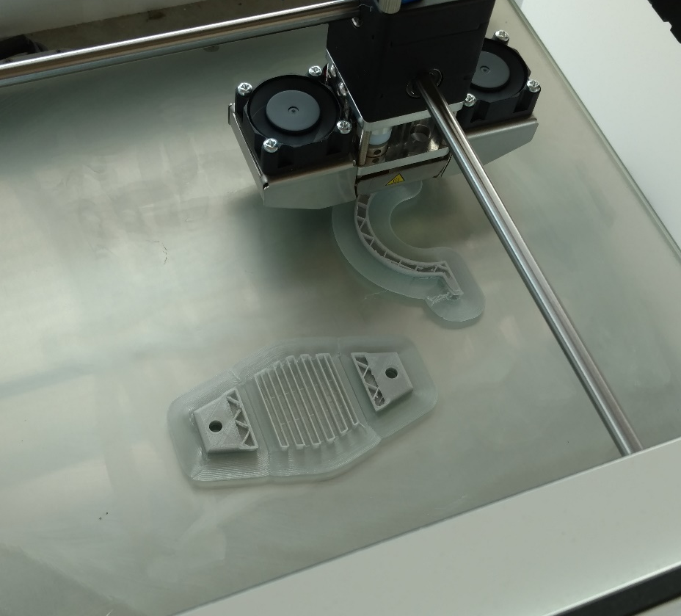
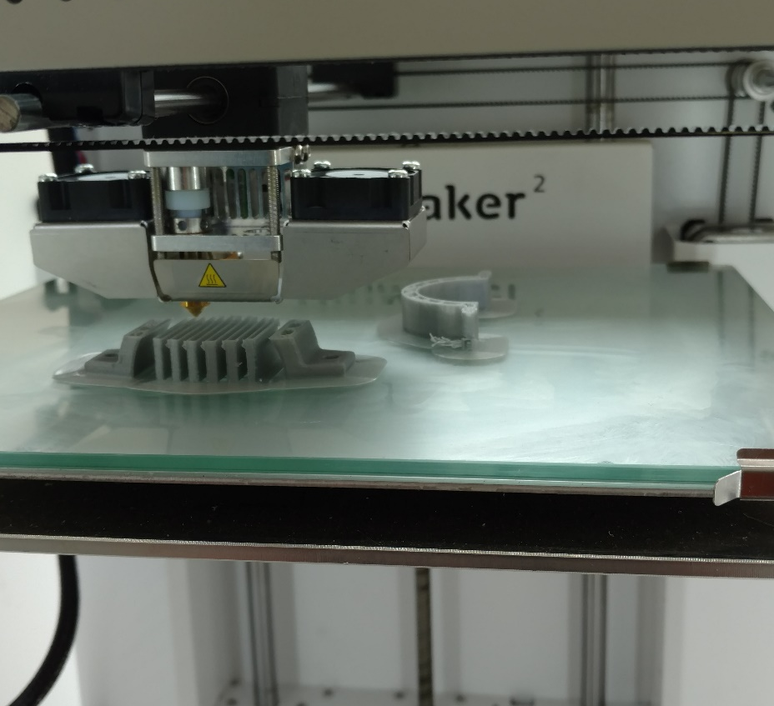
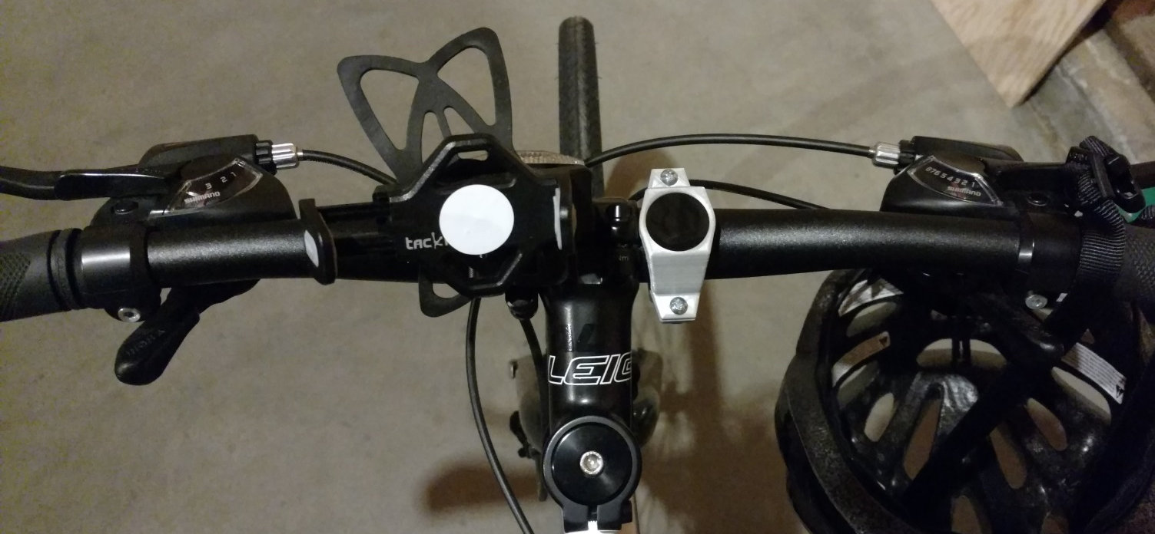
Best Practices
Print models one at a time!
In Cura
Faster prints
Failures in prints means losing part, not all
Model positioning in Cura
Widest part down
Check your spool!
Never wrap filament over itself
Check remaining amount

Slide 33
Best Practices
Break up complex models
Higher success rate
netFabb- free software
Finishing your prints
Paint/sanding goes a long way
Primer filler
Supplement with hardware/other materials
Clean up the printer

Slide 34
Changing Materials
On printer:

Slide 35
Calibrating the Ultimaker 2+

Slide 36
Further Reading/Watching
I Like to Make Stuff: Hobby level tutorials http://www.iliketomakestuff.com/category/3dprinting/
Punished Props: In depth tutorials, blueprints, and finshing how tos: http://punishedprops.com/3d-printing/
Splitting .stl files: http://www.3dprintmd.com/print/split-an-stl-from-the-thingiverse-into-multiple-objects/
Video tutorial: https://www.youtube.com/watch?v=6rostD8O5sg

Slide 37
References
https://3dprintingindustry.com/3d-printing-basics-free-beginners-guide/history/
http://makezine.com/2016/09/15/myanmars-farmers-are-3d-printing-their-own-tools/
http://makezine.com/2013/10/18/3d-printing-umbilical-cord-clamps-in-haiti/
http://www.technologist.eu/the-rise-of-open-source-prosthetics/
https://www.nasa.gov/mission_pages/station/research/news/3Dratchet_wrench
http://www.protoparadigm.com/news-updates/the-difference-between-abs-and-pla-for-3d-printing/

Slide 38
References: Videos
SLA Form 1+ : http://www.iliketomakestuff.com/3d-printing-with-the-form-1-sla-printer/
https://www.facebook.com/MARCORSYSCOM/videos/vb.179229838801763/1482358698488864/?type=2&theater

Slide 39
Notes
Pull up Thingiverse
Pull up Cura
Printer, study aides, filaments, tools
Start test print
Websites:
Videos
Punished Props
Maker’s Muse
I Like to Make Stuff

