Slide 1
Applied Risk Analytics: Making Advanced Analytics More Useful
Tony Cox
tcoxdenver@aol.com
NPS
August 4, 2016

Slide 2
Traditional prescriptive analytics
Standard decision problem: Choose x ∈ X to maximize objective function f(x)
  x = decision variable (control vector, trajectory, policy mapping information to action, etc.)
    May be distributed over multiple collaborating agents
  X = choice set
    Possibly specified by constraints, hard to search
Typically, f(x) = EU(x) = expected utility of decision x
  Possibly evaluated via Monte Carlo

Slide 3
In slightly more detail…
Pr(c | x) = probability of receiving consequence c if we do x
  c is a member of consequence set C
  Pr(c | x) is a risk model
    Fine print: Pr(c | x) is not really a conditional probability, because x is an act, not an event
u(c) = utility of consequence c
EU(x) = Σ_{c ∈C}u(c)*Pr(c | x)

Slide 4
Challenges
EU(x) may be uncertain or unknown or may be different for different agents
  Unknown consequence probabilities, Pr(c | x)
    How to estimate from data?
  Uncertain consequence set, C (“Black swans”)
  Uncertain choice set, X
    What constraints hold? How hard or soft?
  Uncertain values, u(c)
    Problems with multiple interacting agents
Even for known EU(x), maximization problem may be hard (or impossible)

Slide 5
Causal analysis challenge
What to do next when consequences of alternative decisions are uncertain?
  Known probabilities → EU theory
    Known risk model: Pr(c | x)
    Known probabilities of different risk models
  Unknown probabilities → ?

Slide 6
Decisions with unknown models
Learn causal model(s) from data/experience, then use them to optimize decisions
  Design of experiments (DOE)
  Randomized control trials (RCTs) and practical PCTs
  Learn from natural experiments, quasi-experiments
Learn decision rules from data
  Adaptive learning: trial and error, low-regret learning
Robust optimization
  Find decisions that perform well no matter how uncertainties are resolved

Slide 7
Applied risk analytics toolkit: Toward more practical analytics
Goal: Discover how to act more effectively
Descriptive analytics: What’s happening?
Predictive analytics: What’s coming next?
Causal analytics: What can we do about it?
Prescriptive analytics: What should we do?
Evaluation analytics: How well is it working?
Learning analytics: How to do better?
Collaboration: How to do better together?

Slide 8
Descriptive analytics:
What’s going on?
What is the current situation?
  Attribution: How many people per year are being killed (or harmed) by X?
    Causes are often unobserved or uncertain
What has changed recently? (Why?)
  Example: More extreme event reports caused by real change or by media?
  Change-point analysis (CPA) algorithms
What should we worry about?
  How is this year’s flu season shaping up?

Slide 9
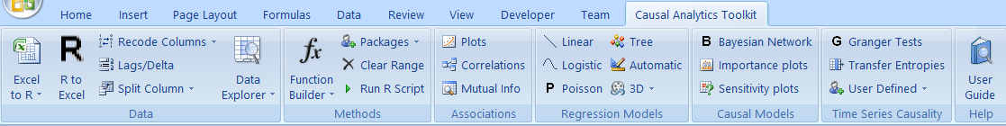
Causal Analytics Toolkit (CAT) software facilitates analysis

Slide 10
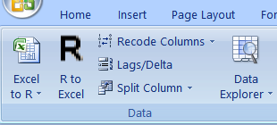
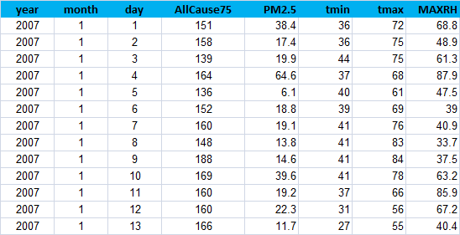
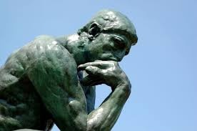
CAT uses data in Excel
Load data in Excel, click Excel to R to send it to R
  Los Angeles air basin
  1461 days, 2007-2010 (Lopiano et al., 2015, thanks to Stan Young for data)
  PM2.5 data from CARB
  Elderly mortality (“AllCause75”) from CA Department of Health
  Daily min and max temps & max relative humidity from ORNL and EPA
Risk question: Does PM2.5 exposure increase elderly mortality risk? If so, how much?

Slide 11
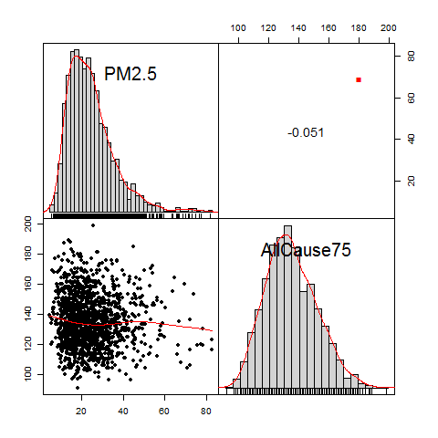
Using CAT to examine associations: Plotting the data
Send data from Excel to R
  Highlight columns
  Click on “Excel to R”
Select columns to analyze
  Click on column headers
  Cntrl-click toggles selection
Click on Plots to view frequency distributions, scatter plots, correlation, smooth regression curves
  PM2.5 is slightly negatively associated with mortality

Slide 12
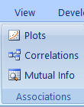
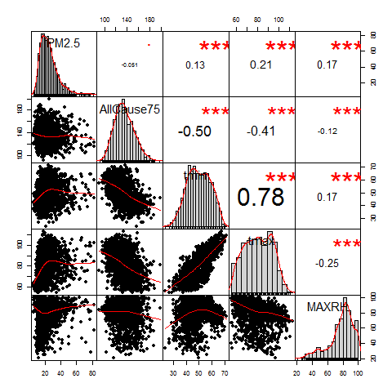
Using CAT to examine associations: Plotting more data
Send data from Excel to R
  Highlight columns
  Click on “Excel to R”
Select columns
  Click on column heads
  Cntrl-click toggles selection
Click on Plots to view frequency distributions, scatter plots, correlations, smooth regression curves
  Temperature is positively associated with PM2.5
  Temperature is negatively associated with mortality,

Slide 13
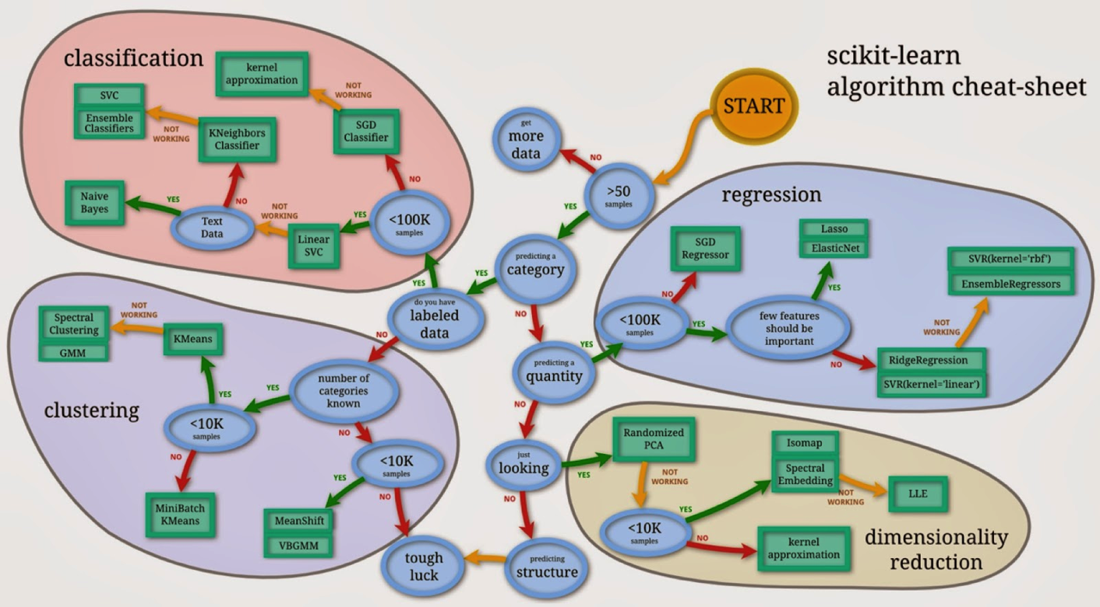
Standard machine learning (ML) tools for descriptive analytics
http://scikit-learn.org/stable/tutorial/machine_learning_map/index.html

Slide 14
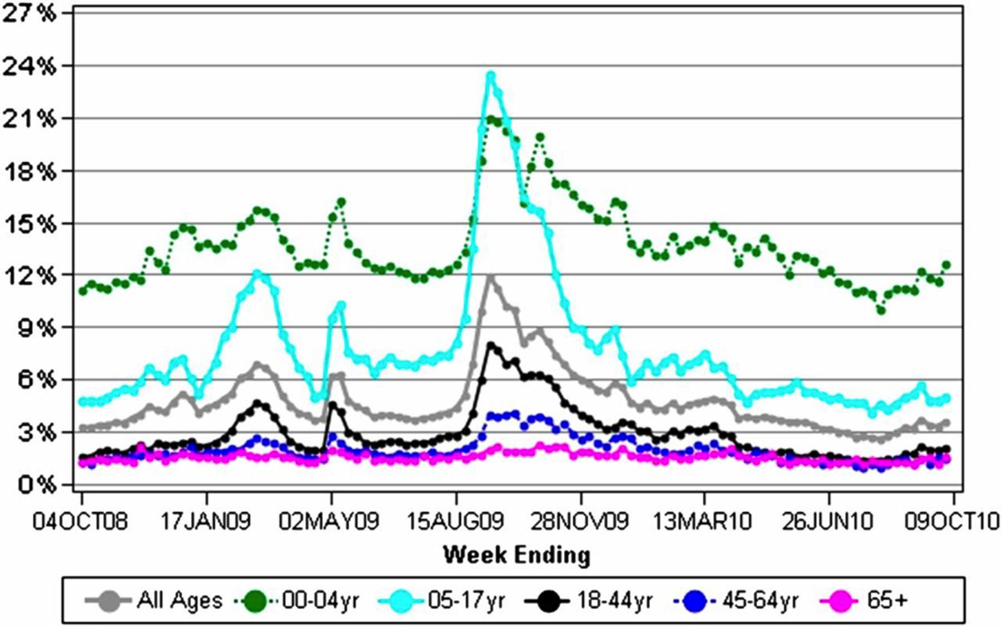
Example: How quickly can a change be detected/used for planning?
http://jamia.oxfordjournals.org/content/19/6/1075

Slide 15
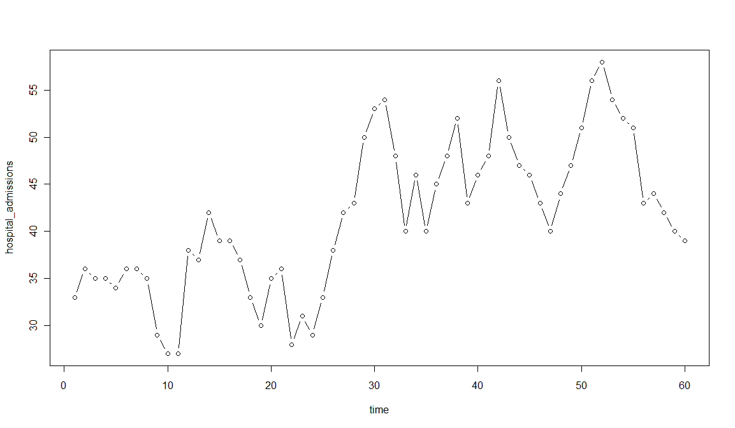
Example: Did time series change? If so, when?
Surveillance time series showing a possible increase in hospitalization rates

Slide 16
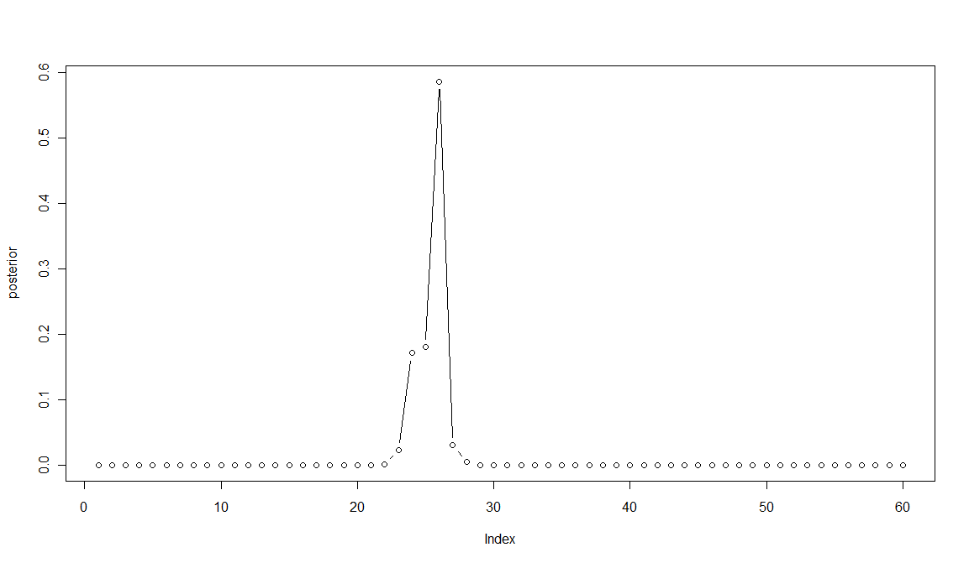
Output from simple likelihood-based CPA algorithm
Data
Posterior distribution for time of change. (Algorithm also estimates size of change)

Slide 17
Algorithms for finding what has changed
Change-point analysis (CPA)
  Basic idea: Search for most likely explanation of observed data
  Provides estimates of
    Times of changes
    Sizes of changes
    Confidence intervals and levels provided
Recent breakthroughs in CPA algorithms
  Model-free CPA using order statistics
  Multiple time series

Slide 18
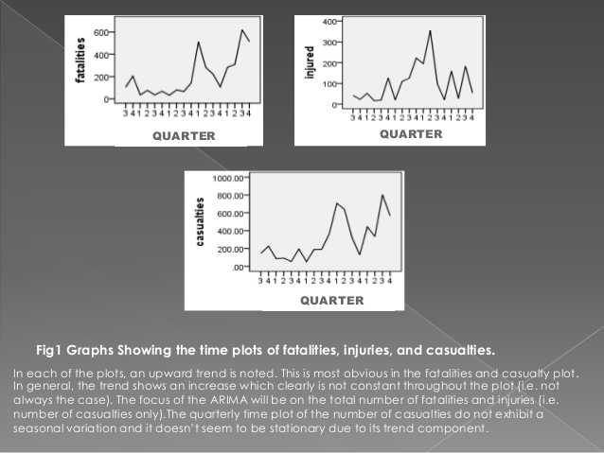
Predictive analytics
What will happen if we do nothing?
How sure can we be?
Example: Black-box ARIMA forecasting of losses due to terrorist attacks
http://www.slideshare.net/VictorOdutokun/arima-analysis-project-slide

Slide 19
Example: Forecasting flu cases
How many, how soon, for how long?
http://jamia.oxfordjournals.org/content/19/6/1075

Slide 20
Predictive analytics challenge: Different models make different predictions for case 7
Model 1: Outcome = Predictor 3
Model 2: Outcome = majority(Predictors 2-4)

Slide 21
Predictive analytics techniques
Forecasting: Pr(future outputs | past)
Regression: Pr(output | covariates)
Dynamic simulation: Pr(Δoutputs | Δinputs)
Bayesian networks (BNs): Joint PDF
  Inference: Pr(outputs | observed inputs)
    Monte-Carlo and exact inference algorithms
    Structure learning and ensemble learning algs
  Dynamic Bayesian Networks (DBNs)
    Kalman filtering and extensions
    Particle swarm optimization

Slide 22
BN learning

Slide 23
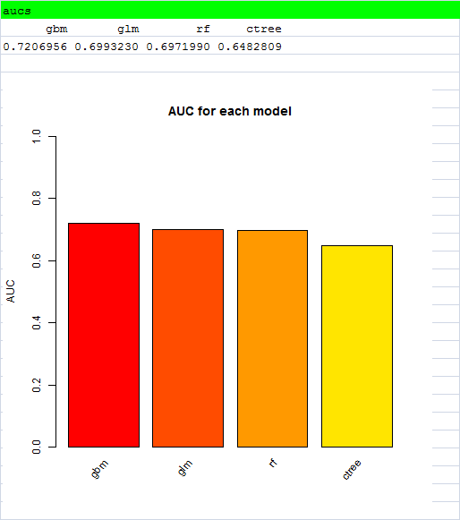
Breakthroughs in predictive analytics
Averaging predictions from multiple models improves predictions!
  More accurate, less bias, more precise (lower error variance), less over-confidence (fewer type 1, type 2 errors)
Ensemble methods improve forecasts
  Random forest (rf)
  Gradient boosting (gbm)
  Cross-validation, BMA
  Super-learning

Slide 24
Causal analytics
Causal model:
  Pr(outputs | input actions)
  Pr(c | x)
    Not BN inference, Pr(output | input observations)
How will future consequence probabilities change if we make different choices?
How do actions affect probable outcomes?

Slide 25
Causal analytics techniques
Causal graph models
  Path diagrams, structural equations models
  (Causal) Bayesian Networks, DBNs, influence diagrams (IDs)
Time series methods
  Granger causality: Causes help to predict effects
  Transfer Entropy: Info flows from causes to their effects
  Hybrid techniques: Inferring causal graph models from time series data
Systems dynamics simulation models

Slide 26
Example: Ambiguous associations undermine causal predictions
How would cutting PM2.5 pollution in half affect future elderly mortalities per year?
Model 1: Average elderly mortality rate = 2*PM2.5 concentration

Slide 27
Example: Ambiguous associations undermine causal predictions
How would cutting PM2.5 pollution in half affect future elderly mortalities per year?
  No way to determine from association data
Model 1: Average elderly mortality rate = 2*PM2.5 concentration
Model 2: Average elderly mortality rate
= 35 – 0.5*PM2.5 concentration – 0.25*Income

Slide 28
Implications
Ambiguous associations make doing sound science more difficult
  Conclusions are not purely data-driven
    hypothesis → data → conclusion
  Instead, they conflate data and modeling assumptions
    hypothesis/model/assumptions → conclusions ← data
  Sound science = good (objective, trustworthy, well-justified, independently repeatable, verifiable) scientific inference about causality
    Undermined when conclusions rest on untested assumptions
  Ambiguous associations are common in practice
Wanted: A way to reach valid, robust (model-independent) conclusions from data that can be fully specified before seeing the data.

Slide 29
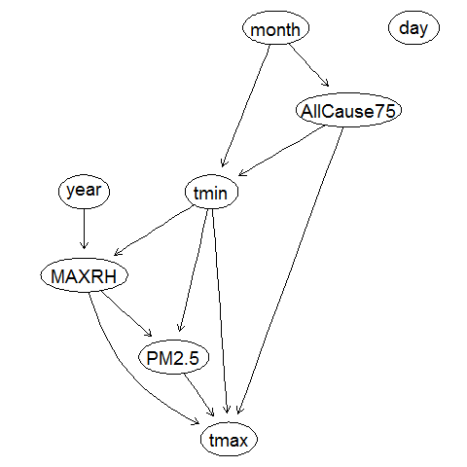
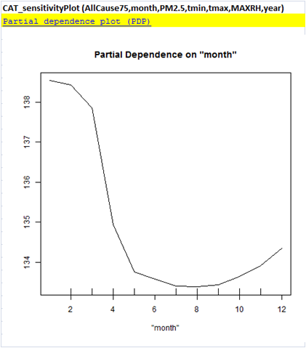
Basic ideas of Causal Analytics
Use a network to show which variables provide direct information about each other
  Arrows between variables show they are informative about each other, even given all other variables
  Learn network structure directly from data
  Carefully check conclusions
    In non-parametric analyses we trust!
    Do power analyses using simulation
  Interpret neighbors in network as potential direct causes (satisfying necessary condition)
Use sensitivity (partial dependence) graphs (based on averaging over many trees) to quantify relation between independent and dependent variables.

Slide 30
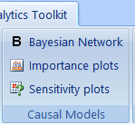
Run BN structure discovery algorithms
Click B Bayesian Network to generate DAG structure.
  Only variables connected to response variable by an arrow are identified as potential direct causes
  Multiple pathways between two variables reveal potential direct and indirect effects
  Example: Direct and indirect paths between tmax and AllCause75.

Slide 31
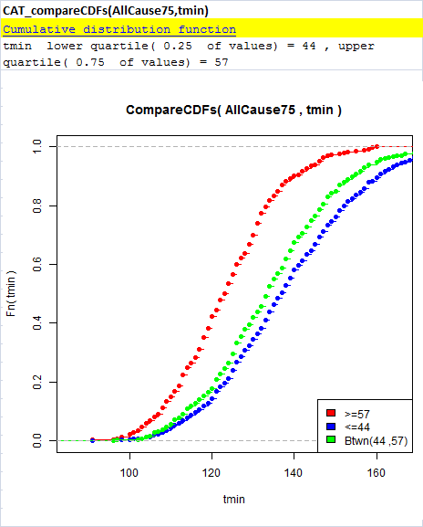
Confirm or refute/refine BN structure with additional non-parametric tests
Conditioning on very different values of a direct cause should cause the distribution of the response variable to change
If the response variable does not change, then any association between them may be due to indirect pathways (e.g., confounding)

Slide 32
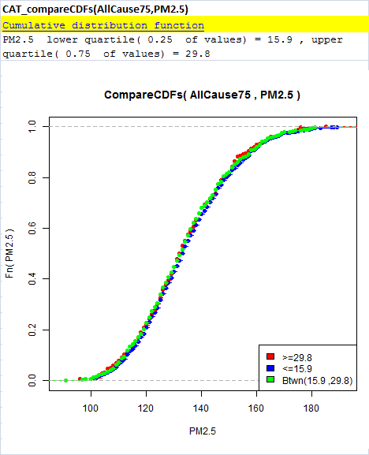
Confirm or refute/refine BN structure with additional non-parametric tests
Conditioning on very different values of a direct cause should cause the distribution of the response variable to change
If the response variable does not change, then any association between them may be due to indirect pathways (e.g., confounding)

Slide 33
Discovering DAG structure resolves ambiguous associations
How would cutting PM2.5 pollution in half affect future elderly mortalities per year?
  No way to determine from association data
Model 1: Income → PM2.5 → Mortality: mortality would be halved
Model 2: PM2.5 → Mortality ← Income: mortality would increase
Model 3: PM2.5 ← Income → Mortality: mortality would not change

Slide 34
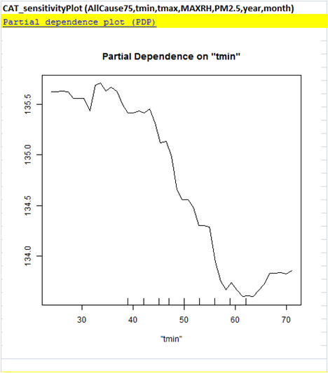
Quantify direct causal relations
Procedure: To quantify direct (potentially causal) relations after controlling for other variables and indirect pathways, estimate partial dependence graph for response R vs. (potential) cause C.
Rationale: Screening and BN structure discovery have shown that the relation might be causal. Partial dependence estimates size of potential effect.

Slide 35
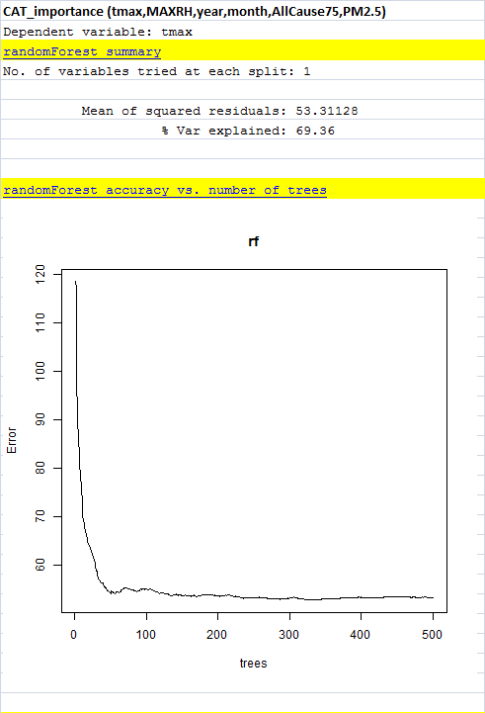
Validate quantified C-R relations in hold-out sample
Current CAT uses bootstrap and cross-validation approaches for Random Forest ensembles
Cross-validation and hold-out sample validation reports for regression and other analyses

Slide 36
Summary of CAT’s causal analytics
Screen for total, partial, and temporal associations and information relations
Learn BN network structure from data
Estimate quantitative dependence relations among neighboring variables
  Use partial dependence plots (Random Forest ensemble of non-parametric trees)
  Use trees to quantify multivariate dependencies on multiple neighbors simultaneously
Validate on hold-out samples

Slide 37
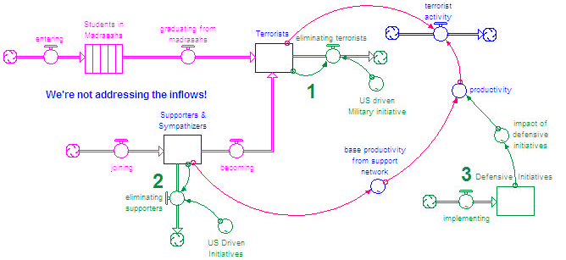
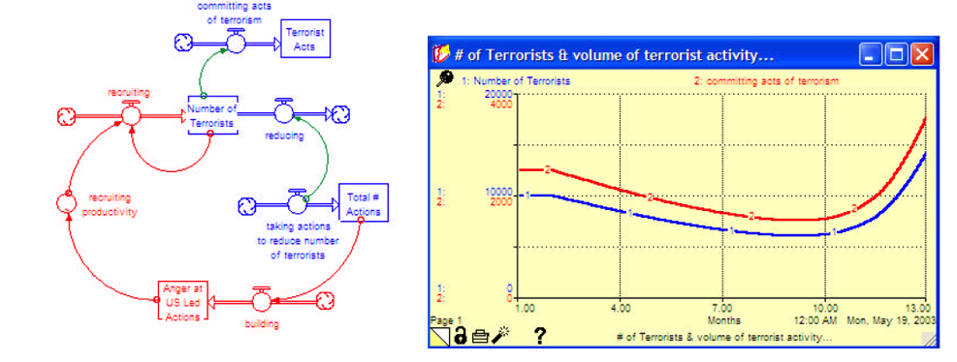
Systems dynamics simulations
http://www.systemdynamics.org/conferences/2003/proceed/PAPERS/417.pdf

Slide 38
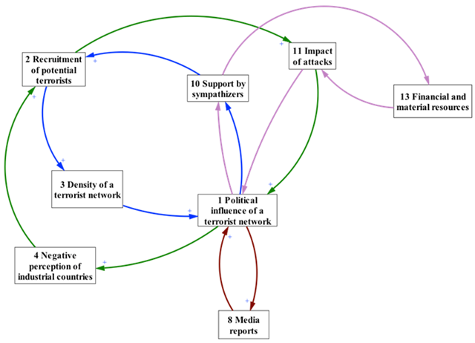
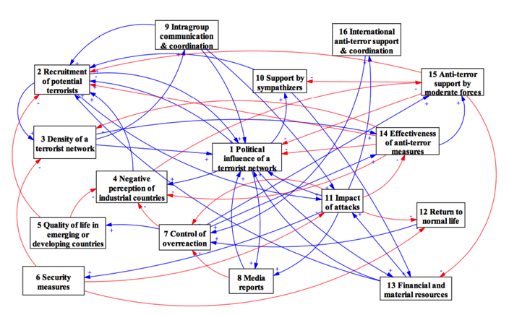
Systems dynamics model structure reveals key loops to break
https://wdsi.wordpress.com/2014/03/30/analysing-terrorism-from-a-systems-thinking-perspective/

Slide 39
Prescriptive analytics
What to do next?
  Uncertain models for predicting probable effects of different actions
  Value-of-information
  Exploration-exploitation trade-off
SMART trial design
  Sequential multiple assignment randomized trials

Slide 40
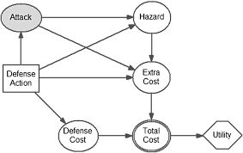
Optimize changes in controllable inputs, given Pr(c | x) and u(c)
https://wdsi.wordpress.com/2014/03/30/analysing-terrorism-from-a-systems-thinking-perspective/
http://www.tandfonline.com/doi/abs/10.1198/jasa.2009.0155?journalCode=uasa20

Slide 41
Algorithms for optimizing actions
Influence diagram algorithms
  Learning from data
  Validating causal mechanisms
  Using for inference and recommendations
Simulation-optimization
Robust optimization
Adaptive optimization/learning algorithms

Slide 42
Example: Influence diagram for policy decision support

Slide 43
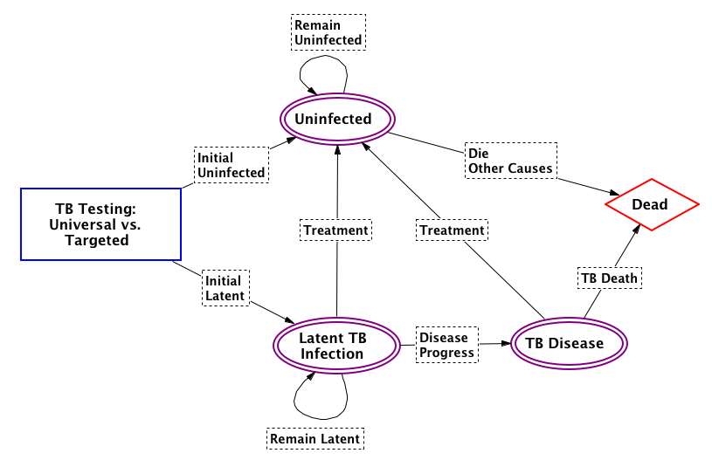
Simulation-optimization example
http://publichealth.lacounty.gov/pa/PA_Model_Simulation.htm

Slide 44
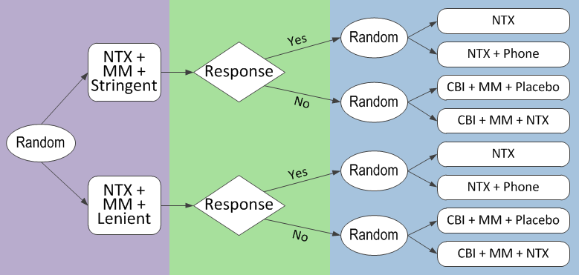
Sequential multiple assignment randomized trial (SMART) design
https://methodology.psu.edu/ra/adap-inter/example

Slide 45
Evaluation analytics:
How well are policies working?
Algorithms for evaluating effects of actions, events, conditions
  Intervention analysis/interrupted time series
    Key idea: Compare predicted outcomes with no action to observed outcomes with it
      Counterfactual causal analysis
      Google’s new CausalImpact algorithm
Quasi-experimental designs and analysis
  Refute non-causal explanations for data
  Compare to control groups to estimate effects

Slide 46
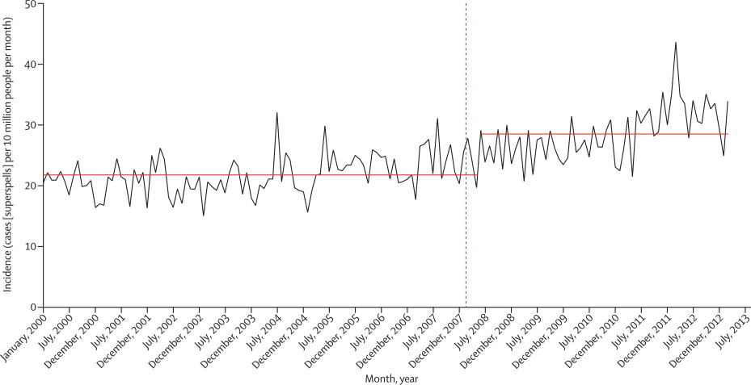
How did U.K. National Institute for Health and Clinical Excellence (NICE) recommendation of complete cessation of antibiotic prophylaxis for prevention of infective endocarditis in March, 2008 affect incidence of infective endocarditis?
www.thelancet.com/journals/lancet/article/PIIS0140-6736(14)62007-9/fulltext?rss=yes

Slide 47
Different models yield different conclusions.
So, how to deal with model uncertainty?
Solution: Model ensembles, Bayesian Model Averaging (BMA)
www.thelancet.com/journals/lancet/article/PIIS0140-6736(14)62007-9/fulltext?rss=yes

Slide 48
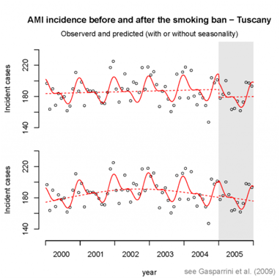
Nonlinear models complicate inference of intervention effects
Solution: Non-parametric models, gradient boosting

Slide 49
Algorithms for evaluating effects of combinations of factors
Classification trees
  Boosted trees, Random Forest, MARS
Bayesian Network algorithms
  Discovery
    Conditional independence tests
  Validation
  Inference and explanation
Response surface algorithms
  Adaptive learning, design of experiments

Slide 50
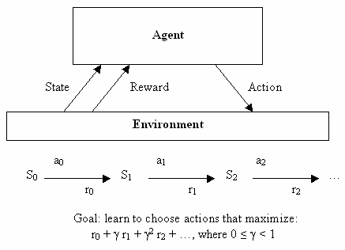
Learning analytics
Learn to predict better
  Create ensemble of models, algorithms
    Use multiple machine learning algorithms
      Logistic regression, Random Forest, SVM, ANN, deep learning, gradient boosting, KNN, lasso, etc.
  “Stack” models (hybridize multiple predictions)
    Cross-validation assesses model performance
      Meta-learner combines performance-weighted predictors to produce an improved predictor
    Theoretical guarantees, practical successes (Kaggle competitions)
Learn to decide better
  Low-regret learning of decision rules
    Theoretical guarantees (MDPs)
    practical performance
http://www2.hawaii.edu/~chenx/ics699rl/grid/rl.html

Slide 51
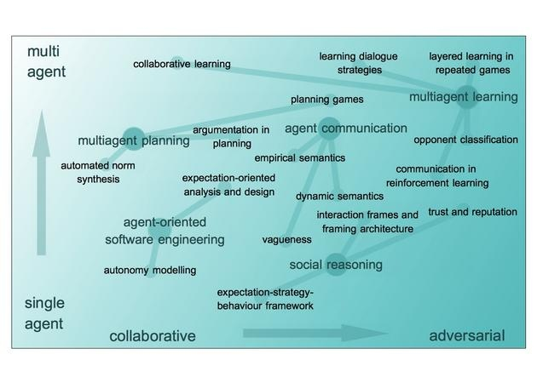
Collaborative risk analytics: Multiple interacting learning agents
http://groups.inf.ed.ac.uk/agents/index.php/Main/Projects

Slide 52

Collaborative risk analytics
Global performance metrics
Local information, control, tasks, priorities, rewards
  Hierarchical distributed control
  Collaborative sensing, filtering, deliberation, and decision-control networks of agents
    Mixed human and machine agents
    Autonomous agents vs. intelligent assistants
http://www.cities.io/news/page/3/

Slide 53
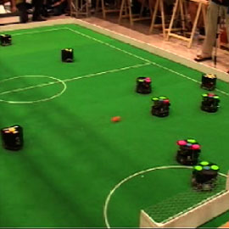
Collaborative risk analytics: Games as labs for distributed AI
Challenges: local information, control, tasks, priorities
  Hierarchical distributed control
  Collaborative sensing, deliberation, control networks
Decentralized agents can form effective risk analytics teams and HCI support
  Trust, reputation, performance
  Sharing information, attention, control, evaluation, learning
http://people.idsia.ch/~juergen/learningrobots.html

Slide 54
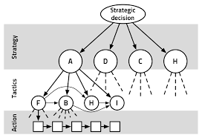

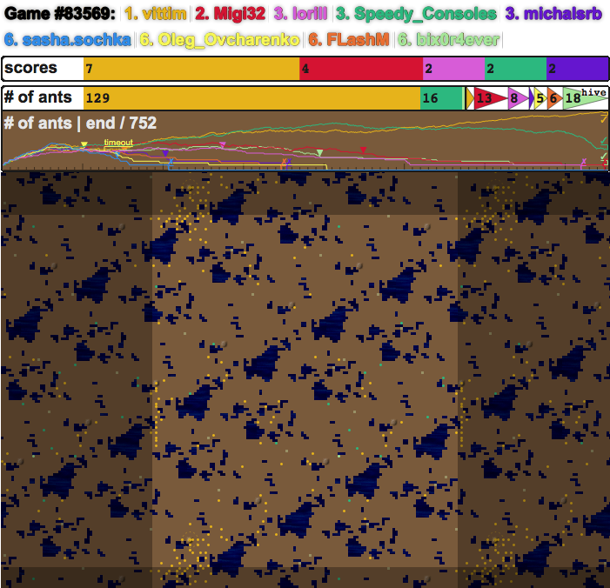

Future: Competing teams learning to optimize and coordinate attack and defense in real time
http://emotion.inrialpes.fr/people/synnaeve/phdthesis/phdthesis.html
http://www.masterbaboon.com/tag/ai/
http://www.michael-elbert.com/portfolio.html

Slide 55
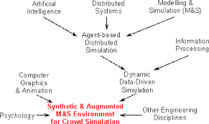

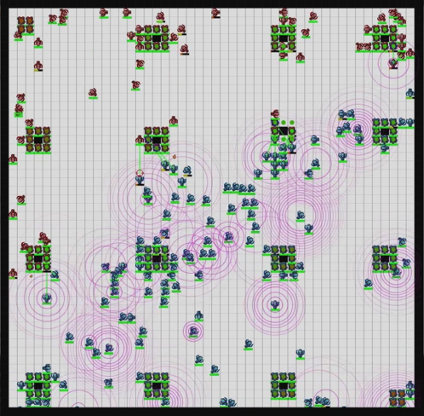
Near future: Distributed AI support for battle teams on increasing spatial scales
http://www3.ntu.edu.sg/home/aswtcai/projects.htm
http://www.ultimategeneral.com/
http://www.nowwithvitaminr.com/files/uploads/2011/05/daibattlecode.jpg

Slide 56


Vision: Teams adaptively optimizing attack and defense… supported by real-time risk analytics
www.splashdamage.com/blog/1158/brand-new-execution-game-mode-test-weekend#.Vh1EGvldV8E
https://en.wikipedia.org/wiki/Close_quarters_combat

Slide 57
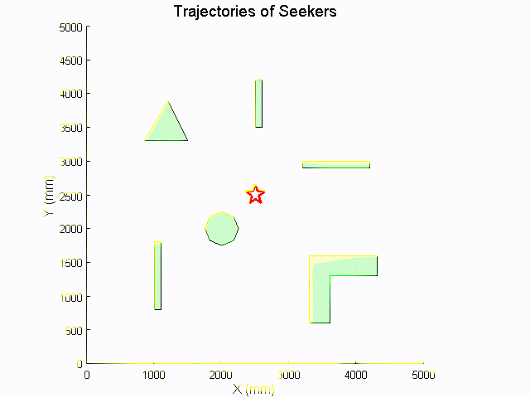

Future: Trust autonomous agents for key tasks, such as sensing and responding to changes, seeking targets
http://www.gamasutra.com/view/feature/2484/using_particle_swarm_optimization_.php?print=1
https://www.reddit.com/r/starcitizen/comments/34excc/looking_at_missile_mechanics_and_locking/
http://www.web.me.iastate.edu/sbhattac/group/pso.htm

Slide 58
Risk analytics toolkit: Summary
Descriptive analytics
  Change-point analysis, likelihood ratio CPA
  Machine learning , response surfaces ML (LR, RF, GBM, SVM, ANN, KNN, etc.)
Predictive analytics
  Bayesian networks, dynamic BN BN, DBN
  Bayesian model averaging BMA, ML
Causal analytics & principles
  Causal BNs, systems dynamics (SD) DAGs, SD simulation
  Time series causation
Prescriptive analytics: IDs, simulation-optimization, robust
Evaluation analytics: QE, credit assignment, attribution
Learning analytics
  Machine learning, superlearning ML
  Low-regret learning of decision rules Collaborative learning

Slide 59
Applied risk analytics toolkit: Summary
Reorientation: From solving well-posed problems to
discovering how to act more effectively
Descriptive analytics: What is?
Predictive analytics: What will be?
Causal analytics: What could be? How to cause it?
Prescriptive analytics: What to do next?
Evaluation analytics: How well is it working/did it work? What was the effect?
Learning analytics: How to do better?
Collaboration: How to do better together?

Slide 60
Thanks!
Questions?

